Slide 1
Some Like it Hot! Some Like It Cold! Four Billion Years of Climate Change on Planet Earth: The Cook’s Tour
Jonathan Ariel Forest Byrne
Earth and Space Science
Rising Sun Consulting, AMS
Climate Advisor: Cape Cod Baywatch

Slide 2
Some like it hot! Some like it cold!
Hot house periods: Higher levels of greenhouse gases e.g. CO₂
Glacial Maxima: Low CO₂ ; Orbital + Sub Orbital forcing

Slide 3
New Paradigms
Interrelationships between earth systems:
Chaos theory: Attractors, bifurcation (tipping) points, cascades,
Multiple states of equilibrium
Feedback loops
Slow: vegetation, SST. CO₂
Fast: Clouds, water vapor

Slide 4
Stops along the “Cook’s Tour”
Forcings responsible for climate change: Internal, External
Archean Eon:
Proterozoic Eon
Phanerozoic Eon
Expanded tour:
Cenozoic era
Pleistocene
Holocene
Anthropocene.

Slide 5
The Big Picture
External Forcing:
Cosmic rays
Interstellar dust
Earth – sun geometry
( Milankovith cycles)
Bolloid impacts
Internal forcing: Paleocycles
Plate tectonics
Orogenesis /volcanism
Ocean composition
+ circulation
Biosphere ( C0₂ excursion /down draw cycles
Solar Variability
Albedo patterns

Slide 6
Forcing Overview
Feedbacks ( g)
S = ΔT (1- Σg)
g= climate sensitivity
When the value for g is large the climate is more sensitive
Energy balance and radiative forcing
F. = F_{sw} ⬇ ( 1 – α.) - σT⁴ + F_{LW}

Slide 7
Interstellar gas / dust
Possible Impacts:
Solar dimming
= cooler regime
Solar ignition = warmer regime.

Slide 8
Cosmic Rays
Decreased solar magnetic field =
Increased atmospheric bombardment of cosmic rays =
Increased production of condensation nuclei via ionization =
Increased cloud cover =
Increased albedo =
cooler regime

Slide 9
Milankovitch Theory: Orbital induced climate forcing: Variations in earth / sun geometry = variations in solar insolation = 3 oscillations

Slide 10
Solar Variability:
Solar constant =
1365 w/m²
Sunspot cycle: 11 yrs
Increase = increase solar output = warmer regimes
Decrease = decrease solar output = cooler regimes ( “Little Ice Age” 13th – 19th century)

Slide 11
Bolloid Impacts
Injection of dust particles, ash, and aerosols = increased albedo = decrease in global mean temperature
Example: KT Extinction 65 ma / bp ( Cretaceous / Tertiary boundary

Slide 12
Plate tectonics: Volcanism
Injection of greenhouse gases e.g. CO₂ + CH₄ = warmer regime ( Deep historic 100 – >1000 x present levels?)
Injection of ash, aerosols = increase atmospheric albedo = cooler regime
Vegetation = C0₂ Draw down

Slide 13
Four Major Volcanic Events 19th – 20th century

Slide 14
Ocean Currents
Global circulation and distribution of temperature.
Tectonic changes result in shifts / redistribution of temperature
Coupled with atmospheric circulation e.g. Atlantic / Pacific gyres
Sensitive to changes in thermohaline fluctuations

Slide 15
Archean Eon: 4 ba ( billion annum before present)
Dim Sun Hypothesis
Solar output = 30% less than present
Greenhouse gas saturation overcompensates
CO = 380.000 ppm(?)
Mean global surface temp = 140 f ( ?)

Slide 16
Proterozoic Eon 850 ma bp – 650 ma bp
Formation of Rodinia
Oscillations: Global glacial / hot house regimes
i.e. Snowball (Slushball?) Earth:
Complete ( partial) global glaciation

Slide 17
Snowball Earth
Top:
Ice thickness 0 – 5,000 m
Center:
Temperature -110 – 10c
Bottom:
Precipitation 0 – 10,000 mm

Slide 18
Snowball Earth Hypothesis 716 ma bp – 630 ma bp

Slide 19
Phanerozoic Era Temp / CO₂
Graph ( Geocarb III) reflects additional climate forcings:
Milankovitch Cycles
Solar variability (-4%) during Cambrian = higher threshold for glaciation (e.g 3000 ppm)
Increase vegetation = Increase CO₂ down draw

Slide 20
Paleozoic Era 543 ma bp = 245 ma bp

Slide 21
Paleozoic Era
Oscillations between warm ( dry) and cold ( glacial regimes)
Two significant extinction events e.g. Permian.
Carboniferous 398 ma bp – 298 MA BP ( significant biomass – contemporary significant petroleum resources)

Slide 22
Cambrian 543-490 ma BP: Warm
Break up of Rodinia
Allows free circulation of Artic waters =
Ice free earth =
Elevated C0₂ ( 10,000 ppm)
Warm regime

Slide 23
Ordovician Period 490 ma bp – 443 ma bp Warm - Cold
445 ma bp: Significant Glacial Event
Forcings:
Orbital ( Shift in earth sun geometery via Milankovith cycle.
Plate tectonics:
Gondwana shift
toward the southern
latitudes = increased
albedo = rapid global
heat loss

Slide 24
Silurian Period 443 ma bp – 417 ma bp
Greenhouse gas forcing = long, warm, stable regime.
Gondwana continues to shift toward the equator.
Glaciers nearly vanish

Slide 25
Devonian Period 417 ma bp – 354 ma bp
Shifting of Gondwana toward equator =
Warmer, drier, more stable regime
End of mass exinctions ( bolloid impacts?)

Slide 26
Mesozoic Era 245 ma bp - 65 ma bp

Slide 27
Mesozoic Era
Warmest era of the Phanerzoic Eon
SST 33c – 42c
C0 max 6500 ppm
Equator – Pole ΔT 19c -23c
OAEs ( Ocean Anoxic
Events)
Major extinction event
K/T boundary ( Bolloid
impact)

Slide 28
Cenozoic Era: Temperature extremes for all!
Palo-Eocene Thermal Maximum 55 - 53 ma bp
Pleistocene Glacial Maxima ( 4)
1.8 ma – 10,000 ka bp

Slide 29
Cenozoic Era
65 ma: Rapid warm up after K/T extinction event.
Forcing: Increase GHG
54 ma: PETM ( Paleo –Eocene Thermal Maximum) ΔT +8c – +10c
Forcing: Methane hydrate due to increased tectonic activity
38 ma: Olig Cenozoic decline commences = ice caps
13 ma:

Slide 30
Pleistocene Epoch 2.58 ma – 11.7 ka
4 significant glacial excursions.
Mean surface temp -5 - -10 colder than present levels.
Forcings: Orbital coupled with internal ( 3 MA Formation of the Isthmus of Panama = shift in N. Atlantic MOD.)

Slide 31
Laurentide - Fenno Scandian Ice Sheet 80,000 – 18,000 ka. The Cooling power of ice: t + kR² = hR
T = -6 Ice Edge / 0c Permafrost
Ice thickness 1.5 x 10³m – 3 x 10³m
Area = 13 x 10⁷ km

Slide 32
NA Weather Pattern Baroclinic zone along terminus = “glacial feeder”
L L L L

Slide 33
So where was “global warming” when you needed it?
Have a little heat ICE MAN!
You’re about 18,000 years too late dude! Just a little INCONVENIENT!

Slide 34
Younger Drayas Oscillation
Fresh water forcing = shut down of the N. Atlantic MOD
Cooling -5c - -10c arund the N. Atantic Basin

Slide 35
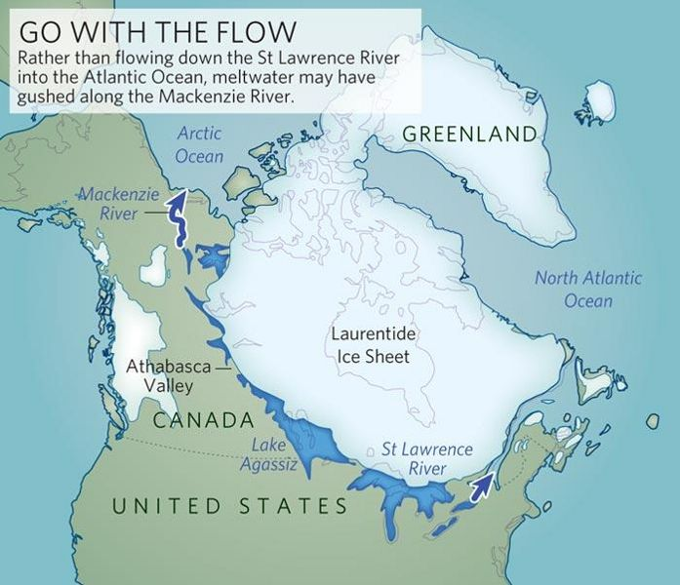
The Younger Drayas Oscillation Orbital Induced ( Precession) warming
Fresh water forcing = shut down of the N. Atlantic MOD
Cooling -5c - -10c around the the N. Atlantic Basin

Slide 36
Hysteresis: N. A. Thermohaline Circulation

Slide 37
Global Mean Temperature

Slide 38
Late Holocene Epoch

Slide 39
Little Ice Age 1350 – 1850 A.D.
External Forcing:
Sunspot Activity: Maunder, Dalton and Sporer minima
Internal
Decrease in NAMOC
Increase in volcanism
Decrease in human population ( agriculture) = increase CO₂ Draw Down

Slide 40
Late Holocene Climate Oscillations
Little Ice Age 1400 – 1700
Maunder Sunspot Minima
Medieval Warm Period 950 – 1250 Prolonged La Nina?

Slide 41
LIA Solar Cycles

Slide 42
The Anthropocene 1850 - Present
“Human induced forcing” within the climate system / biosphere
ΔT / ΔCO₂ 1880 - 2005

Slide 43
Summary
Climate change:
Stochastic interaction
of forcings as a function of time:
External ( orbital)
Earth – sun geometry
Cosmic rays
Interstellar gas /dust
Internal ( sub-orbital)
Biosphere - lithosphere
hydrosphere
= oscillations between warm and cold regimes

Slide 44
Some Like It Hot! Some Like It Cold! Coming to a theater near you!

Slide 45
Bibliography
Broecker, Wally The Great Ocean Conveyer 2010 Princeton University Press
National Research Council Abrupt Climate Change 2002
Brooks C. E. P. Climate Through The Ages
1949 Dover Books
*Svensmark, Henrik The Chilling Stars: A New Theory of Climate Change 2007 Icon Books ltd
Fagan, Brian The Little Ice Age Basic Books

Slide 46
Bibliography
Cornell, Sara Understanding the Earth System 2012 Cambridge University Press
Cronin, Thomas M Paleoclimates 2010 Comumbia University Press

