Slide 1
How Businesses "Weather the Storm”
Southern New England Weather Conference
Presented by:
Kenneth Otis, CBCP, MBCI
October 25, 2014

Slide 2
Agenda
Weather and it’s impacts
How does a business prepare
Risk assessment
Mitigation
Contingency planning
Managing crisis events
Takeaways

Slide 3
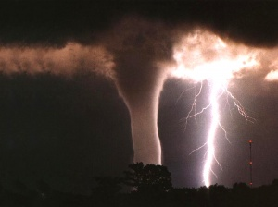
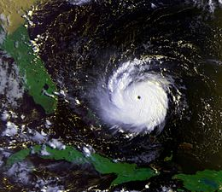
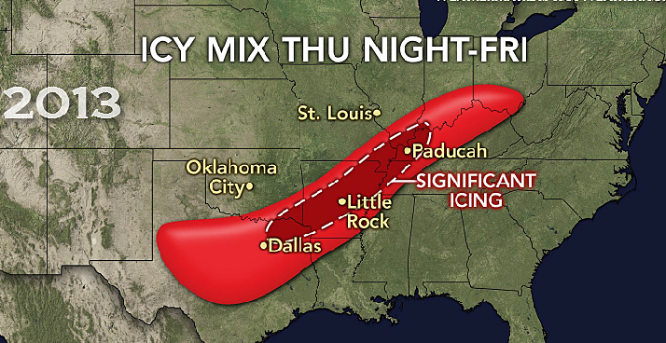
Weather Extremes and its Impacts
Loss of life
Loss of homes/businesses
Loss of communication
Loss of inventory
Loss of revenue
Displaced staff unable to report
Loss of market share
Loss of 3rd Party vendors
Supply chain interruptions
Missed SLAs
Eroded public image
Infrastructure damages:
electric, gas, roadways, broadband, cell towers

Slide 4
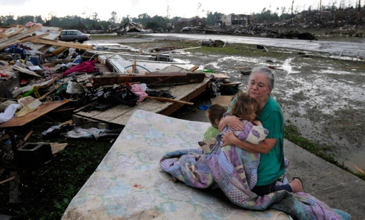
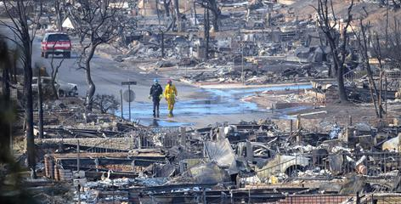
So How Does A Business Prepare?
Know your Risks & Mitigate what you can!!
Identifying your Risks, will help you Mitigate or minimize business disruptions
You can’t Mitigate all Risks, so prepare contingencies
4
Notes:
4

Slide 5
Risk Assessment & Mitigation
Assess the Risks:
Natural (Floods, Tropical Weather, Wildfires, Winter Weather)
Man-made (Sabotage, HazMat, Workplace Violence)
Technology (IT Network, Power Failure, IT Virus)
Mitigate the Risks:
Strategies:
Risk Acceptance: Does not reduce any effects, however it is still considered a strategy option. Usually preferred option when the cost of other risk management options outweigh the cost of the risk itself.
Example: It may cost $220K to mitigate a risk for a function with revenues of only $180K
Risk Avoidance: Risk avoidance is the opposite of risk acceptance. It is the action that avoids any exposure to the risk whatsoever.
Example: Company decides not to manufacture a new product
Risk Transference: Risk transference involves passing the risk off to a 3rd party.
Example: Outsource certain operations; obtaining insurance coverage
Risk Limitation: Risk limitation is the most common strategy, limiting the exposure by taking some mitigating actions. Combines risk acceptance, risk avoidance and/or risk transfer.
Example: Company decides to build 2nd location for it’s manufacturing lines along gulf coast; buys insurance for business interruptions
Notes:
5

Slide 6
What You Can’t Mitigate, Plan Contingencies
Step 1:
Initiate
Business
Continuity
Program
Step 2:
Conduct
Business
Impact
Analysis
Step 3:
Develop
Recovery
Strategies
Step 4:
Document
Business
Continuity
Plan
Step 5:
Test
Business
Continuity
Plan
Step 6:
Update
Business
Continuity
Plan
The Business Continuity Planning Lifecycle has 6 steps, guiding coordinators through their planning efforts
The methodology follows industry best practices as described by ISO 22301, NFPA 1600, DRII, & BCI
Business Continuity is not a one-time project; it is an ongoing program that will mature over time
Notes:
6

Slide 7
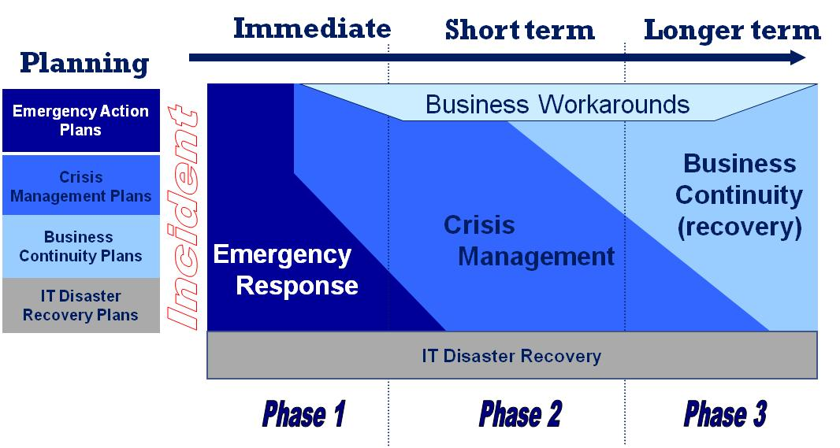
How Will You Manage A Crisis?
3 Phased Approach
7
Notes:
7

Slide 8
BCP Phase 1: Emergency Response (Minutes to Hours)
Objectives
Contain the incident
Minimize:
injury (life safety)
property damage
overall event impact
Coordinate with responding public agencies
Communicate with other departments and site leadership
Elements
Formal ER Plan & Team(s)
Tested evacuation & response plans
Communications plan
Adequate emergency supplies
Coordinated on-site activities and interaction with responding public agencies
Escalation assessment
Training, training, training
Notes:
8

Slide 9
BCP Phase 2: Crisis Management (Hours - Days)
Objectives
Provide Leadership/Guidance
Assess the damage:
Department, Line, Site level
Division or Corporate impact
Set recovery priorities
Allocate resources, i.e., staff, equipment, & services
Effective communications
Restart Operations as quickly as possible
Elements
Crisis Management Leadership Team
Critical business processes identified
Notification procedures
Team meeting space
Subject Matter (Process) Teams
Team Roles and Responsibilities
Resources (Vendors, records, critical equipment, etc.)
Training
Notes:
9

Slide 10
BCP Phase 3: Business Continuity/ Recovery (Days - Months)
Objectives
Continue critical operations
Align all recovery activities
Ensure recovery plans stay on track
Coordinate key services
Maintain communications with employees, customers, Corp Offices
Restore operations to pre-incident levels as efficiently as possible
Elements
Department Business Continuity Teams & Plans
Business workarounds for critical business processes
Clear assignments / responsibilities by process
Critical process resources identified
Communications plan
Training
Notes:
10

Slide 11
Managing an Enterprise During Times of Crisis
Working Philosophy of Crisis Management
Most incidents are Local in nature
Tend to be isolated impacts
Able to be managed at the local level
Limited corporate crisis team oversight
Few incidents have Regional impacts
Tend to impact multiple functions & office locations
Require corporate crisis team interaction
Varying impacts to markets & corporate departments
Require greater collaboration between the varying offices & the multiple local crisis teams
Tend to involve executive management oversight

Slide 12
Managing an Enterprise: Recent Events
Crises differ in scope, magnitude, and duration
Real events under my watch:
California Earthquake (2014)
Marathon Bombing (2013)
Blizzard Nemo (2013)
Hurricane Sandy (2012)
Hurricane Irene (2011)
NH Ice Storm (2008)
CA wildfires (annually)
Civil Unrest: G8, G20 summits, Occupy Movement (annually)
600+ Person office – IAQ issue (2013)
Shooting outside an office (2011)
Office fires (2009 & 2013)
Boston power outages (2008 & 2012)
Domestic / Workplace violence (2009, 2011, 2012)
Boston water main break (2010)
Earthquakes Chile (2010) & Japan (2011)
Must be ready to respond in a moments notice

Slide 13
Crisis Management Framework
Executive Leadership Team
Corporate
Corporate Crisis Management Team
Business Unit
Crisis Teams
Business Unit
Crisis Teams
Business
Unit
Local Crisis
Management Teams
Function
BCP Teams
Function
BCP Teams
Site
Function
Function
Function
Function
Function
Department
13

Slide 14
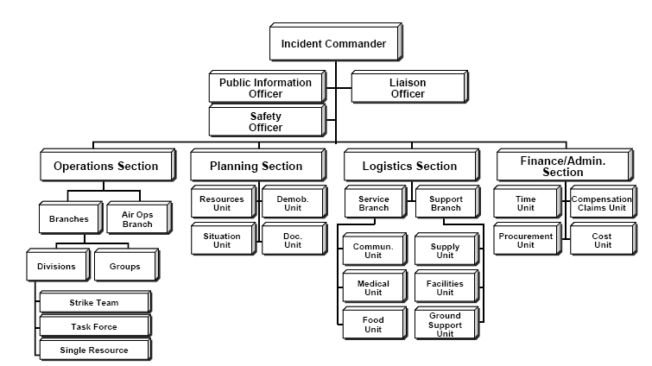
Traditional Incident Command System (ICS) Structure

Slide 15
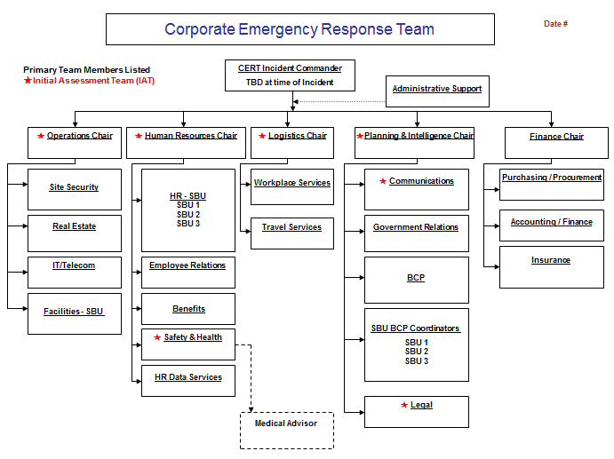
Modified ISC Structure

Slide 16
Takeaways
Take any action now, before it’s too late
Get senior management engaged
Conduct risk assessment
Mitigate risks through one of the proposed strategies
Complete Business Impact Analysis (BIA)
Use BIA to build Business Continuity Plans (BCP)
Integrate the BCP with Crisis Management (CM)
Set up a CM structure that works for your organization
Communicate at all levels during a crisis
Capture Lessons Learned following every event
Ken’s 6 week rule: You’ll have ~ 6 weeks to implement changes if you want them to stick!
Notes:
President Bertolino

Slide 17
Questions
Kenneth Otis, CBCP, MBCI Director, Business Continuity Management Cell: 774-300-7893
Kenneth.Otis@CVSCaremark.com

