Slide 1
Two Frigid 2014 Snow Storms – A Look at Snow to Liquid Ratios
Kevin Cadima
2014 Southern New England Weather Conference

Slide 2
Overview
2 storms last January
Not classic blockbusters
Both storms occurred during anomalously cold surface temps
Snow to liquid ratios (SLR) did not behave according to commonly used empirical techniques
Discuss why
Focus on microphysics and mid level temp anomalies

Slide 3
What happened?
January 2-3 Storm
Temps in the teens falling into single numbers to near zero
6 to 10” with Snow to Liquid Ratios (SLR) 10-15:1
Localized 2 ft amounts with SLR up 35:1
January 21-22 Storm
Temps in the teens
6-12” with locally up to 18”
SLR 20-30+:1

Slide 4
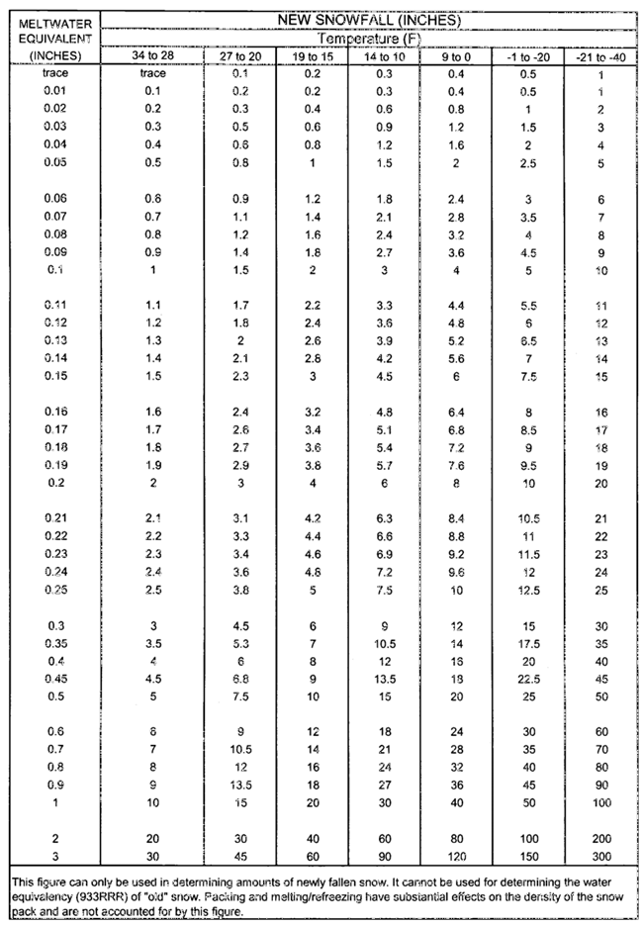
Snowfall to Estimated Meltwater Conversion Table
From NWS Observing Handbook
(based solely on surface temp)
Temp SLR
34-28° 10:1
27-20° 15:1
19-15° 20:1
14-10° 30:1
9-0° 40:1

Slide 5
Factors which modulate Snow Density
In cloud processes that affect shape/size of ice crystals ➔ microphysics
Dendrites best for high SLR
Sub cloud processes
Warm layers, dry layers
Modify ice crystals as they fall
Ground level compaction
What happens to the snow when it reaches the ground

Slide 6
Ice Crystal Growth Occurs in 3 ways
Accretion
Ice crystals collide with supercooled water droplets and freeze on contact
Aggregation
Merging of ice crystals
Deposition
Process where water vapor deposits on ice in liquid form and freezes immediately

Slide 7
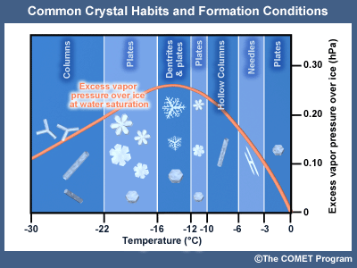
Deposition
Dominant Ice Crystal Growth Process
Ice crystal growth from deposition maximizes at temps around -15C
Dendritic Growth Zone (DGZ) ➔ -12 to -18C
This is where dendrites are preferred crystal type
Higher SLR due to extra space between each crystal
Notes:
Difference in saturation vapor pressure over water and ice as a function of temp

Slide 8
Omega vs DGZ
Dendrites are favored where vertical motion (omega) maximums intersect the DGZ (-12 to -18C)
Can be as warm as -8 to -10C in SNE (near coastal regions) due to warmer ice nuclei activation temps of salt water
High SLR
If max omega is below the DGZ
Warmer environment ➔ more supercooled water
Could be indicative of shallow lift
Low SLR
If max omega is above the DGZ
Snowflakes dominated by columns and plates
Fine consistency to snow
Low SLR

Slide 9
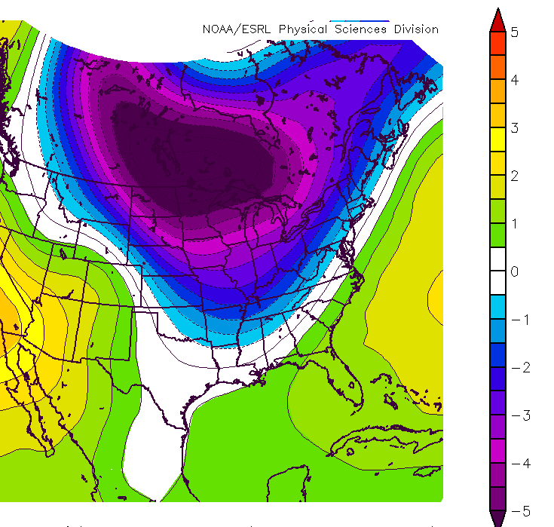
Roebber, Shultz et al. (2002)
SLR is determined by the vertical temperature profile
Vertical temp profile colder (warmer) than normal ➔ higher (lower) than average SLR
Focus on 700 mb temp anomalies or where ice crystal growth is occurring
Notes:
30 year average SLR is associated with the average vertical temperature profile

Slide 10
January 2-3 Storm
Radar and Surface Temps
Time Sections and Temp Anomalies

Slide 11
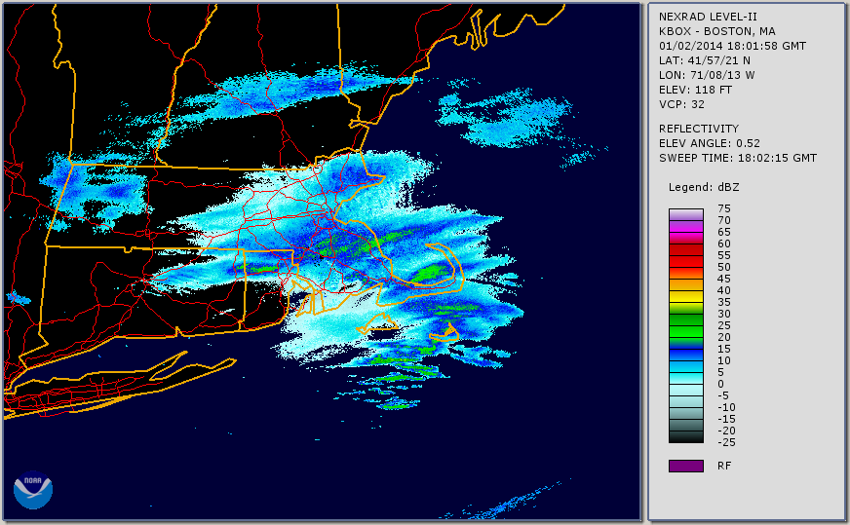
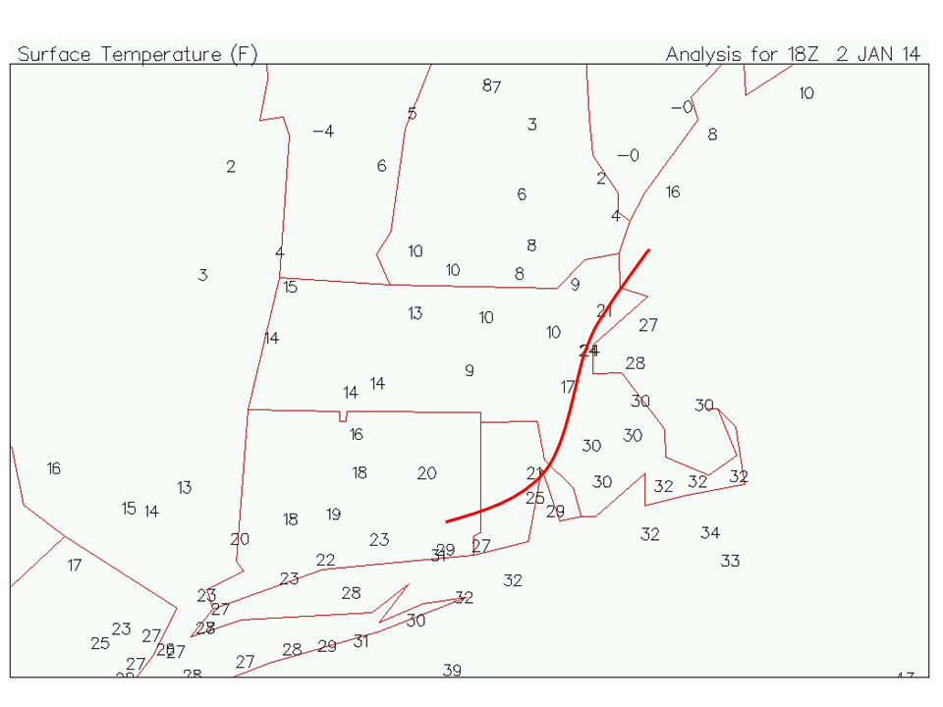
1800 UTC, 2014 January 2

Slide 12
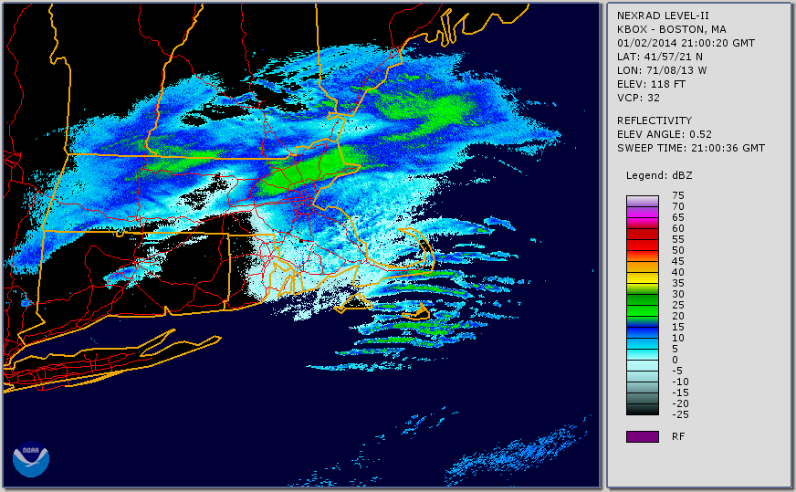
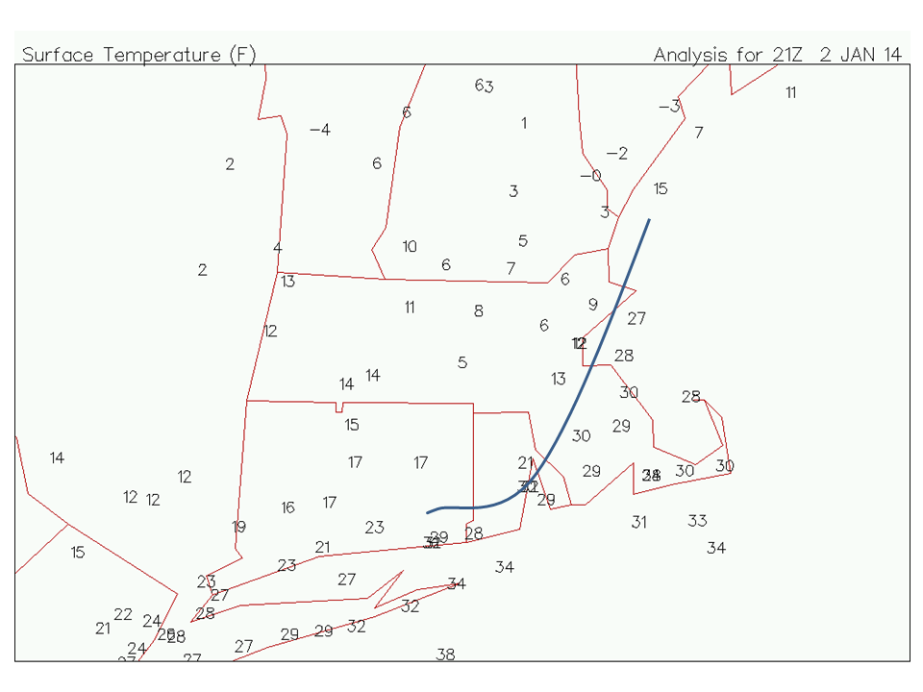
2100 UTC, 2014 January 2
Mesoscale banding signature
Enhanced snowfall rates
Higher SLR?

Slide 13
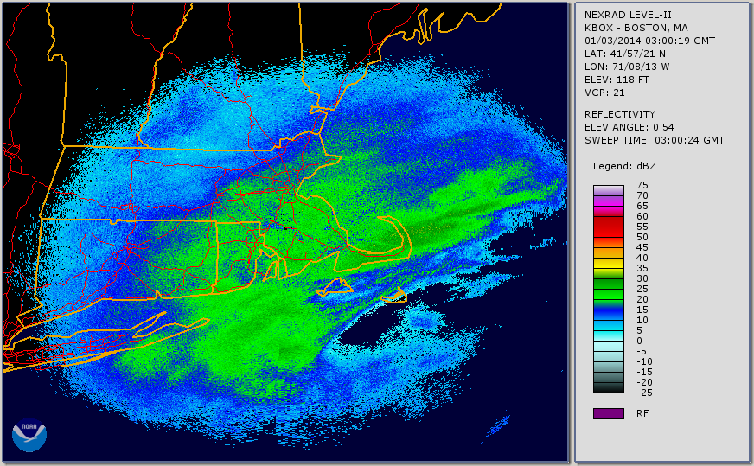
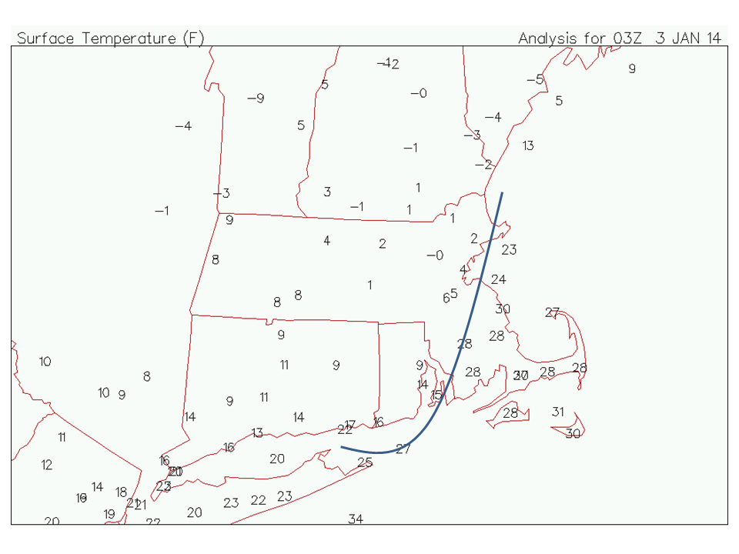
0300 UTC, 2014 January 3

Slide 14
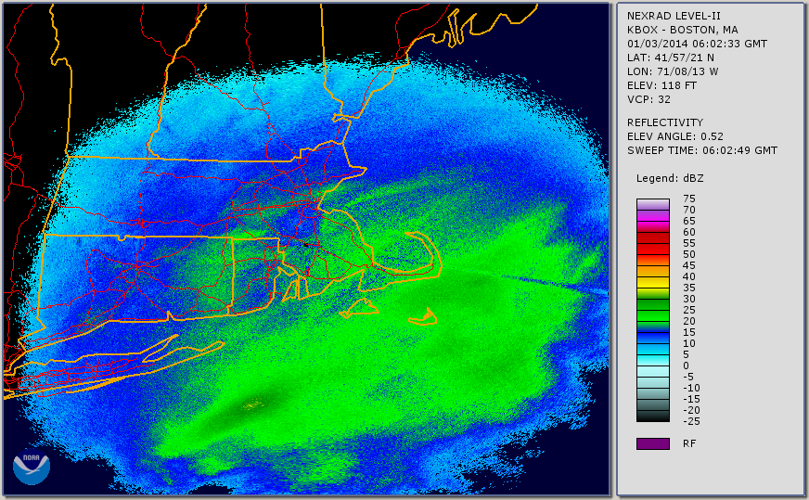
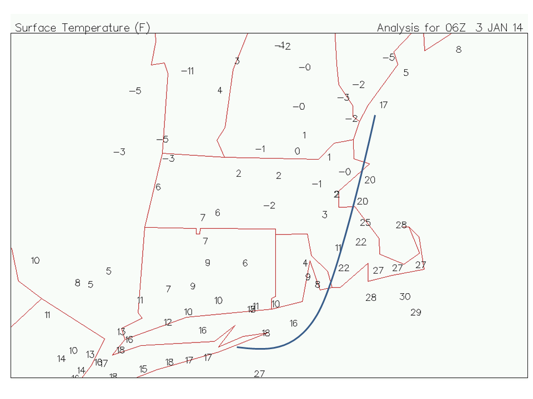
0600 UTC, 2014 January 3

Slide 15
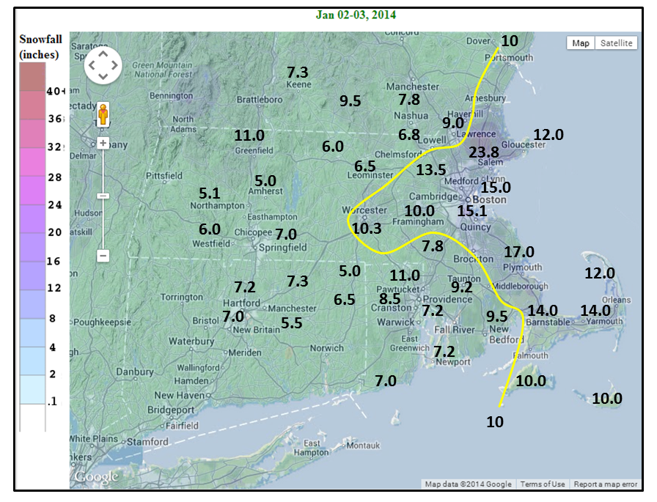
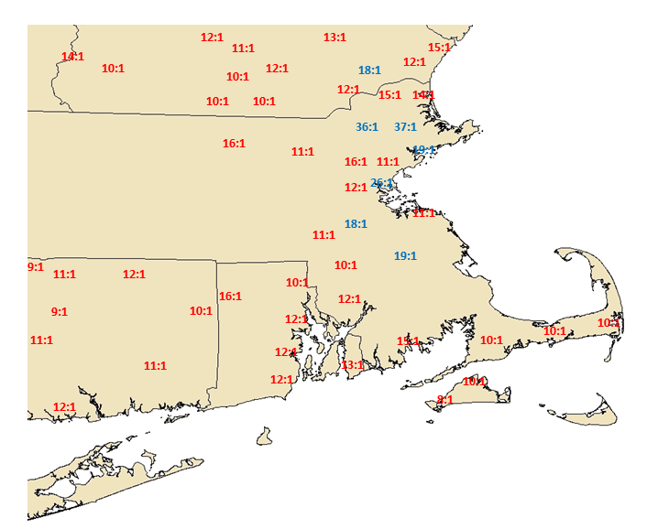
Snow Accumulation and Snow Liquid Ratio
January 2-3
Snowfall Accumulation
Snow: Liquid Ratio

Slide 16
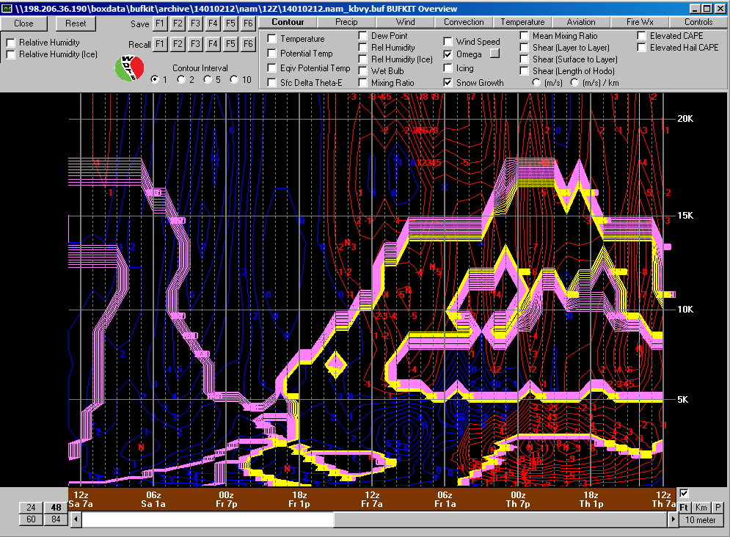
BVY Snow Growth/Omega Jan 2-3 Storm
Snow Growth Region
Modest omega in snow growth region at 10-15K ft
Note secondary snow growth region below 5K ft with stronger omega intersecting
Profile favors high SLR

Slide 17
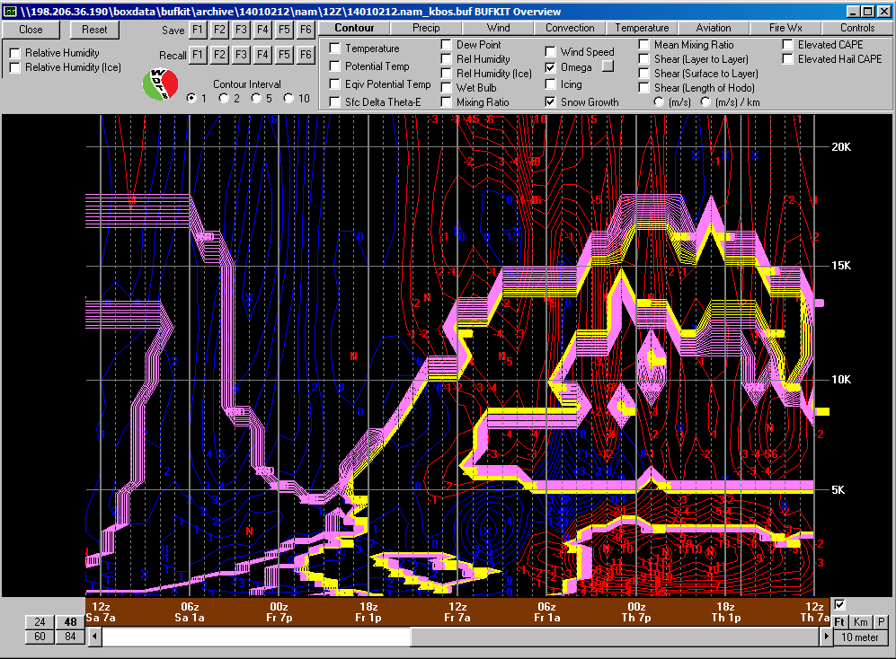
BOS Snow Growth/Omega Jan 2-3 Storm
Snow Growth Region
Strong omega below 5K ft near or just below DGZ (temps -8 to -10C)
Strong low level omega associated with ocean enhancement processes played a significant role in high SLR near the NE MA coast
Warmer IN activation temps
(-8 to -10C) near the coast place
max omega within DGZ

Slide 18
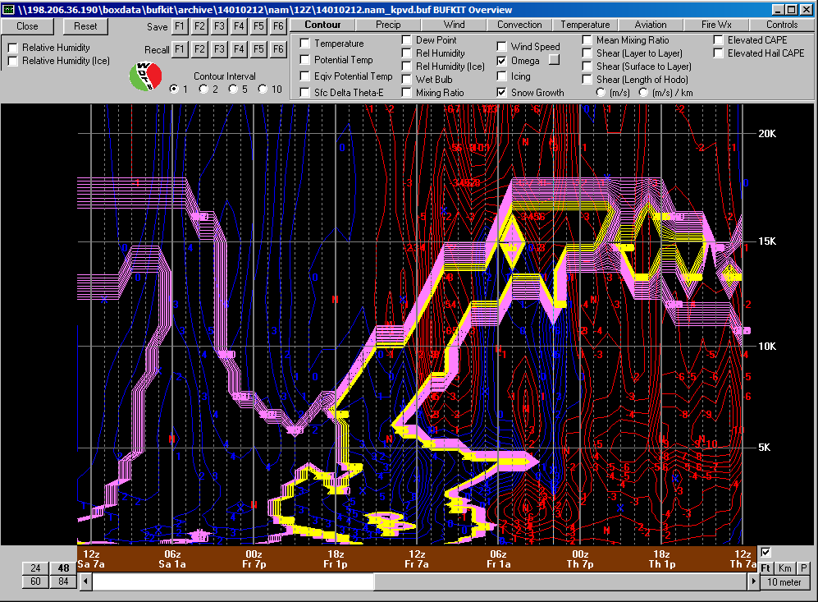
PVD Snow Growth/Omega Jan 2-3 Storm
Snow Growth Region
Generally weak omega all below favorable DGZ
Lower SLR despite cold surface temps

Slide 19
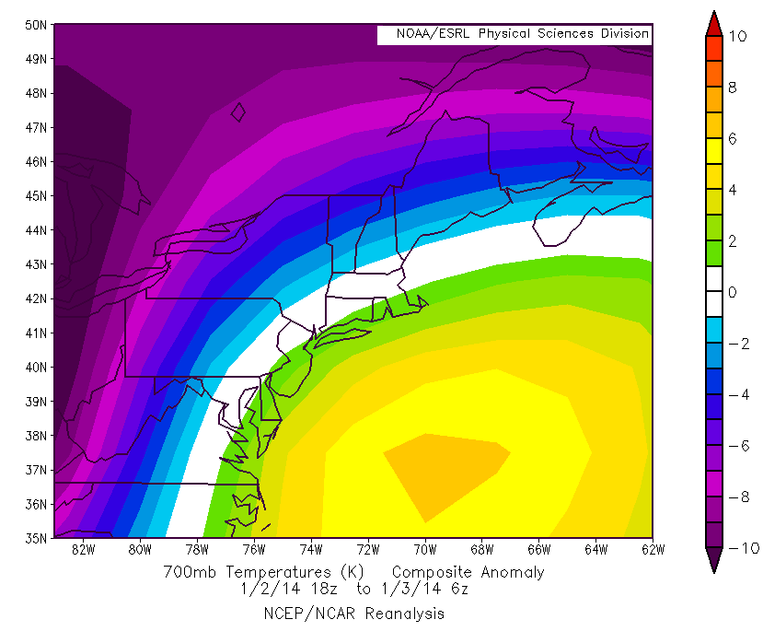
Jan 2-3 700 mb Temp Anomalies
700 mb temp
anomalies near or slightly above normal suggesting SLR close to climatology

Slide 20
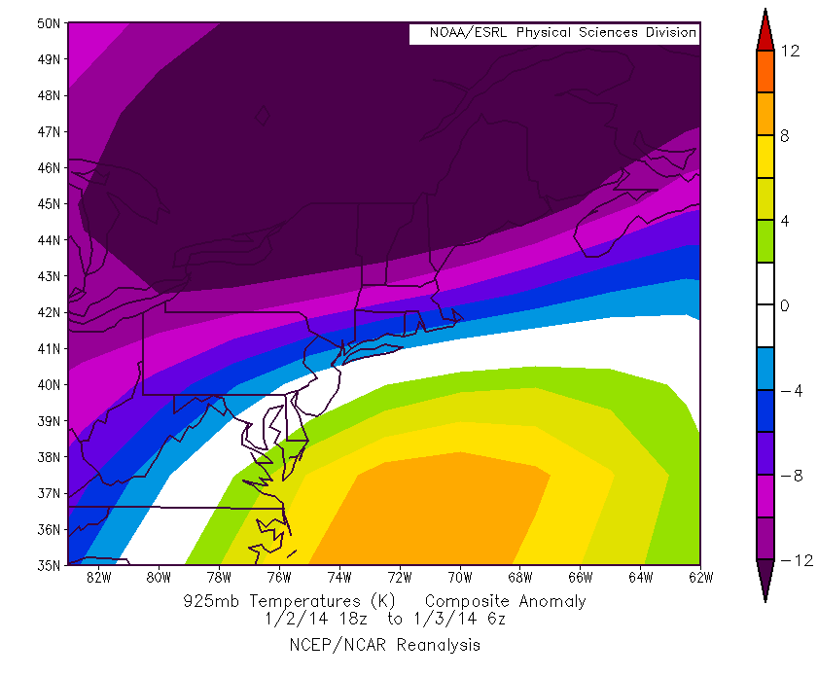
Jan 2-3 925 mb Temp Anomalies
Main ice crystal growth
region below 5000 ft.
925 mb temp
anomalies as much as 8C below normal across NE MA
This combined with excellent snow growth
suggest SLR much higher than climatology

Slide 21
January 21-22 Storm
Radar and Surface Temps
Time Sections and Temp Anomalies

Slide 22
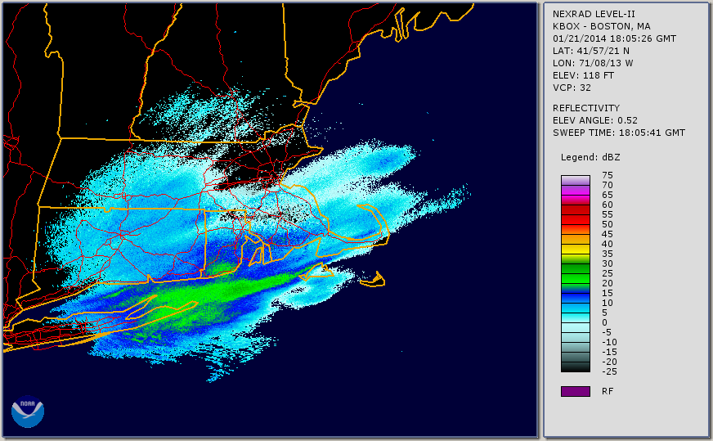
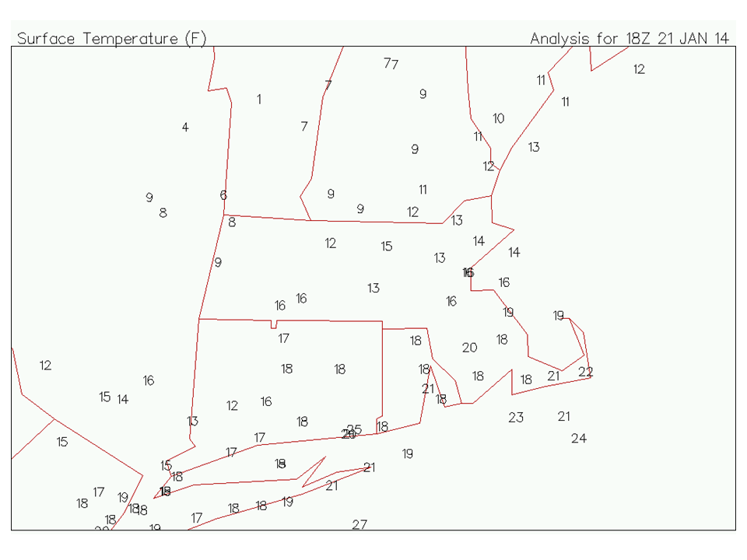
1800 UTC, 2014 January 21

Slide 23
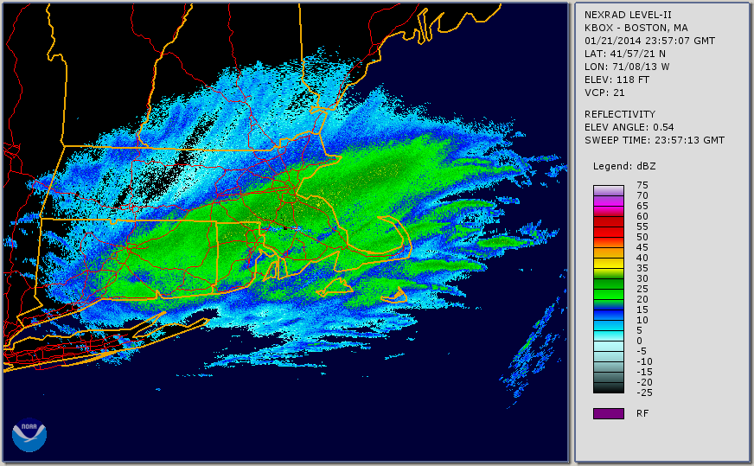
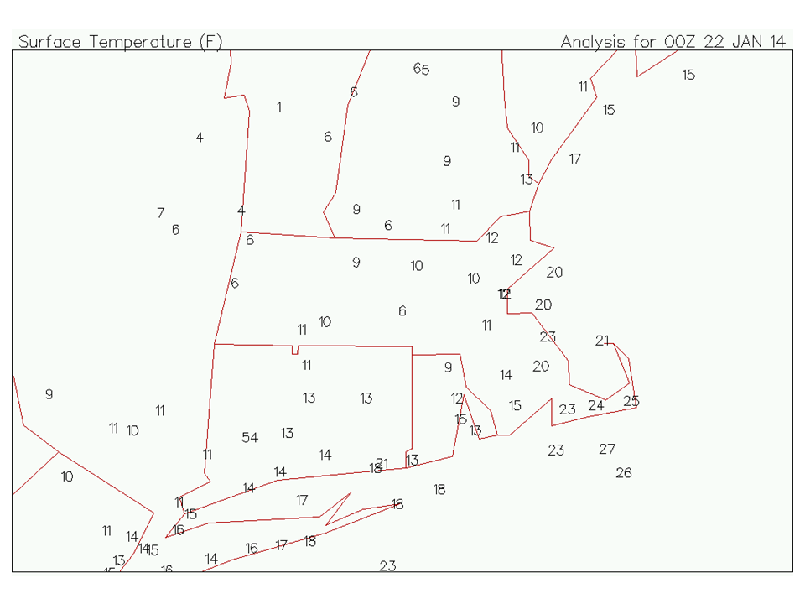
0000 UTC, 2014 January 21

Slide 24
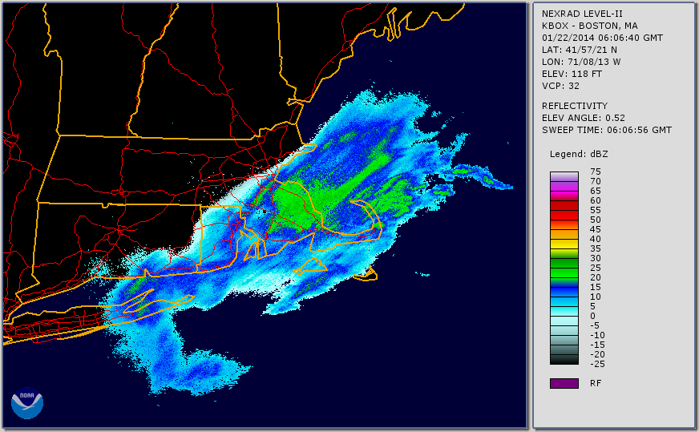
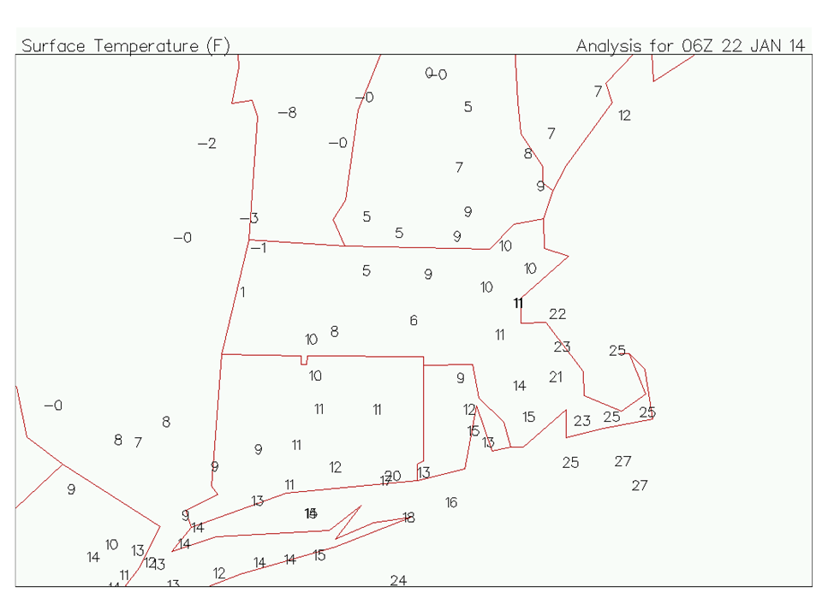
0600 UTC, 2014 January 21

Slide 25
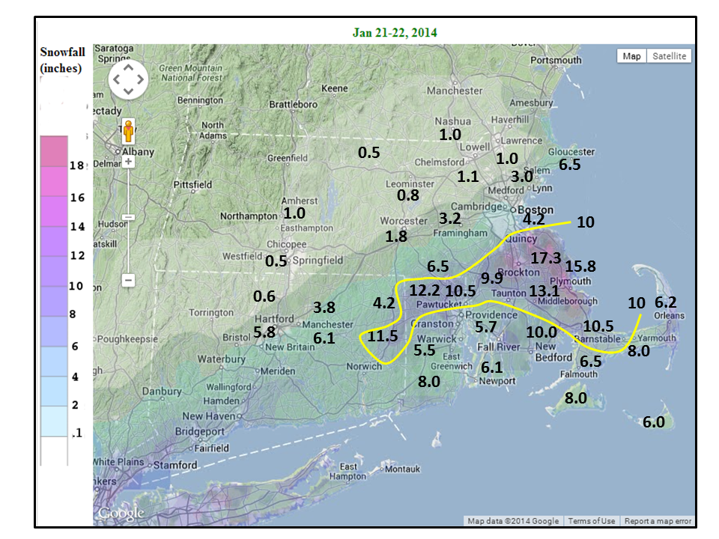
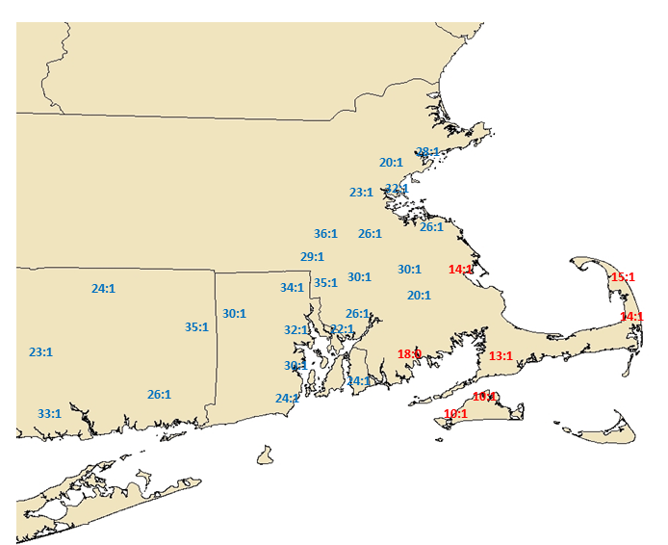
Snow Accumulation and Snow Liquid Ratio
January 21-22
Snowfall Accumulation
Snowfall Accum
Snow: Liquid Ratio

Slide 26
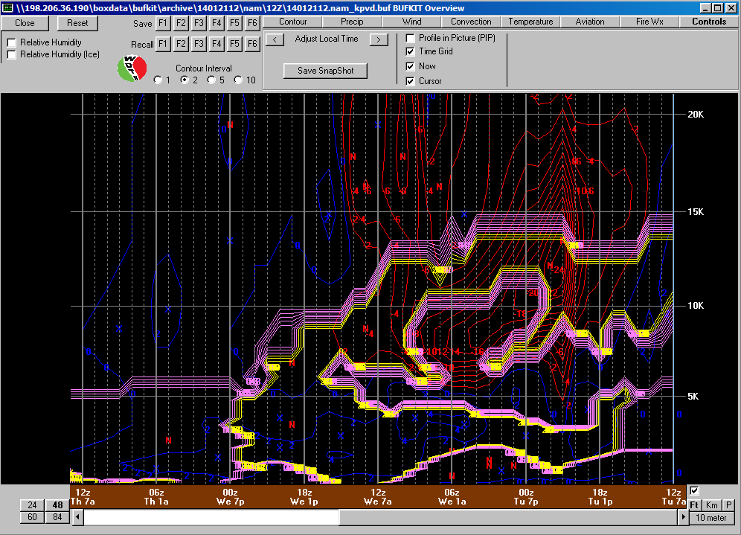
PVD Snow Growth/Omega Jan 21-22 Storm
Snow Growth Region
Strong omega in snow growth region at 10-15K
Omega appears to descend below DGZ after 00z (temps -10C) but warmer IN activation temps near the coast suggest omega well within DGZ
Profile favors high SLR

Slide 27
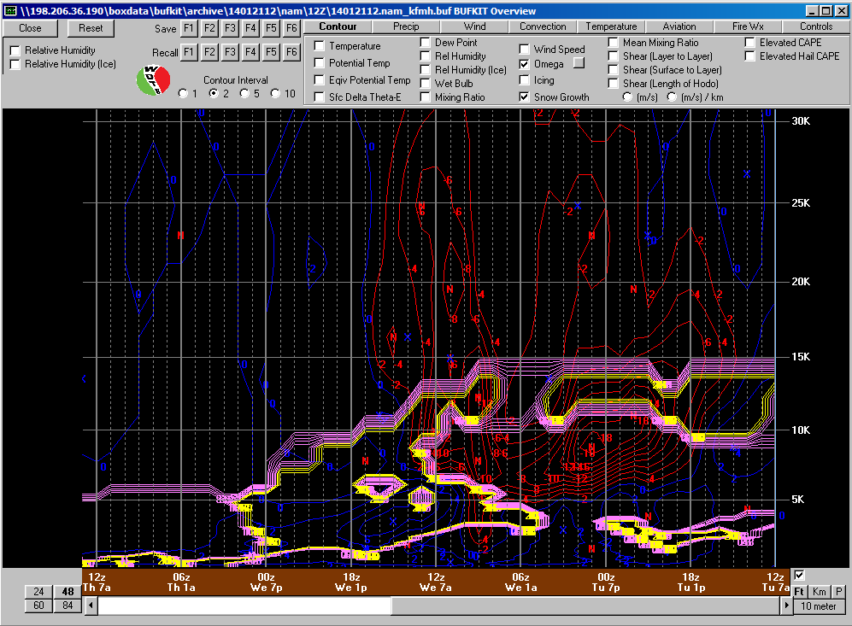
FMH Snow Growth/Omega Jan 21-22 Storm
Snow Growth Region
Strongest omega is mostly below the favorable DGZ
Temps -6 to -8C where best omega favoring lower SLR

Slide 28
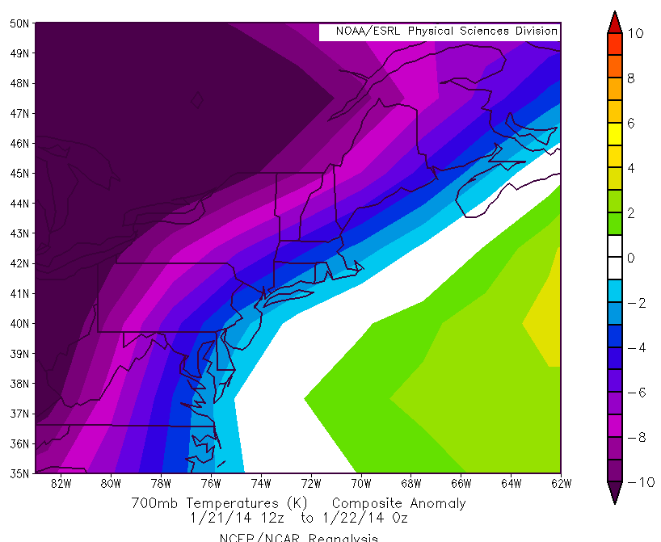
Jan 21-22 700 mb Temp Anomalies
700 mb anomalies are
several degrees below normal
Negative temp anomalies combined
with excellent snow growth favors
SLR well above climatology

Slide 29
Summary
Two winter storms with anomalously cold surface temps produced a wide range of snow liquid ratios
10:1 vs 35:1 SLR for the Jan 2-3 storm with surface temps in the single numbers
20-30+:1 SLR for the Jan 21-22 storm with surface temps in the teens
Move away from strictly using surface temps to derive SLR
Look at microphysics and where ice crystal growth is occurring
Focus on omega in the snow growth region
Can be as warm as -8 to -10C near the coast due to higher IN activation temps
Look at temp anomalies where ice crystal growth is maximized

Slide 30
Questions??

