Slide 1
Fenways Weather Team

Slide 2
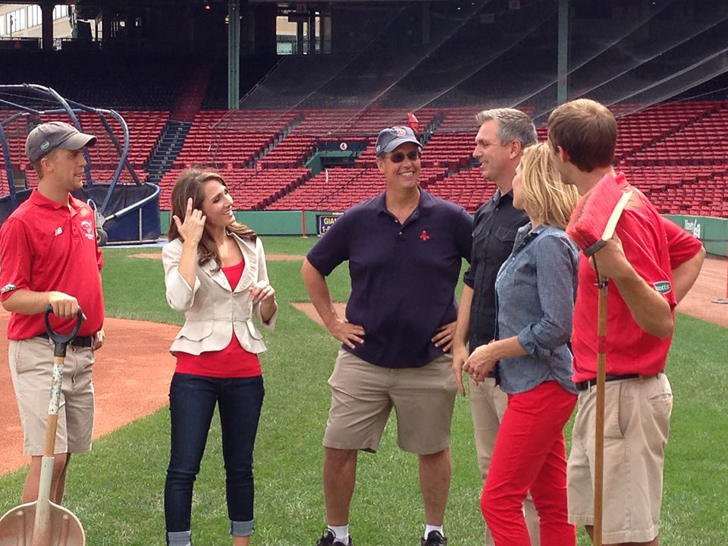
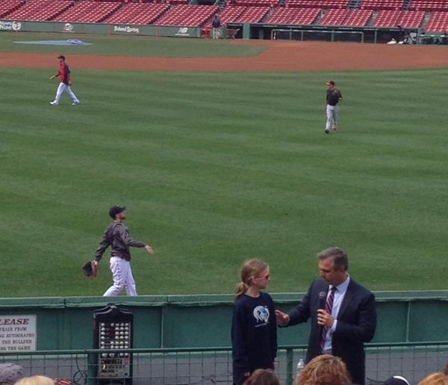
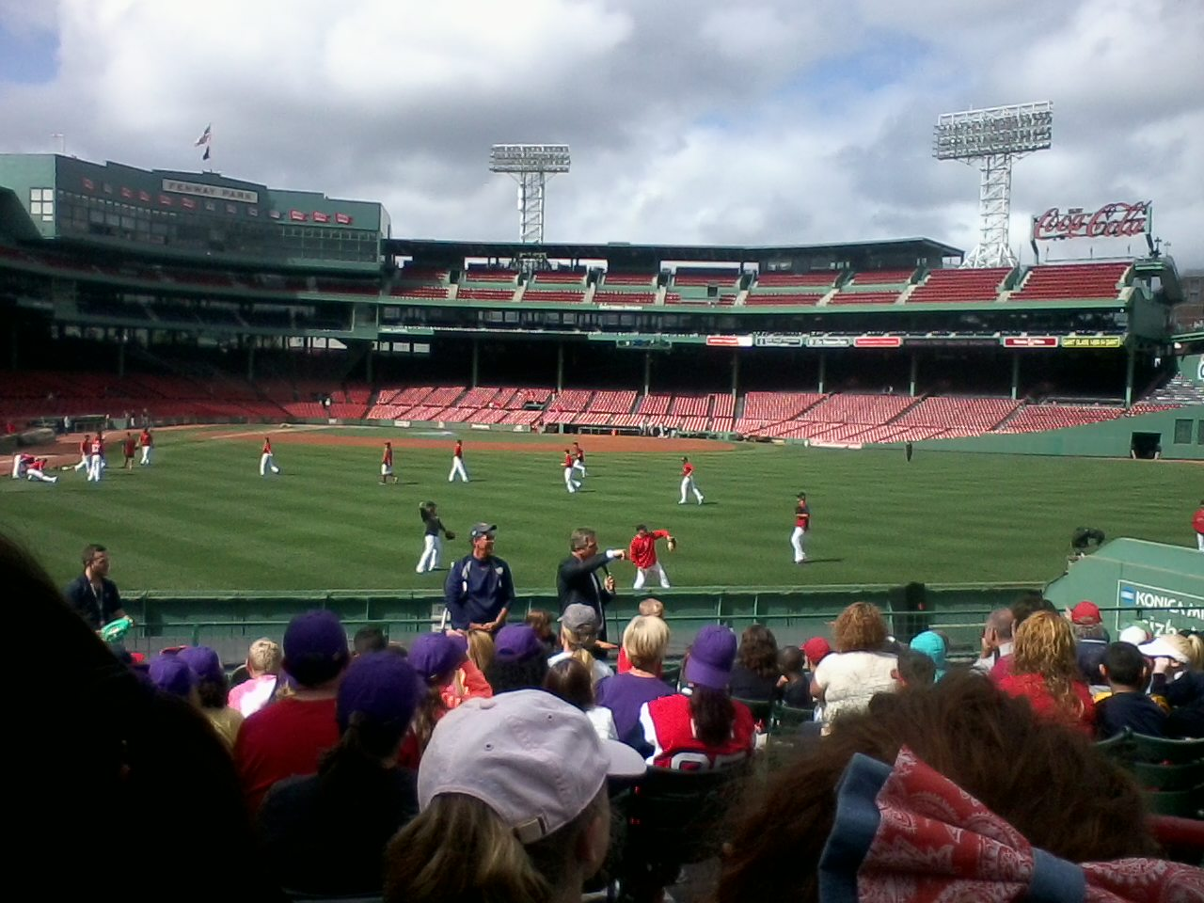

Slide 3
Provide Daily Forecast (Multiple Times a Day…) -Temperature -Dewpoint -Wind -Sky Cover -Precipitation % -Precipitation Amount (to the hundreths!) -Thunderstorm Threat

Slide 4
GAME DAY: Daily Forecast Plus… -Weather Conditions for Start to Finish of Game/Event -Update NESN and REDSOX through Calls/Texts/Emails
IF RAIN IS IN THE FORECAST:
-Start Time of Precipitation -Amount of Precipitation that will fall
-Rate of Rain (Light/Heavy)
-Finish Time of Precipitation
-Chance of Lightning
-How long break between pop up showers/storms

Slide 5
Can Be a Challenge as Some Storms Come Close…

Slide 6
But Just Miss…

Slide 7
And Others Hit! Too CLOSE!
During Rain Delay: Red Sox Ground Crew and Umpires Depend on our forecast To Ensure a Safe Environment at Fenway Park

Slide 8
It’s Not Just Baseball…

Slide 9
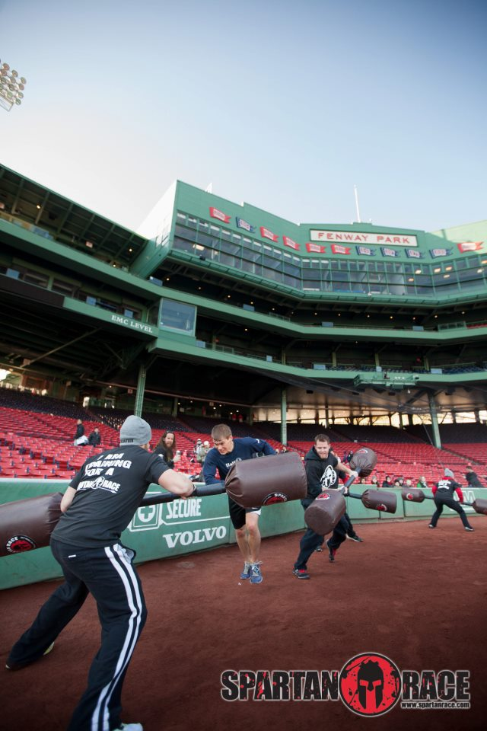
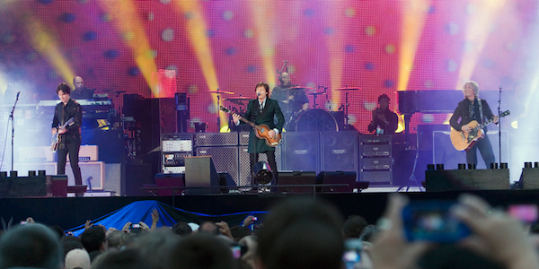
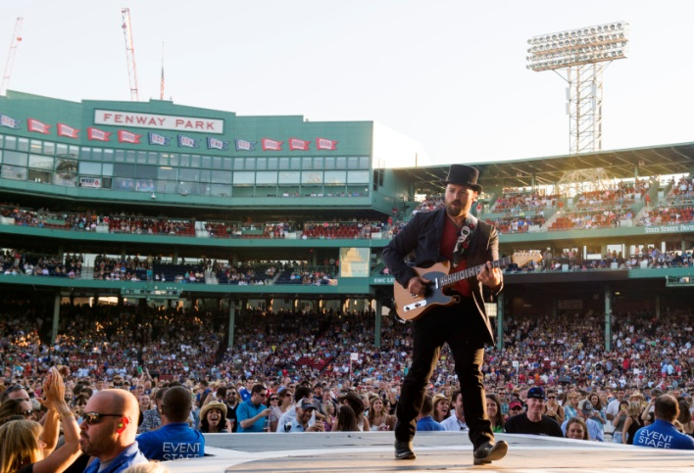
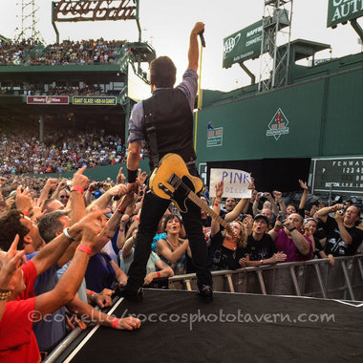
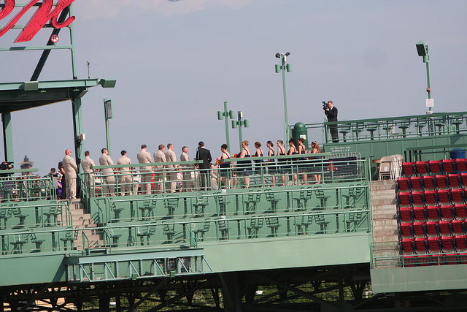
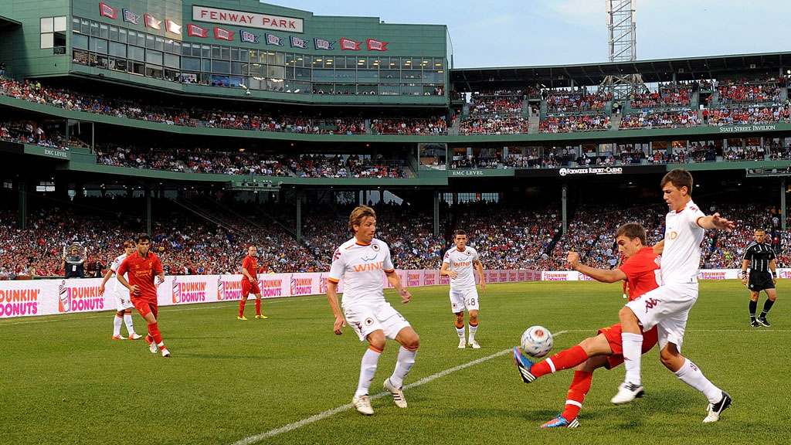
Events at Fenway are Year Round!

Slide 10
Fenway Park Events Are Year Round…

Slide 11
Frozen Fenway 2014 Not so Frozen…

Slide 14
Frozen Fenway 2014 Not so Frozen…

Slide 15
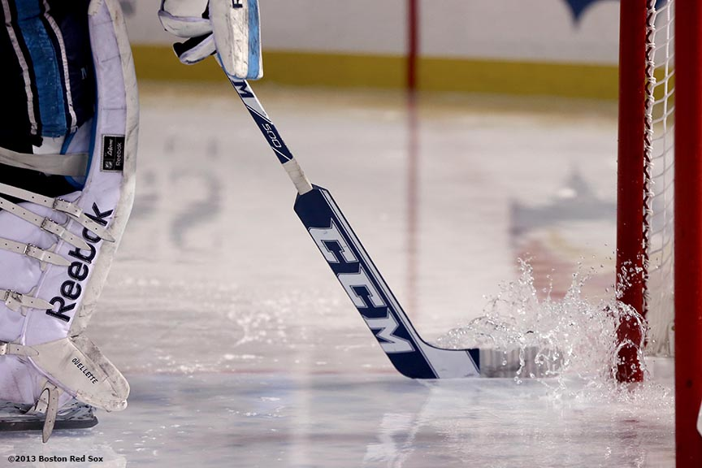
Frozen Fenway 2014 Not so Frozen…
http://www.youtube.com/watch?v=1dJ-Nbp2Jdw

Slide 16
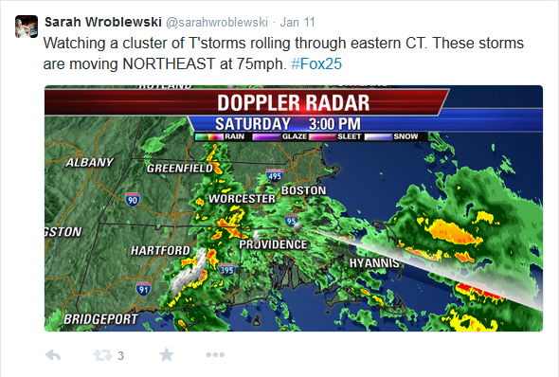

Slide 17
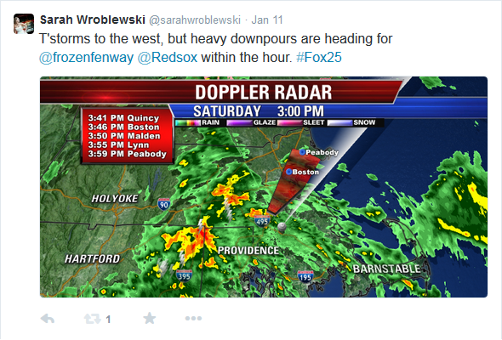

Slide 18
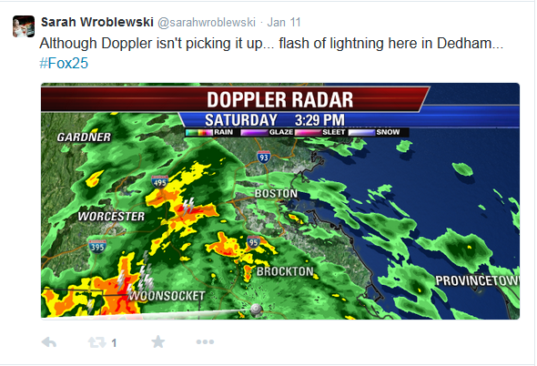

Slide 19
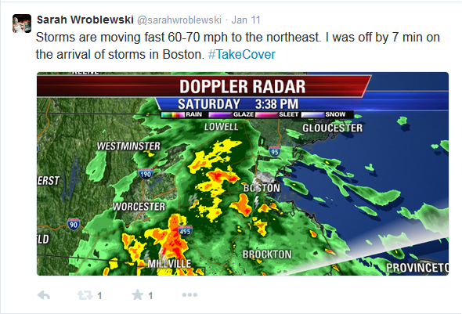

Slide 20
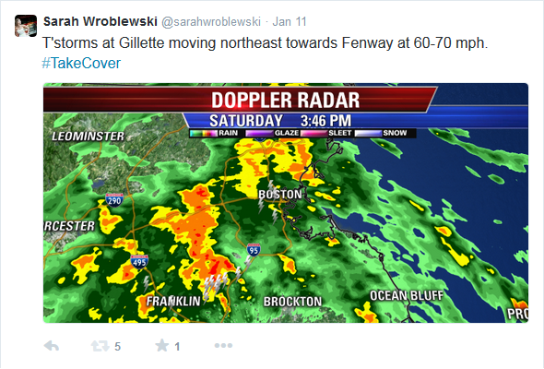

Slide 21
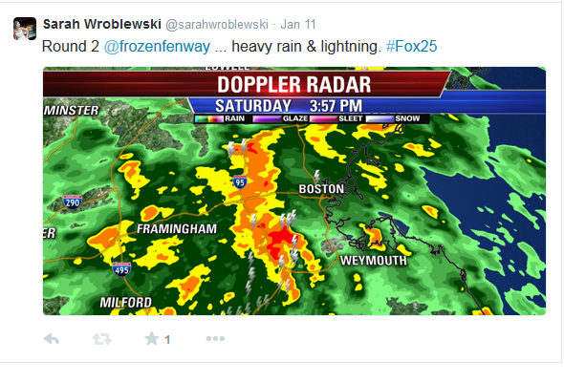

Slide 22
Rain Delay… Fans & Players Take Cover

Slide 23
Rain Delay…
3:25 p.m.: BU has won the opening faceoff and we’re underway!
First period, 2:36, 0-0 : Neither team has created a quality chance as they go through the feeling out process and adjust to a slick, rain-covered ice surface.
First period, 6:37, Maine 1-0: Maine has opened the scoring! Black Bears right winger Ryan Lomberg took a pass and fired a wrist shot from the slot that beat O’Connor.
First period, 7:25, Maine 1-0 : We are in a weather delay at Fenway Park. Heavy rain, lightning and thunder has forced action to stop and the teams have headed back to their locker rooms.
4:00 p.m.: The rain is falling at an even stronger rate than when the game was delayed. The lightning has also continued. The teams remain in the locker room.
4:16 p.m.: According to @BUGameday, the two teams will return to the ice at 4:30 p.m. The ice crew is currently pushing as much water off the ice as possible.

Slide 24
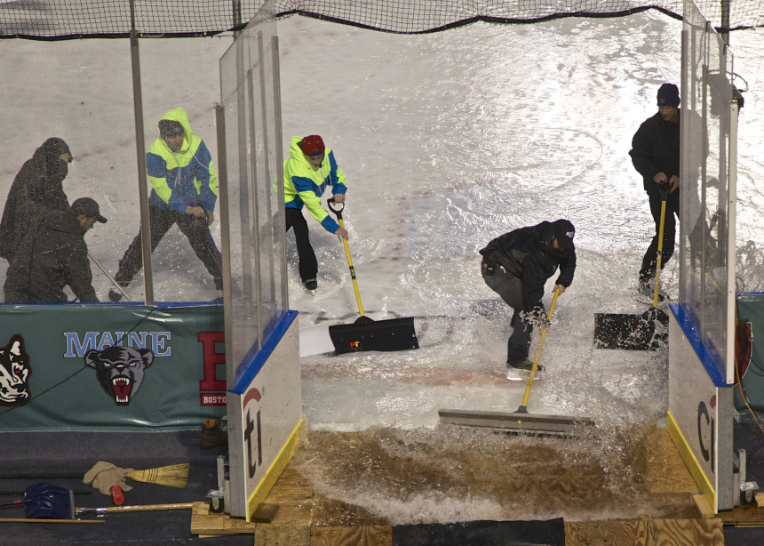
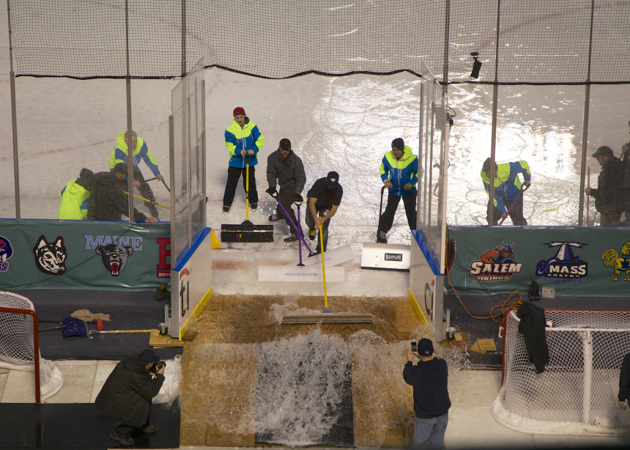
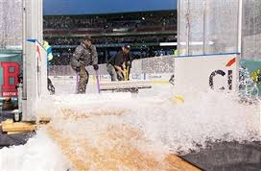
Rain Delay… Flooded Rink

Slide 25
Rain Delay…
4:23 p.m.: The Zambonis are back on the ice. Both teams are scheduled to resume play in seven minutes. Maine leads BU 1-0 with 12:35 remaining in the first period.
4:32 p.m.: Play will resume in approximately 10 minutes…
First period, 10:51, Maine 2-0: The two sides have changed ends halfway through the first period because of the weather. They will do this in each period.
End third period, Maine 7-3: The game is over. Maine defeats BU 7-3 in the final matchup of Frozen Fenway 2014

Slide 26
Fenways Weather Team

