Slide 1
Atlantic Basin Seasonal Hurricane Prediction
October 25, 2014
Phil Klotzbach
Department of Atmospheric Science

Slide 2
Outline
Introduction
Atlantic Basin Hurricane Multi-Decadal Variability
2013 Atlantic Basin Seasonal Forecast Bust
2014 Atlantic Basin Hurricane Prediction
Notes:
Lexington Insurance 07-09
10/23/2014
2

Slide 3
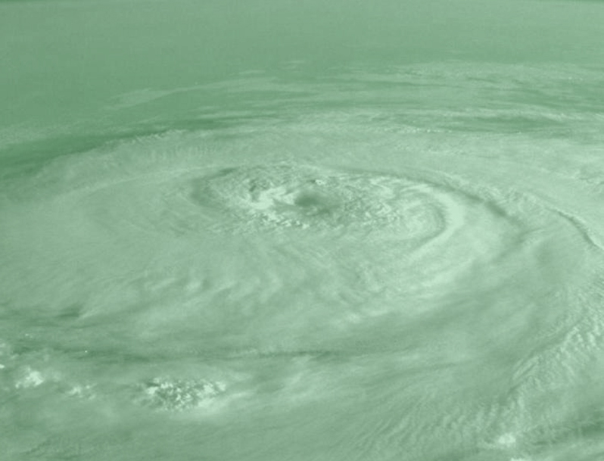
1 JUNE 1982
“There is no way to tell how active the coming Atlantic hurricane season is going to be.”
-Neil Frank, Director of NHC

Slide 4
“It's tough to make predictions, especially about the future”
HOWEVER…
“You can see a lot by looking”
Yogi Berra
Notes:
Lexington Insurance 07-09
10/23/2014
4

Slide 6
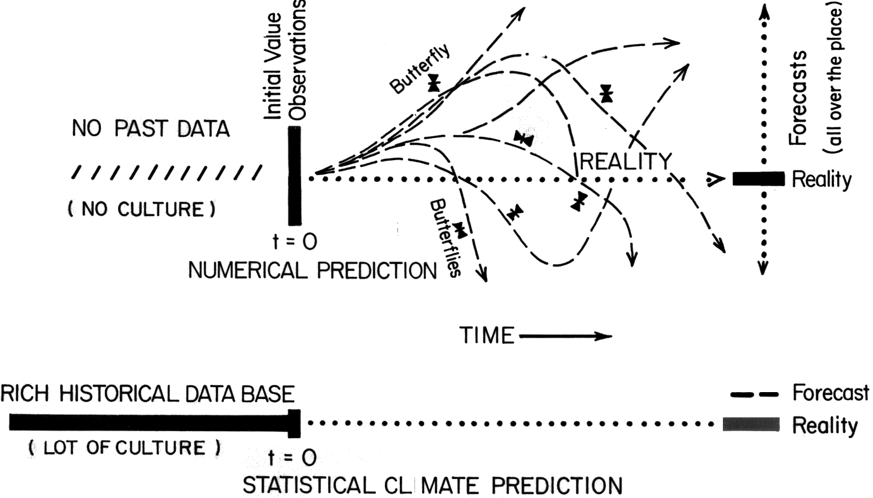
ECMWF
10 days
I

Slide 7
OUTGOING LONGWAVE RADIATION
LATENT HEAT FLUX
SENSIBLE HEAT AND POTENTIAL ENERGY FLUX
ABSORBED SOLAR RADIATION
NET ENERGY BALANCE
SUBSURFACE HEAT STORAGE
THERMAL INERTIA
OCEAN HEAT FLUX
TEMPERATURE
Flow diagram for climate modeling, showing feedback loops. From Robock (1985).

Slide 8
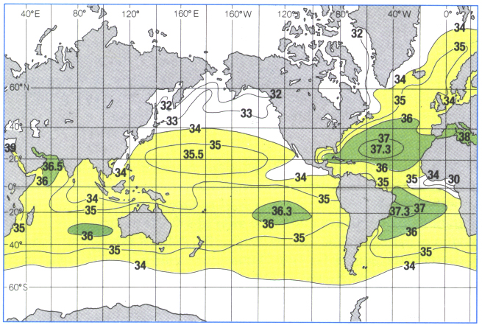

Slide 9
THC (or AMO)
STRONG
THC (or AMO)
WEAK

Slide 10
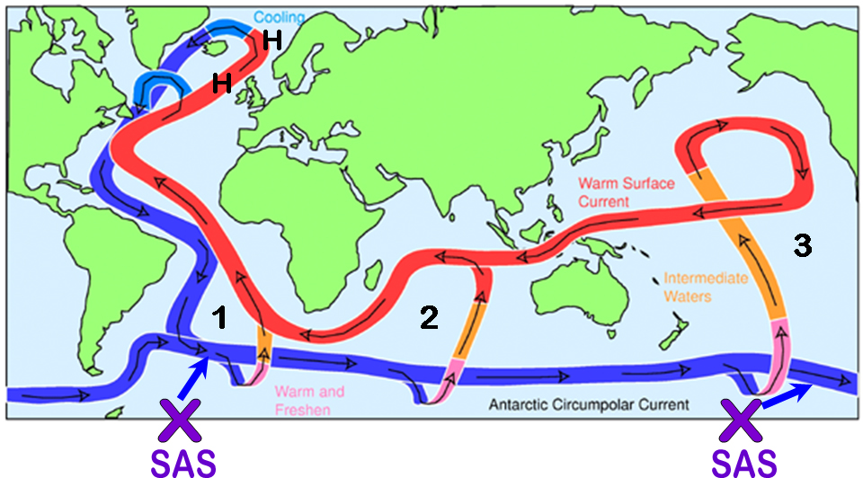
Courtesy of John Marshall (MIT)

Slide 11
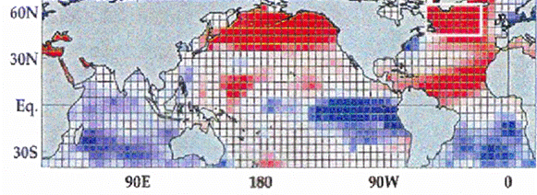
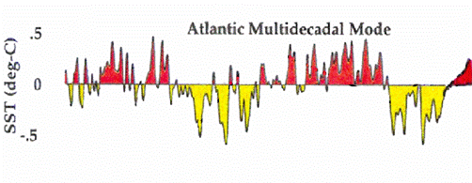
?
1860 1900 1940 1980 2020
Goldenberg et al. (2001)

Slide 15
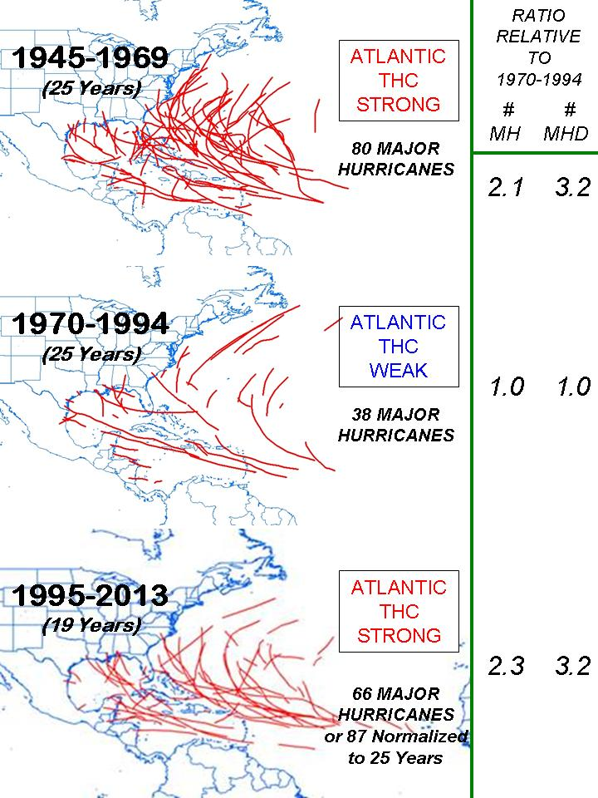

Slide 16
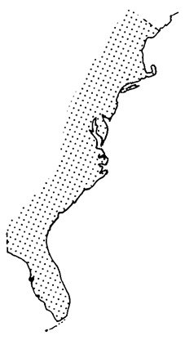
MAJOR HURRICANE LANDFALL
1918-1965 48 YEARS 26 MH
1966-2013 48 YEARS 7 MH
54
38
55
44
33
85
54
55
54
96
60
59
89
28
04
49
33
47
50
21
45
26
05
48
65
04
92
44
60
50
29
19
35
⅓ as frequent

Slide 17
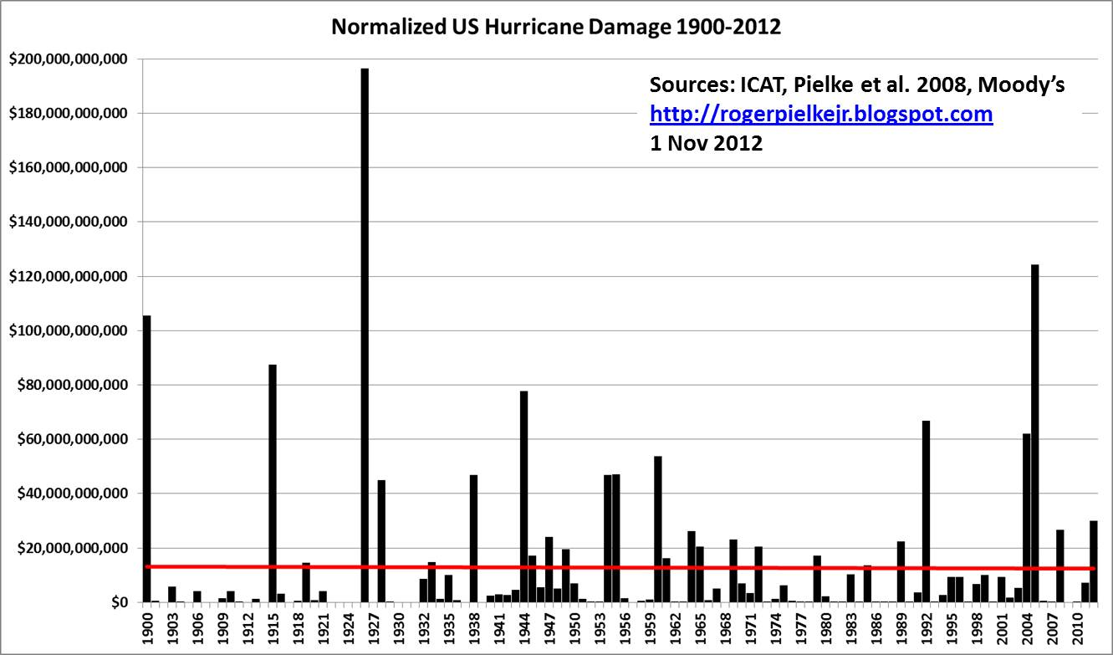

Slide 18
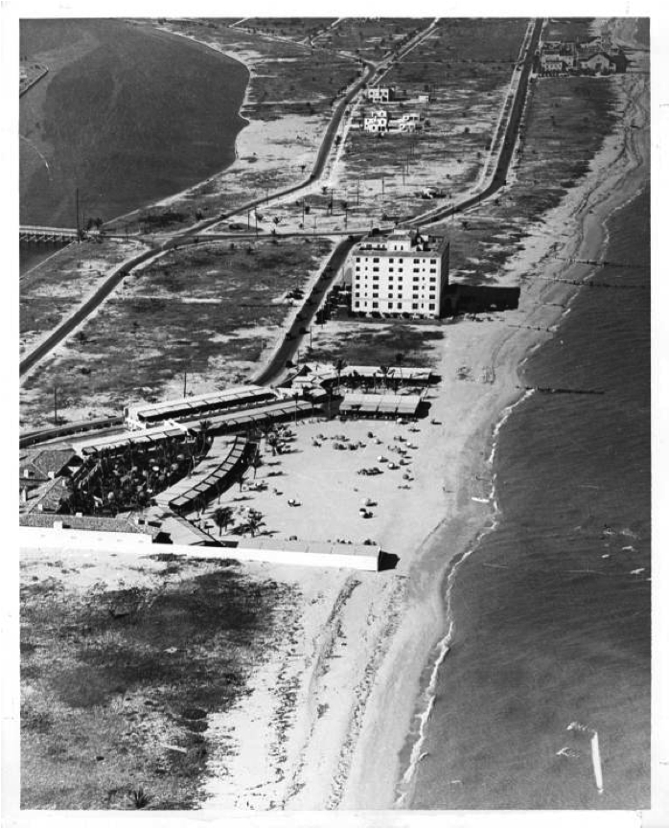
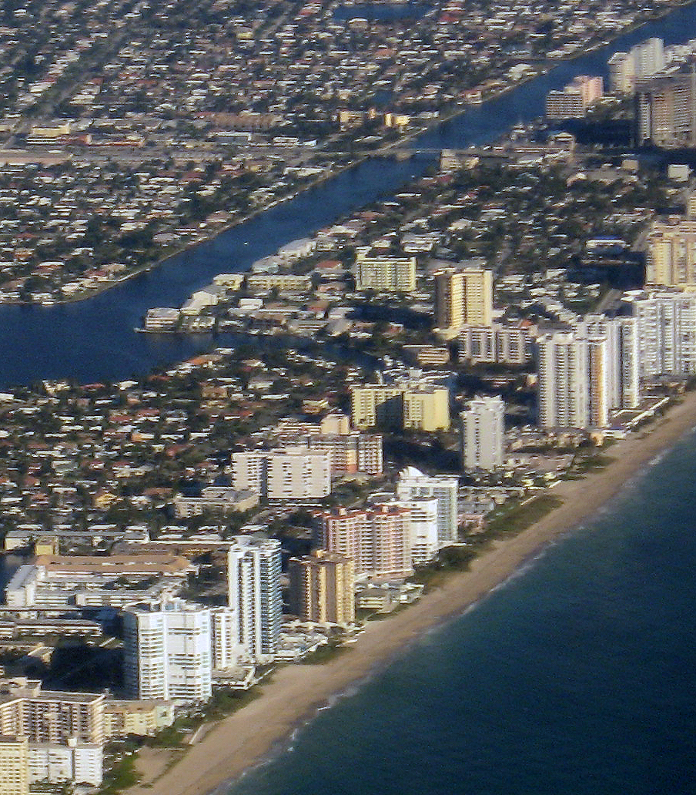
1926 Great Miami Hurricane - $165 Billion Insured Damage
1926
2006

Slide 19
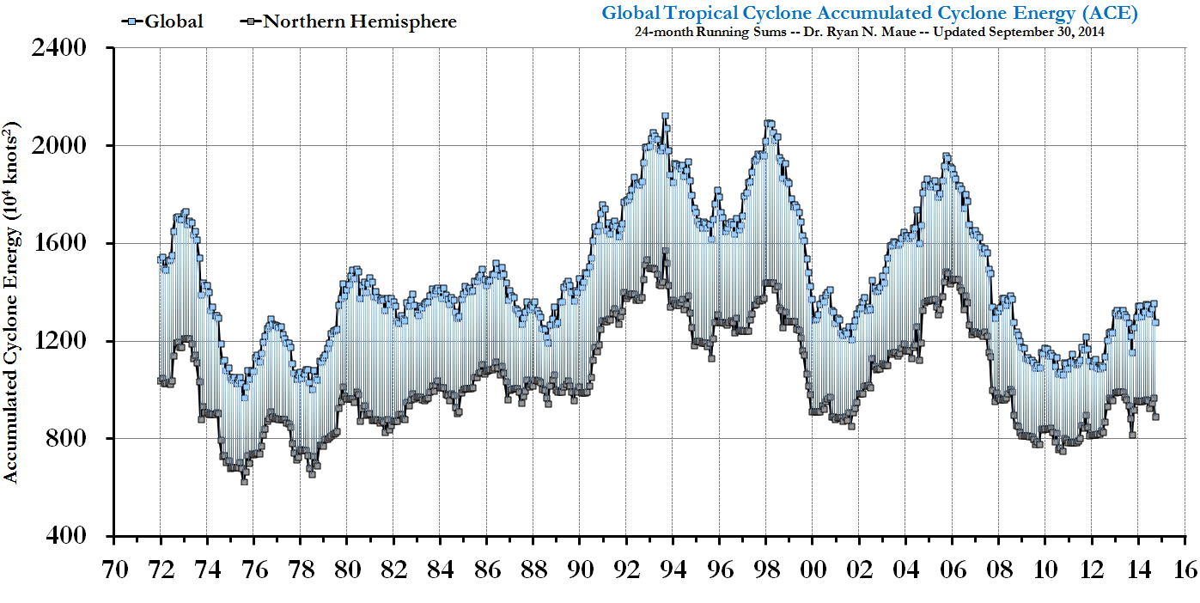

Slide 20
2008 | 7 Dec. 2007 | Update 9 April | Update 3 June | Update 5 August | Obs.
Hurricanes | 7 | 8 | 8 | 9 | 8
Named Storms | 13 | 15 | 15 | 17 | 16
Hurricane Days | 30 | 40 | 40 | 45 | 29.50
Named Storm Days | 60 | 80 | 80 | 90 | 84.75
Major Hurricanes | 3 | 4 | 4 | 5 | 5
Major Hurricane Days | 6 | 9 | 9 | 11 | 8.50
Accumulated Cyclone Energy | 115 | 150 | 150 | 175 | 146
Net Tropical Cyclone Activity | 125 | 160 | 160 | 190 | 164
2010 | 9 Dec. 2009 | Update 7 April | Update 2 June | Update 4 August | Obs.
Hurricanes | 6-8 | 8 | 10 | 10 | 12
Named Storms | 11-16 | 15 | 18 | 18 | 19
Hurricane Days | 24-39 | 35 | 40 | 40 | 37.50
Named Storm Days | 51-75 | 75 | 90 | 90 | 88.25
Major Hurricanes | 3-5 | 4 | 5 | 5 | 5
Major Hurricane Days | 6-12 | 10 | 13 | 13 | 11
Accumulated Cyclone Energy | 100-162 | 150 | 185 | 185 | 163
Net Tropical Cyclone Activity | 108-172 | 160 | 195 | 195 | 195

Slide 21
DISASTER
2013 | 10 April | Update 3 June | Update 2 August | Obs.
Hurricanes | 9 | 9 | 8 | 2
Named Storms | 18 | 18 | 18 | 14
Hurricane Days | 40 | 40 | 35 | 3.25
Named Storm Days | 95 | 95 | 84.25 | 42.25
Major Hurricanes | 4 | 4 | 3 | 0
Major Hurricane Days | 9 | 9 | 7 | 0
Accumulated Cyclone Energy | 165 | 165 | 142 | 36
Net Tropical Cyclone Activity | 175 | 175 | 150 | 47

Slide 22
GRAY
KLOTZBACH
2013 Seasonal Hurricane Forecast
“The best laid schemes of mice and men sometimes go awry”
-- R. Burns

Slide 23
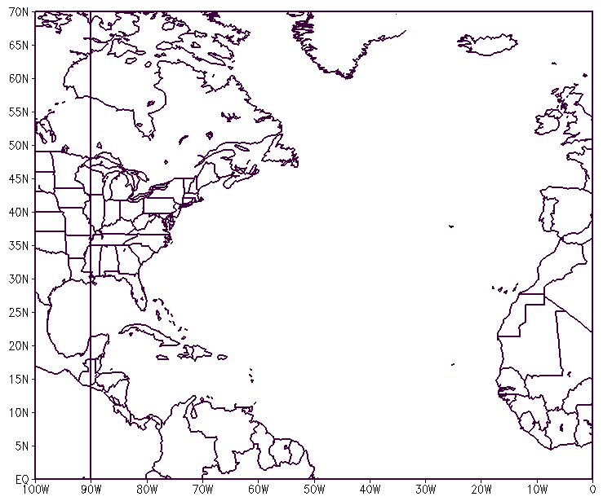
THC WEAK (Apr-June)
H
H
COLD
ADVECTION
Cooler +
TROUGH
More ΔT SLPA + SSTA -
WARM

Slide 24
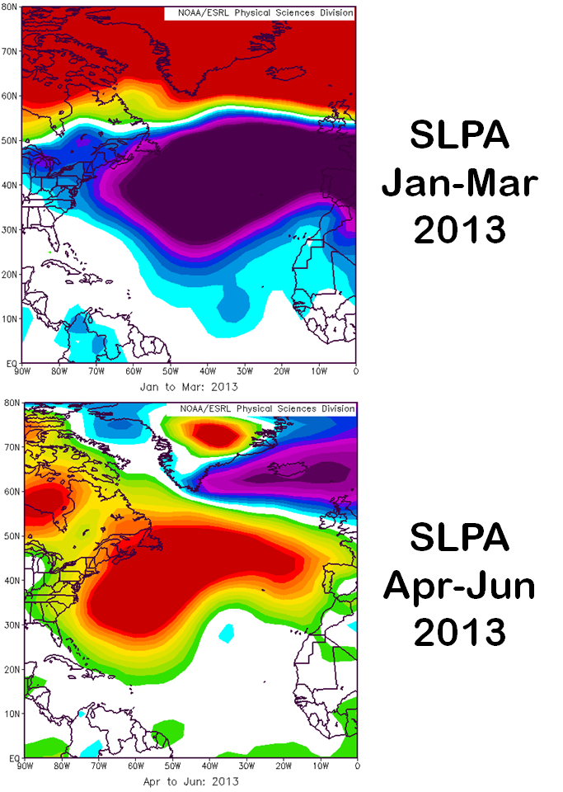

Slide 25
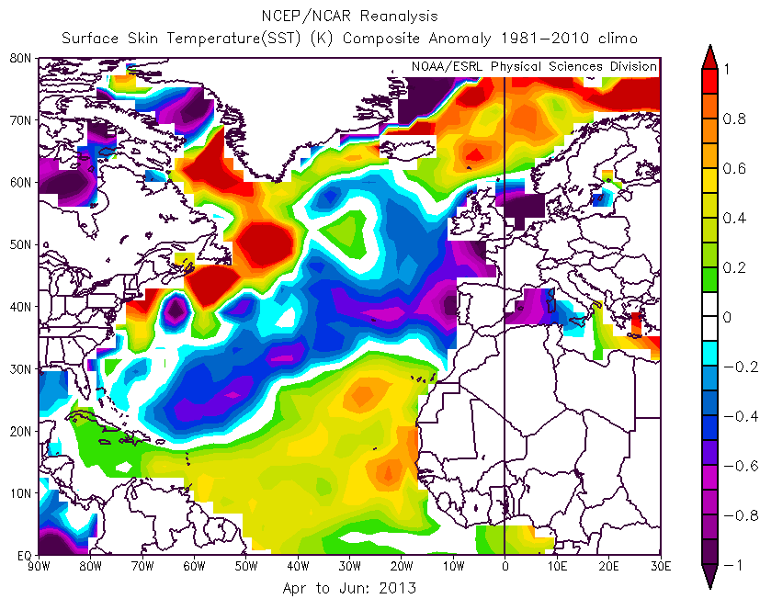

Slide 26
Outlook for the 2014 Atlantic Hurricane Season
Phil Klotzbach
Department of Atmospheric Science
Colorado State University
All forecasts and verifications are available on our project’s website:
http://tropical.atmos.colostate.edu
Notes:
Lexington Insurance 07-09
10/23/2014
26

Slide 27
2014 FORECAST AS OF 1 AUGUST 2014
Forecast Parameter | Statistical Forecast | Final Forecast | 1981-2010 Median
Named Storms (NS) | 8.8 | 10 | 12.0
Named Storm Days (NSD) | 35.1 | 40 | 60.1
Hurricanes (H) | 4.9 | 4 | 6.5
Hurricane Days (HD) | 12.9 | 15 | 21.3
Major Hurricanes (MH) | 0.9 | 1 | 2.0
Major Hurricane Days (MHD) | 1.1 | 3 | 3.9
Accumulated Cyclone Energy (ACE) | 51 | 65 | 92
Net Tropical Cyclone Activity (NTC) | 57 | 70 | 103

Slide 28
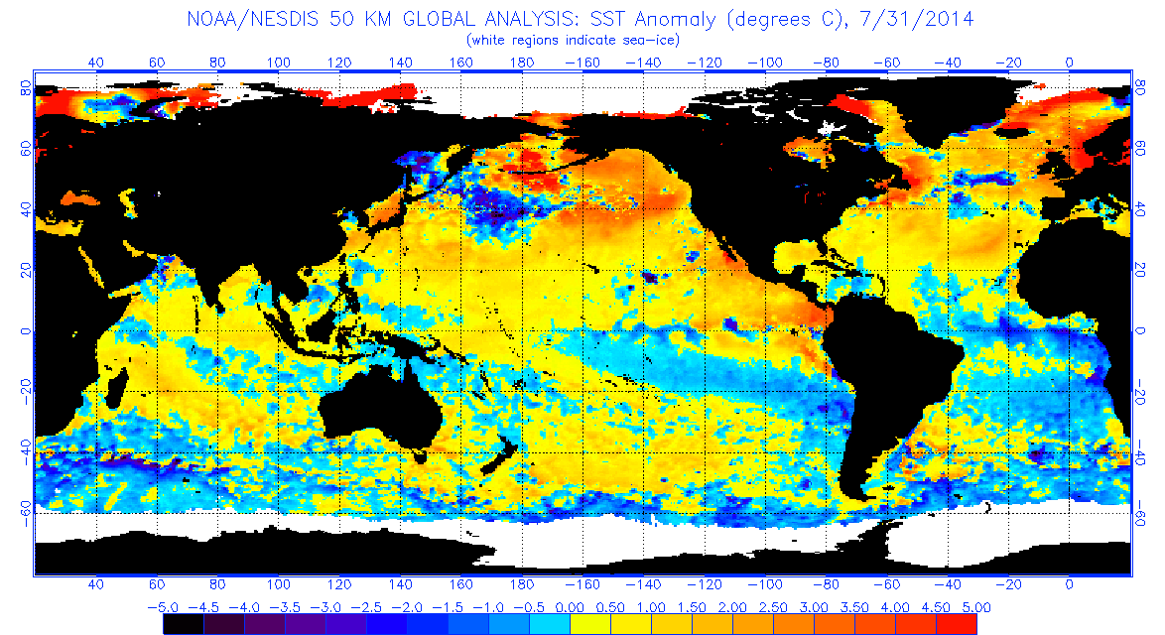

Slide 29
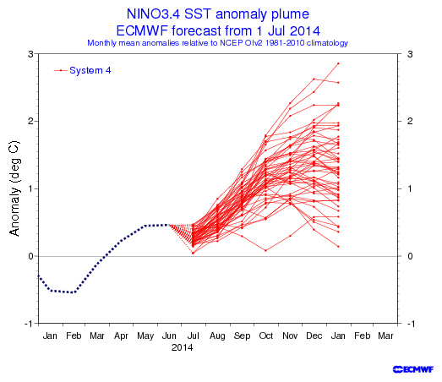
El Niño
La Niña

Slide 30
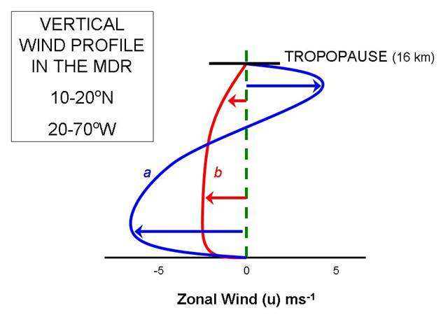
Vertical Wind Profile in the Main Development Region
10-20°N, 70-20°W
b – more TCs
a – fewer TCs

Slide 31
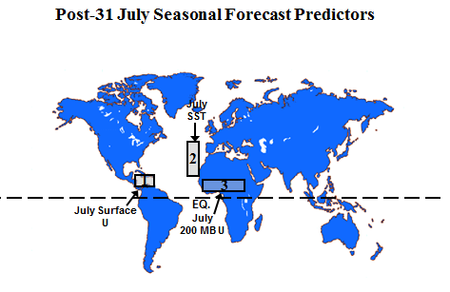

Slide 33
2014
Forecast Schedule
Date | 10 April | 2 June | 1 July | 31 July
Seasonal Forecast | X | X | X | X
Notes:
Lexington Insurance 07-09
10/23/2014
33

Slide 34
ATLANTIC BASIN SEASONAL HURRICANE FORECASTS FOR 2014
Forecast Parameter and 1981-2010 Median (in parentheses) | 10 April 2014 | Update 2 June 2014 | Update 1 July 2014 | Update 31 July 2014 | Observed 2014 Total Through Oct. 19 | % of 1981-2010 Median
Named Storms (NS) (12.0) | 9 | 10 | 10 | 10 | 7 | 58%
Named Storm Days (NSD) (60.1) | 35 | 40 | 40 | 40 | 34 | 56%
Hurricanes (H) (6.5) | 3 | 4 | 4 | 4 | 6 | 92%
Hurricane Days (HD) (21.3) | 12 | 15 | 15 | 15 | 17 | 80%
Major Hurricanes (MH) (2.0) | 1 | 1 | 1 | 1 | 2 | 100%
Major Hurricane Days (MHD) (3.9) | 2 | 3 | 3 | 3 | 3.75 | 96%
Accumulated Cyclone Energy (ACE) (92) | 55 | 65 | 65 | 65 | 64 | 70%
Net Tropical Cyclone Activity (NTC) (103%) | 60 | 70 | 70 | 70 | 79 | 79%

Slide 35
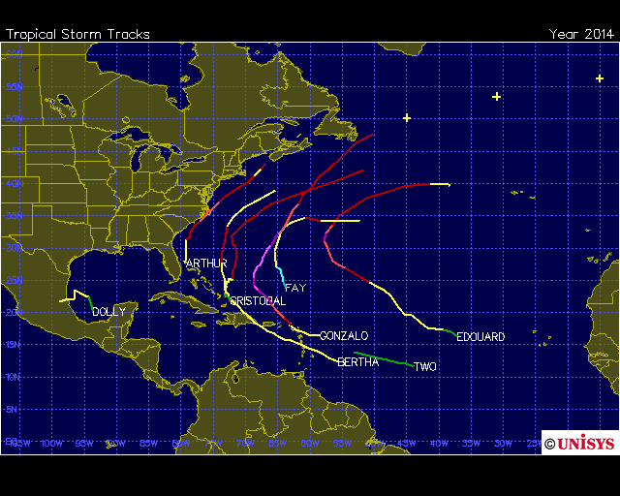

Slide 36
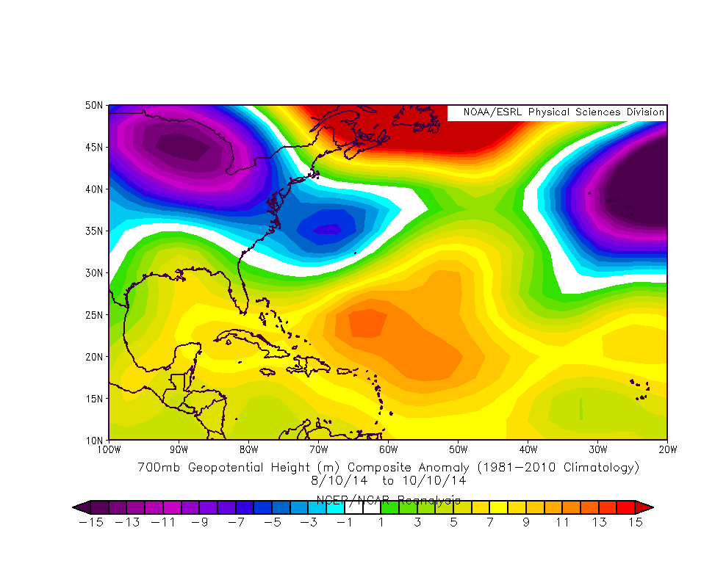
Mid-August – Mid-October 2014 Mid-Level Steering Flow

Slide 37
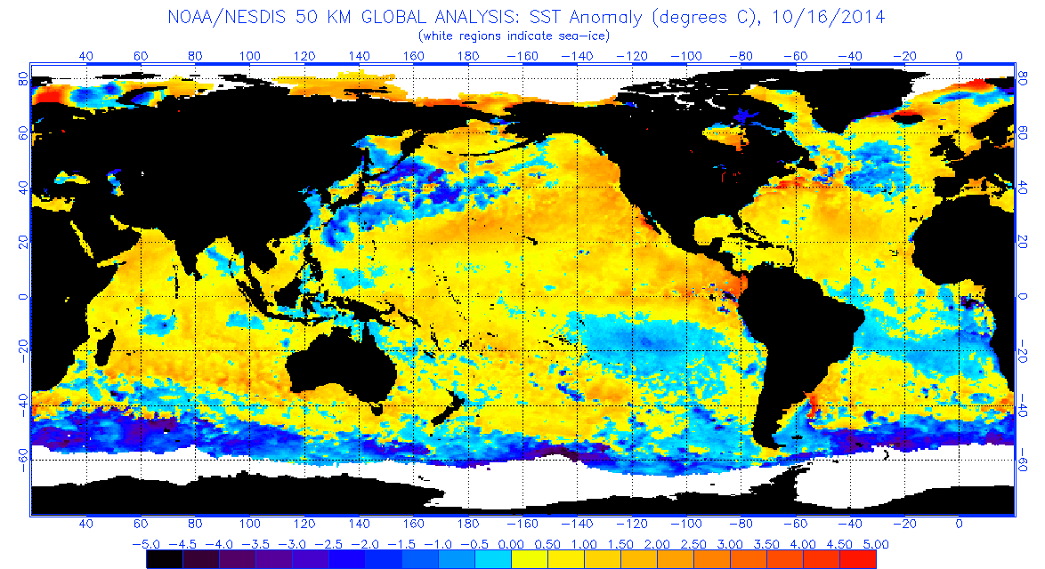
Current Global Sea Surface Temperature Anomaly Map

Slide 38
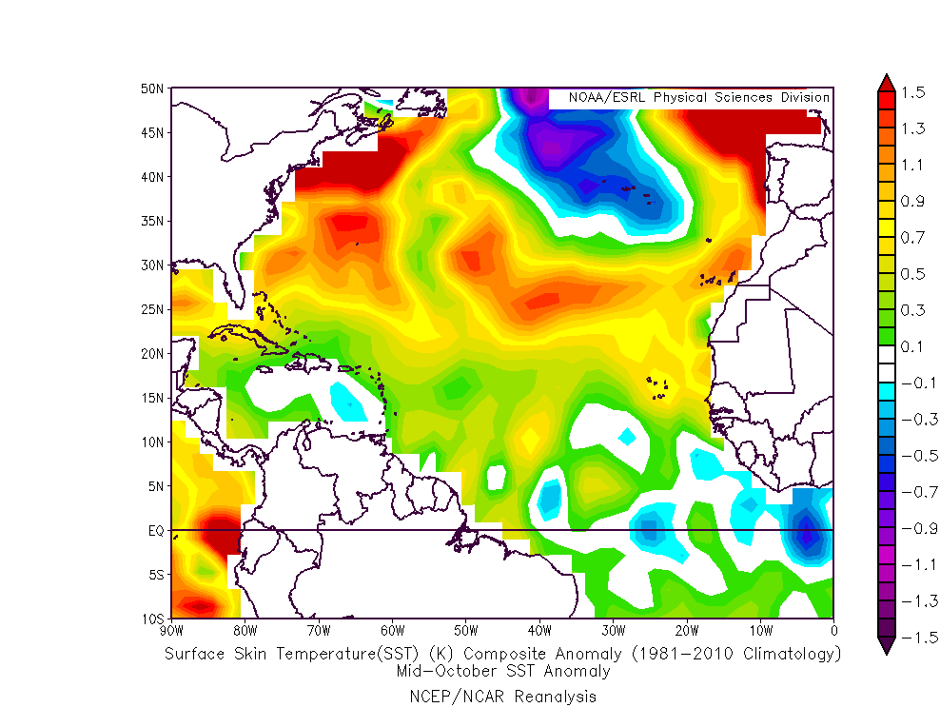
Current Atlantic Basin Sea Surface Temperature Anomaly Map

Slide 39
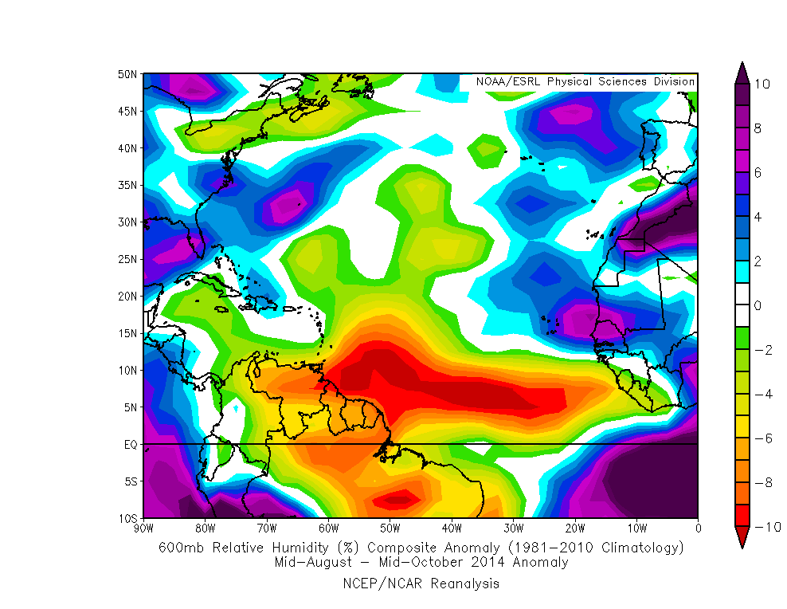
Relative Humidity Anomalies for the Past 2 Months at ≈14,000 Feet

Slide 40
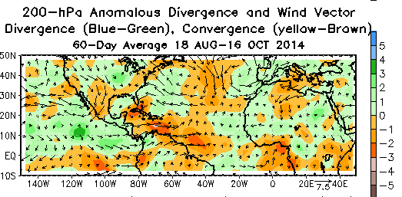

Slide 41
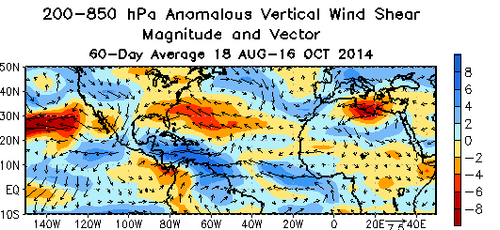

Slide 42
Arago’s Admonition:
“Never, no matter what may be the progress of science, will honest scientific men who have regard for their reputations venture to predict the weather.”
Notes:
Lexington Insurance 07-09
10/23/2014
42

