Slide 1
Tornado Chase: Bowdle, South Dakota – May 22, 2010
Dr. Richard Yablonsky
and Tracy McCormick

Slide 2
Outline
Chasing Logistics
Lessons Learned/Chasing Advice
Environmental Setup – May 22, 2010
Bowdle tornado video
N. Of Midland, TX; May 17, 2010

Slide 3
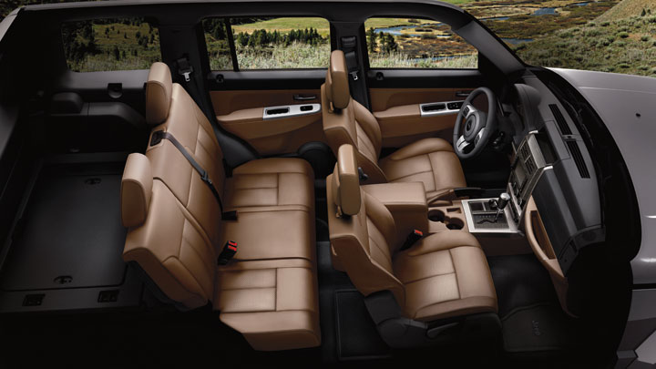
Chasing Logistics – Our Team
Clearly defined roles and frequent communication are key!
TRACY:
Meteorologist,
Coordinator
RICH:
Meteorologist,
Driver
Distance Traveled ≈ 500 mi/day
HAYDEN:
Meteorologist,
Forecaster
MIKE:
Engineer,
Navigator

Slide 4
Lessons Learned…

Slide 5
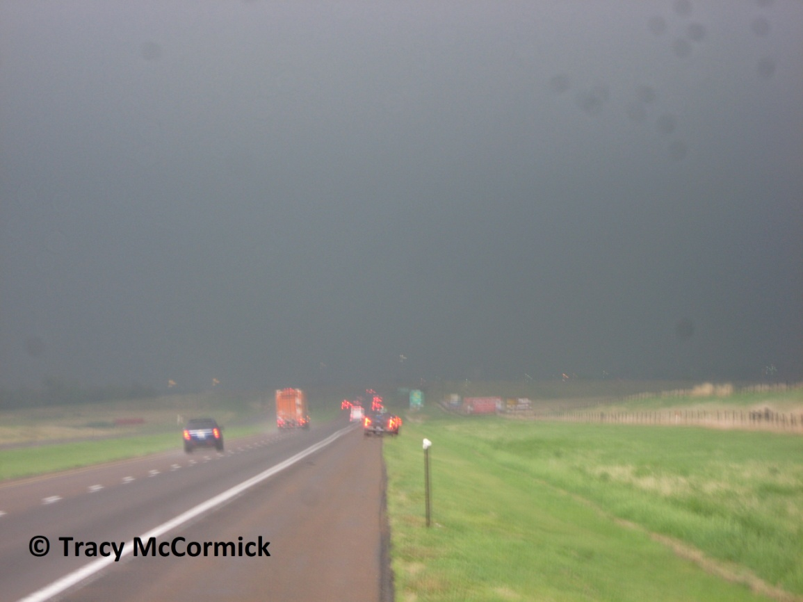
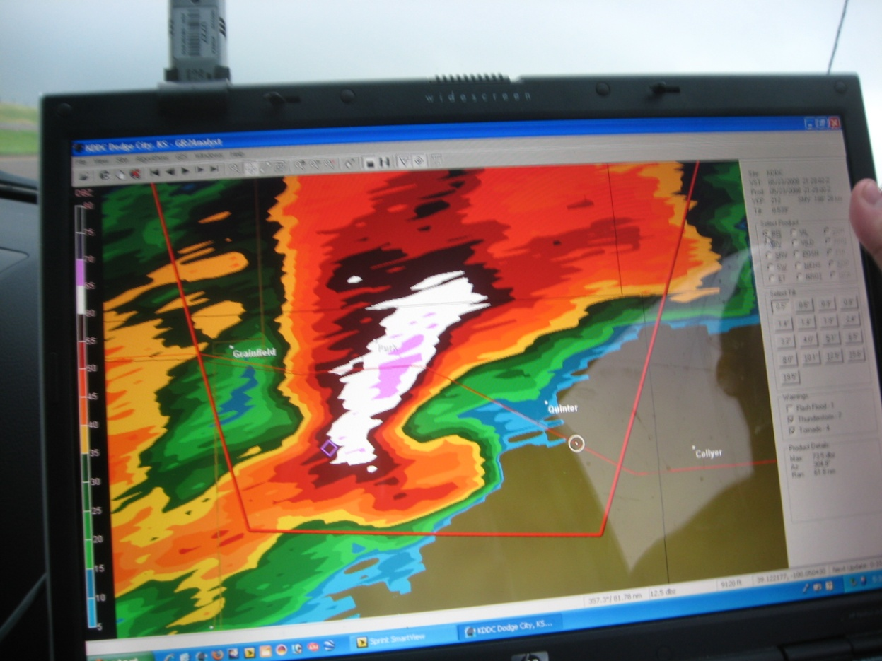
When Tractor Trailers Brake…
You may be staring directly at a massive tornado obscured by rain!
Quinter, KS Tornado, May 23, 2008
Our location

Slide 6
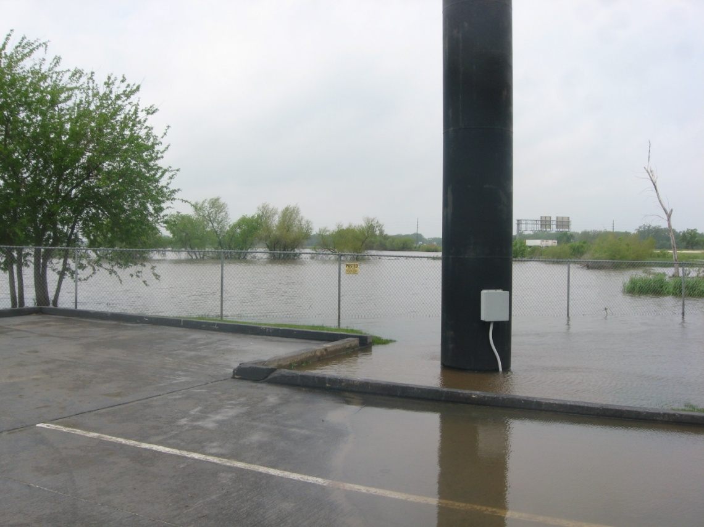
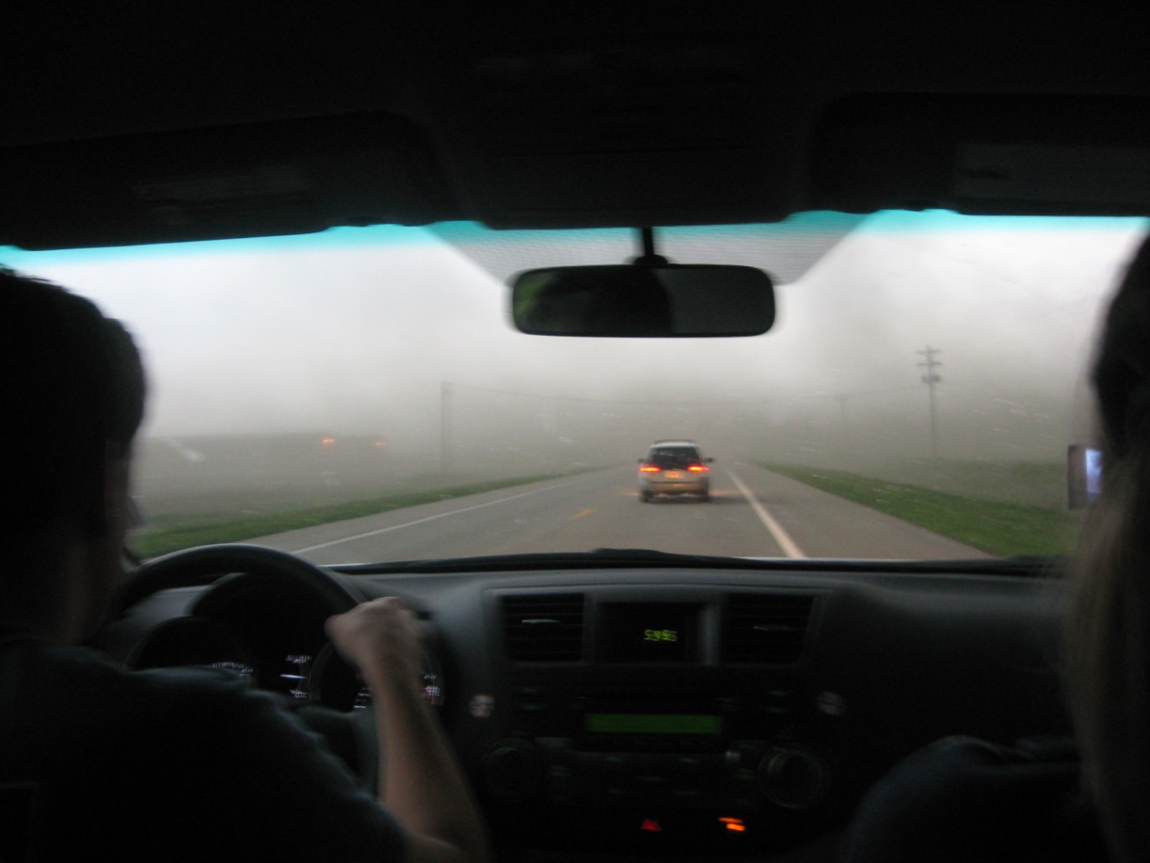
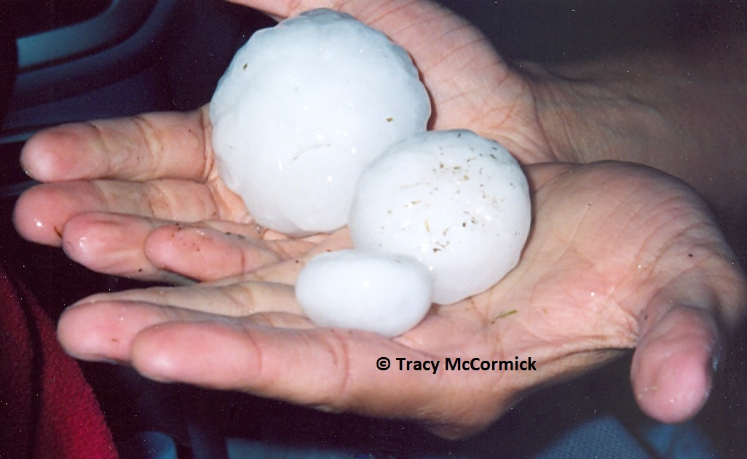
Watch Out For
Tornado Side Effects…
FLOODING
Grand Island, NE
May 29, 2008
“RFD Blasted” AND TUMBLEWEED!
S. Of Kearney, NE
May 29, 2008
LARGE HAIL!
S. Of Perryton, TX
May 23, 2007

Slide 7
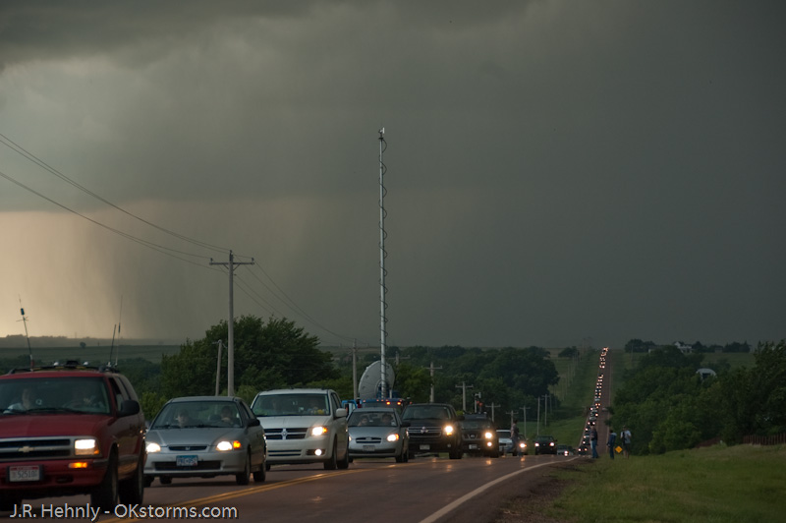
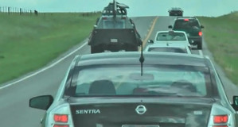
Be Aware of Alternate Routes,…
…Obey traffic regulations, and be respectful!
© Steve Miller

Slide 8
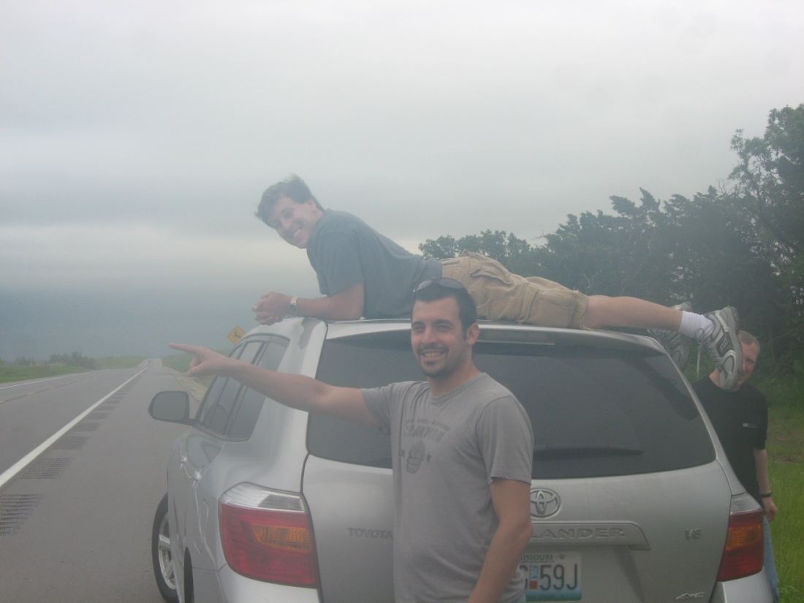
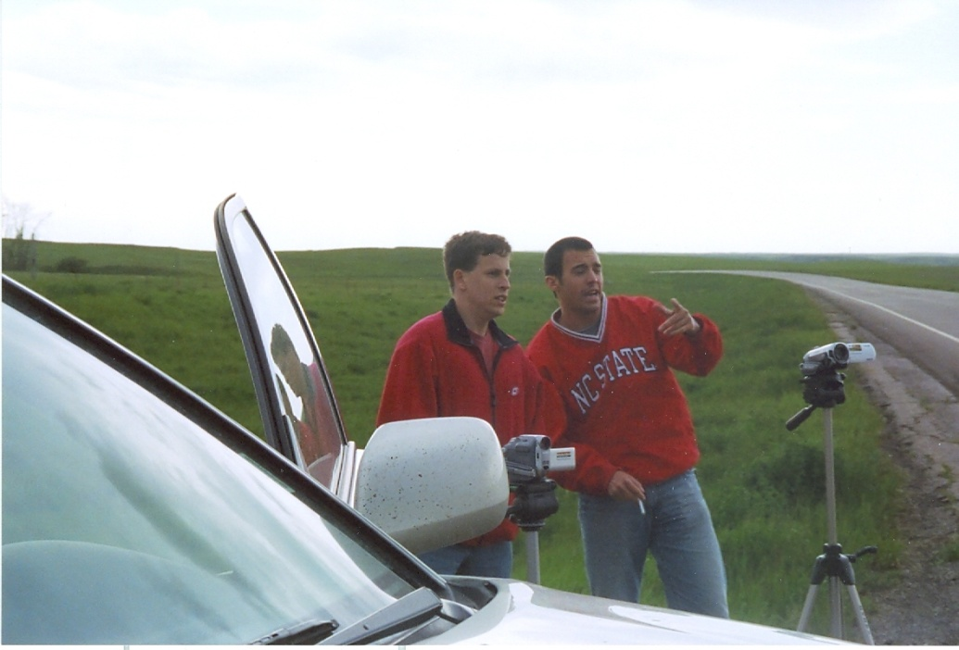
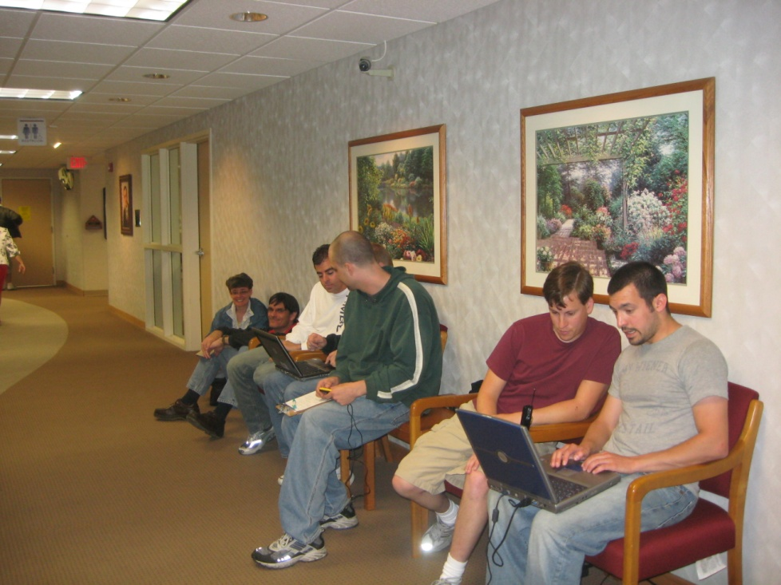
Remain Situationally-Aware At ALL Times…
Topeka, KS
May 24, 2012
S. Of Ellsworth, KS
May 26, 2008
Garden City, KS Hospital
May 28, 2008
S. Of Bismarck, ND
May 25, 2007

Slide 9
Or You May End Up Taking
Cover in McDonalds!
Pratt, KS
May 26, 2008

Slide 10
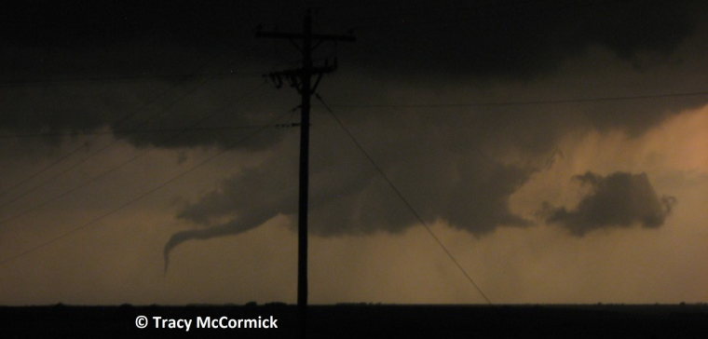
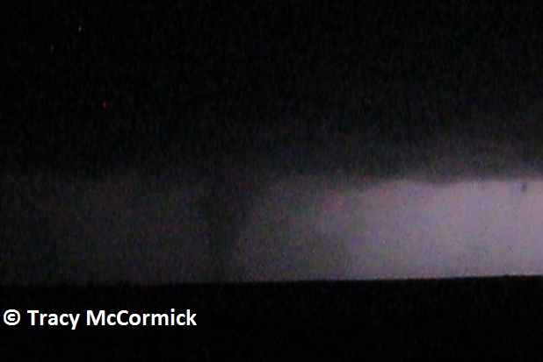
Additional Advice
Russell, KS; May 25, 2012
Full loss damage waiver (rental)
Take decisive action when confident in forecast
Best to be “in position” before convective initiation
If you get behind the storms, it may be hard to safely catch up
Wx and/or car radio on and vehicle running during event
Don’t take dirt roads (rain = mud = stuck)
When stopping, pull off road with 2 tires still on pavement
Don’t chase after dark!
Hennessey, OK
May 19, 2010
LaCrosse, KS; May 25, 2012

Slide 11
And When the Weather Doesn’t Cooperate…

Slide 12
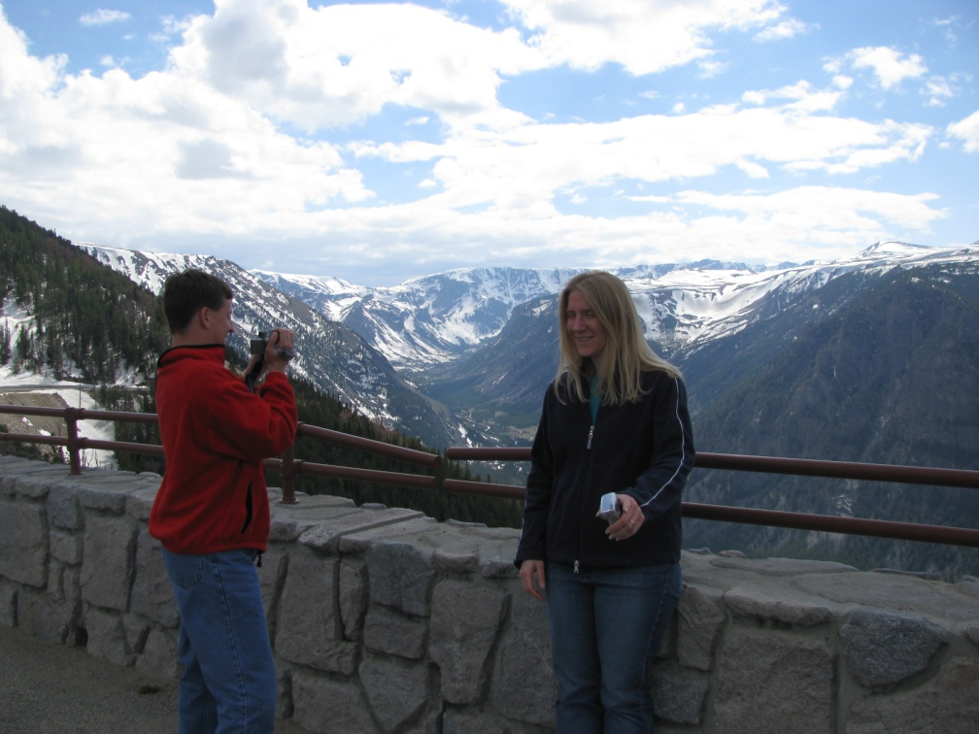
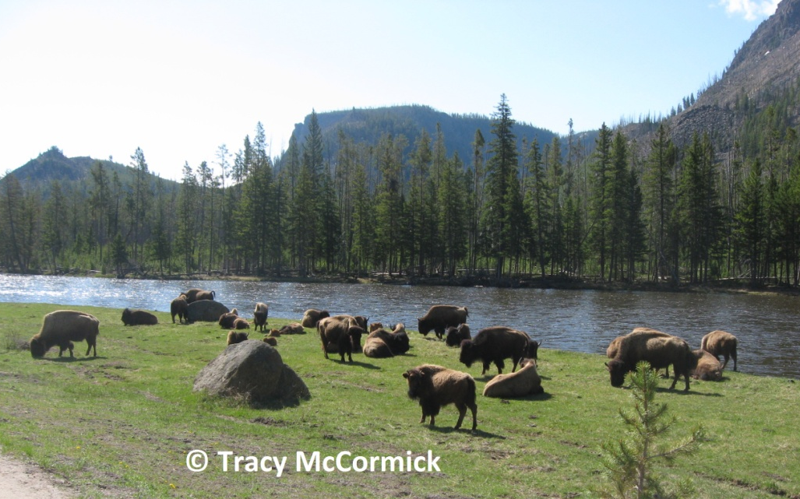
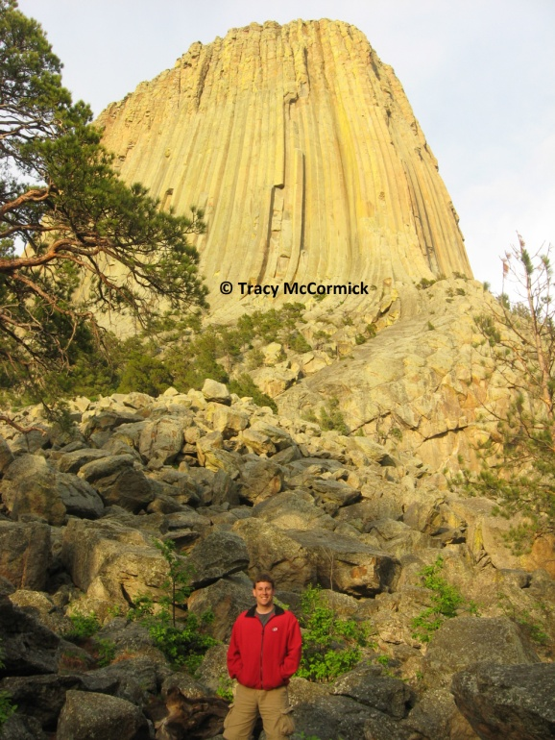
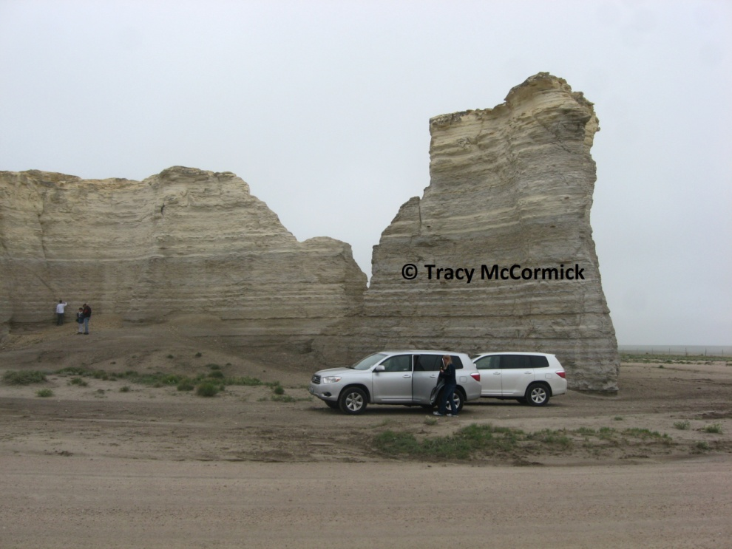
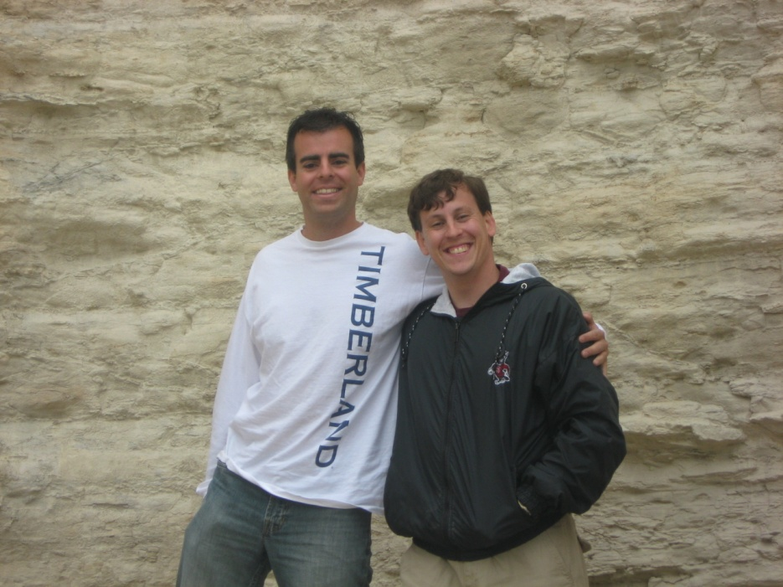
Enjoy the Country’s National Parks/Landmarks…

Slide 13
And Feast On Some Local Cuisine!
Oneille, NE
May 26, 2012

Slide 14
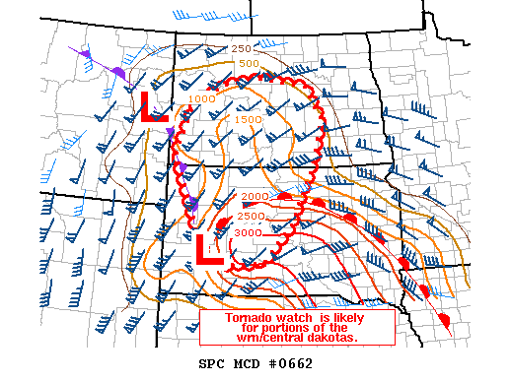
Bowdle, SD Environmental Setup: 22 May, 2010
>3,000 J/kg MLCAPE
50 – 60 kt Effective Bulk Shear
50 kt LLJ transporting high Theta-E Northward
Upper trough approaches from W
0151 PM CDT

Slide 15
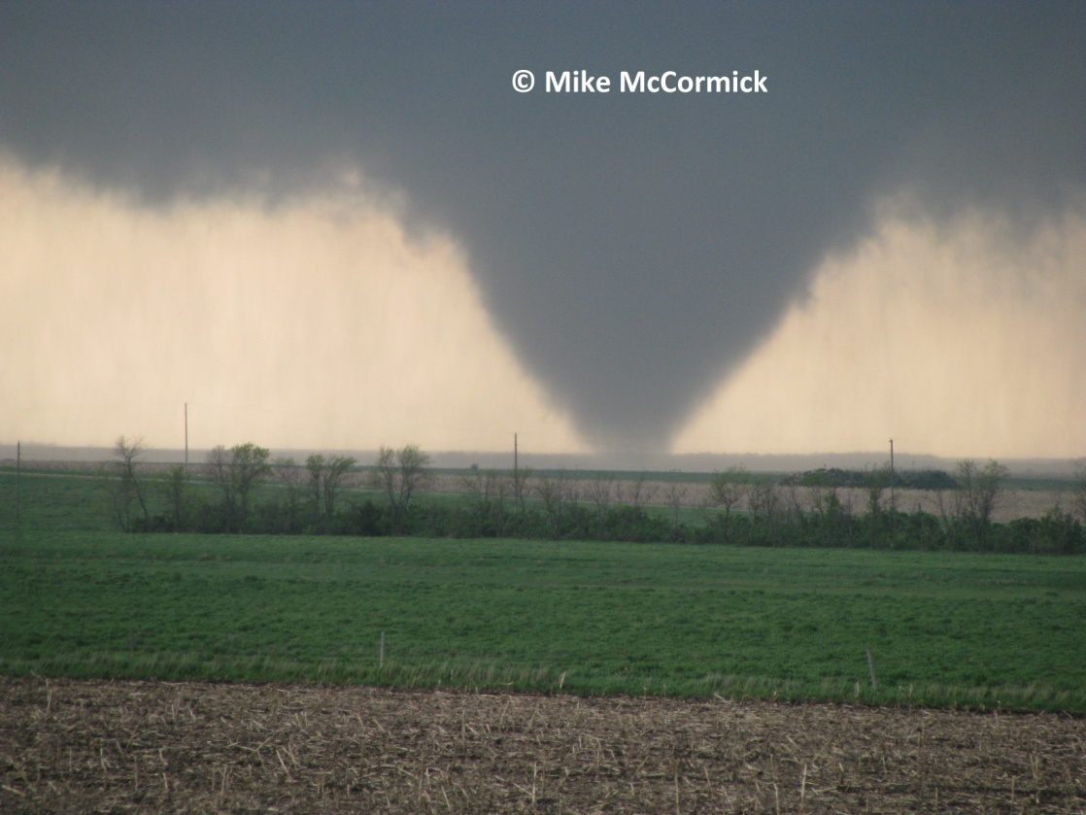
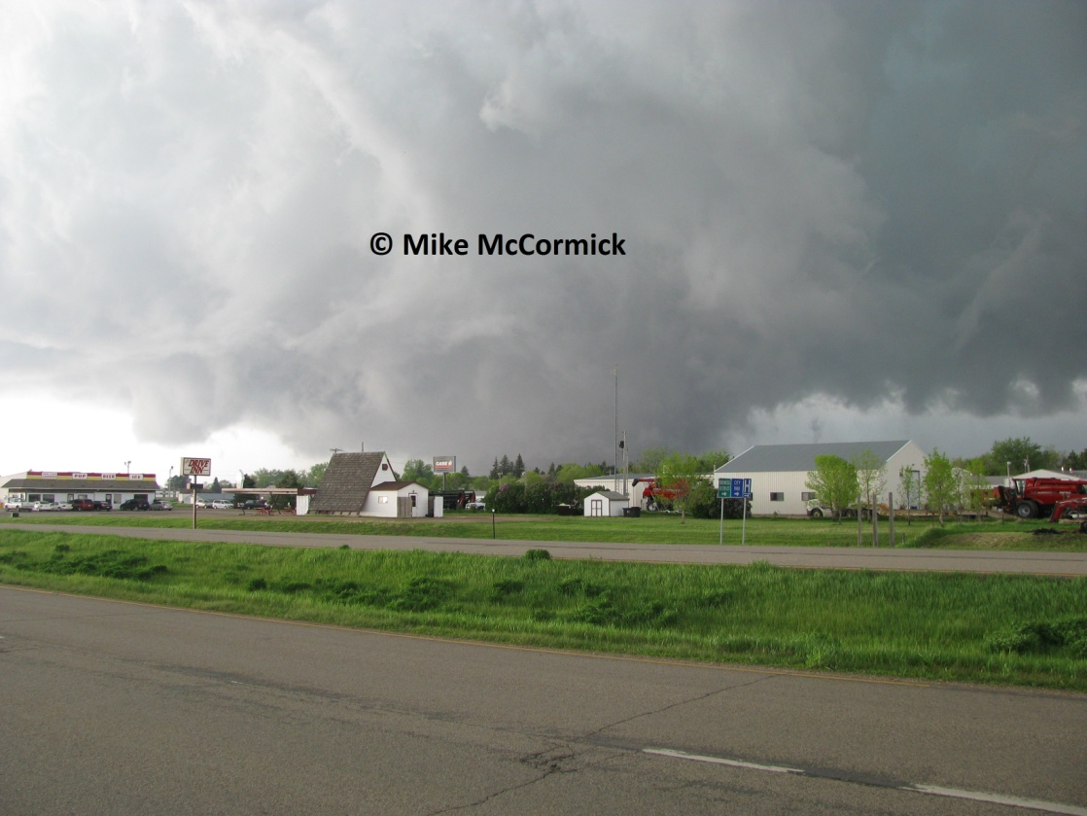
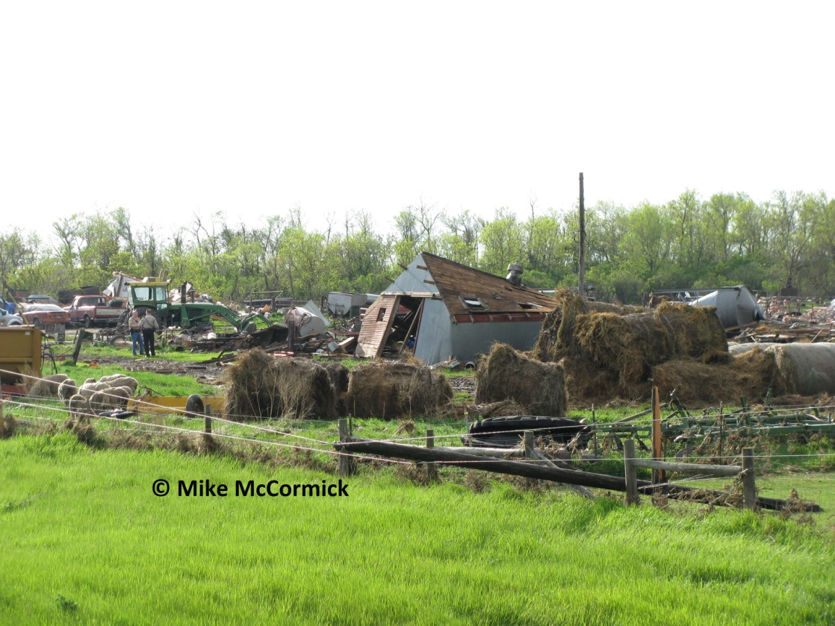
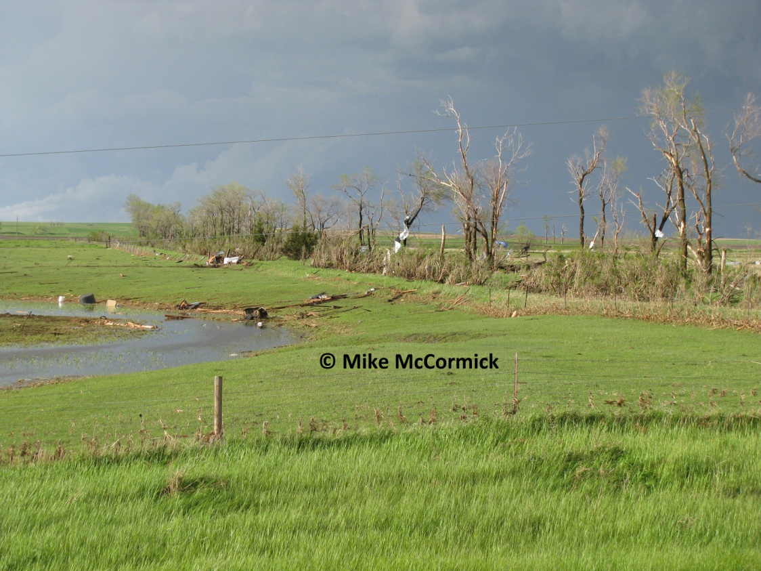
And now on to the Bowdle tornado video…

Slide 16
Supplemental Slides

Slide 17
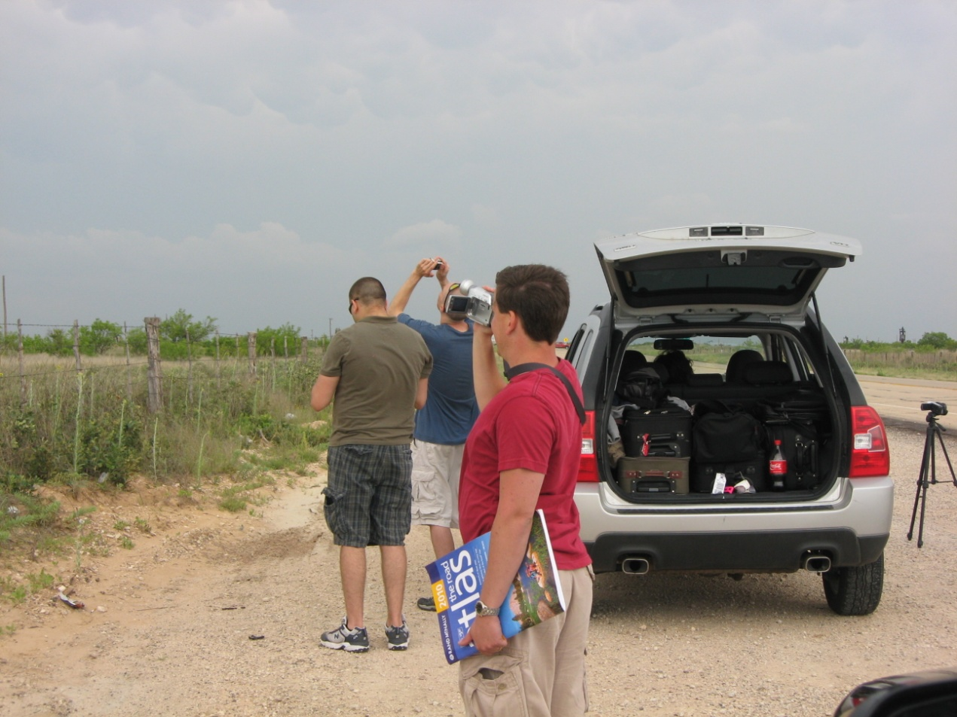
Chasing Logistics – Equipment
NOAA Wx Radio
GPS/Garmin: Travel time(s)
& gas stations!
Road Atlas
GlobalSat USB GPS Receiver for
overlaying position on radar image
Power Inverter w/multiple AC
outlets (for charging electronics)
Video & Digital Camera(s)
Cell Phones and Chargers
Laptop(s) setup with…
Gibson Ridge Software (GRLevel2 and/or 3) for viewing weather radar data and assoc. shapefiles
Bookmarks to frequently-viewed websites (wx obs. & fcsts)
Mobile internet ability (e.g. Verizon)
A coat!
N. Of Midland, TX; May 17, 2010

Slide 18
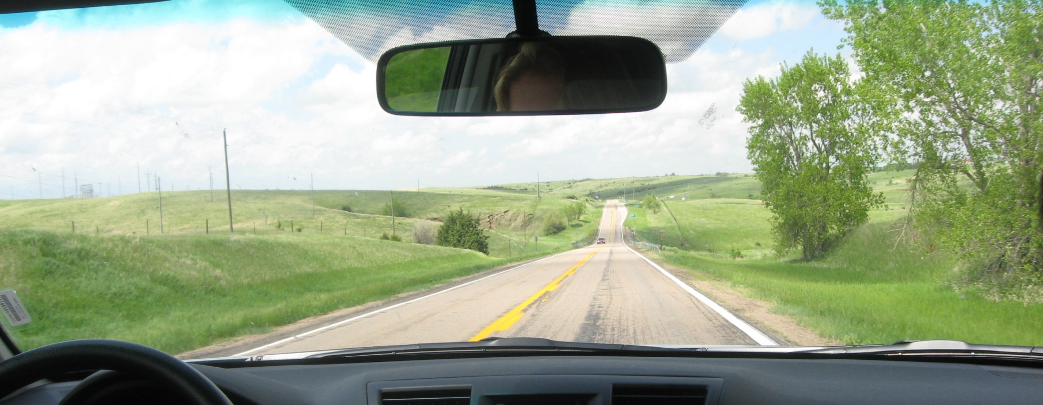
Chasing Logistics – Travel
What works best for us…
Fly into Kansas City early in the day
Rent an SUV W/FULL LOSS DAMAGE WAIVER and ≥2 drivers!
Be prepared for long stretches of travel w/out ANY facilities!
One chase vehicle w/friends whose company you really enjoy!
Nebraska; May 24 2008

Slide 19
A Typical Day
Involves ~500 miles of driving
Morning: Analyze the latest observations & forecast data to determine ‘best’ positioning
Morning – Mid Afternoon:
Drive (potentially hours) to get into position (pick a location at/near a major intersection to maximize road options when the chase begins)
Stay situationally-aware by continuing to monitor obs. and forecast data for boundary development/movement and/or evidence of the cap beginning to break
Once in position, remain situationally-aware while waiting for something to ‘pop’
When something ‘pops’, chase!
Towards dark, call it a day. Begin forecasting for the next day to determine a good location to rest for the night to be in good positioning for the next day.
Call hotels to make a reservation for the night
Grab a late dinner, then drive to your reserved hotel for the night.

Slide 20
250 mb
500 mb
850 mb
SFC
Notes:
-Strong upper level low approaches from W
Upper level jet streak/max approaching from West
- Warm and humid
- 50 kt low level jet transporting high Theta-E air N-ward
Short wave trough
Lots of speed and directional shear
Sfc front
MLCAPE around 3,000 J/kg

Slide 21
250 mb
500 mb
850 mb
SFC

Slide 22
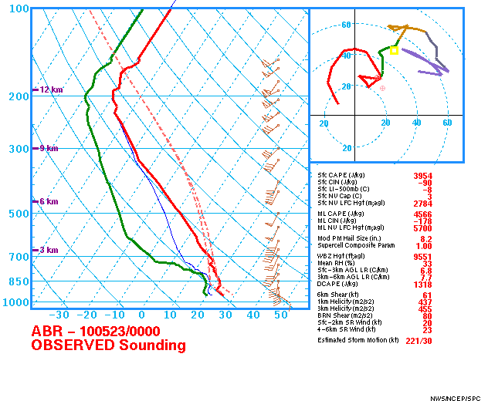

Slide 23
EF4 Bowdle, SD Tornado
Began as EF2 tornado 4 miles W of Bowdle
Touched down directly on a farmstead and destroyed many outbuildings
Weakened into an EF1 as it tossed/destroyed grain bins, flung debris hundreds of yards, and caused shingle and antenna damage to a structure
Quickly strengthened into an EF3 tornado 1.5 mi NW of Bowdle causing widespread tree damage and severe damage/destruction to many outbuildings
Moved NE and reached its peak intensity as an EF4 1 mi north of Bowdle causing major damage to many houses and outbuildings, debarkedg trees, tossed cars into the air, and toppled transmission towers (one was torn off its concrete footings and was thrown hundreds of yards away).
Shifted directions and moved E as an EF2 toppling a state radio tower before lifting shortly thereafter
Based on damage reports, the tornado traveled a distance of 5.01 mi (8.06 km)

