Slide 1
It’s Never Too Cold To Ski
Southern New England Weather Conference
October 24, 2014
Notes:
How may skiers and snowboarders are with us today?

Slide 3
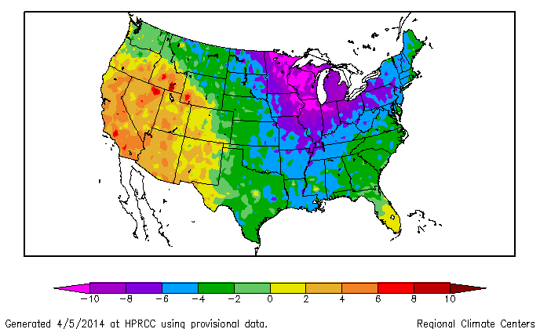
Cold, Cold, Cold!
Notes:
Was it too cold to ski last year? Two words: POLAR VORTEX! Since 95 percent of the population doesn’t ski, 95 percent of the population probable thought it was too cold to ski, or even go outside last winter. In the Central and Eastern part of the country, the big story was the consistently cold air. Not the outstanding snow conditions that the five percent of the population that skis or snowboards considered as an epic winter! But there is no denying it was cold! In fact, the winter temperatures in Minnesota, Wisconsin, and Michigan were low enough to make this the 6th, 5th, and 10th coldest winter on record, respectively. This cold air was also present over the Northern Rockies and throughout New England, which is why both regions had excellent snow conditions for most of the winter and recorded near average amounts of snow.

Slide 4
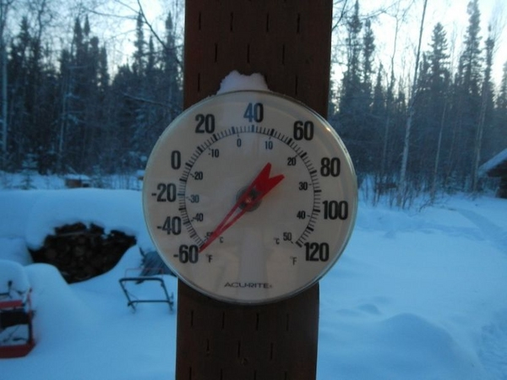
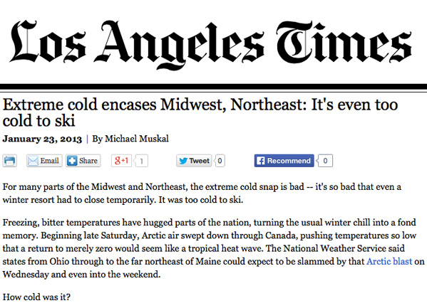
But … was it too cold to ski?
Notes:
According to a Jan. 23 story in the LA Times – Yes! But does anyone in LA actually ski? Wildcat ski area in New Hampshire made national headlines when they closed for a couple days during the January cold spell, but not because it was too cold to ski! They closed because they didn’t want their employees standing out in the cold – especially lift operators during a historically slow mid-week period. Makes you wonder why we promote January as Learn to Ski/Snowboard Month?
How cold was it? – Next image. -60 may be a stretch … but it was cold!

Slide 5
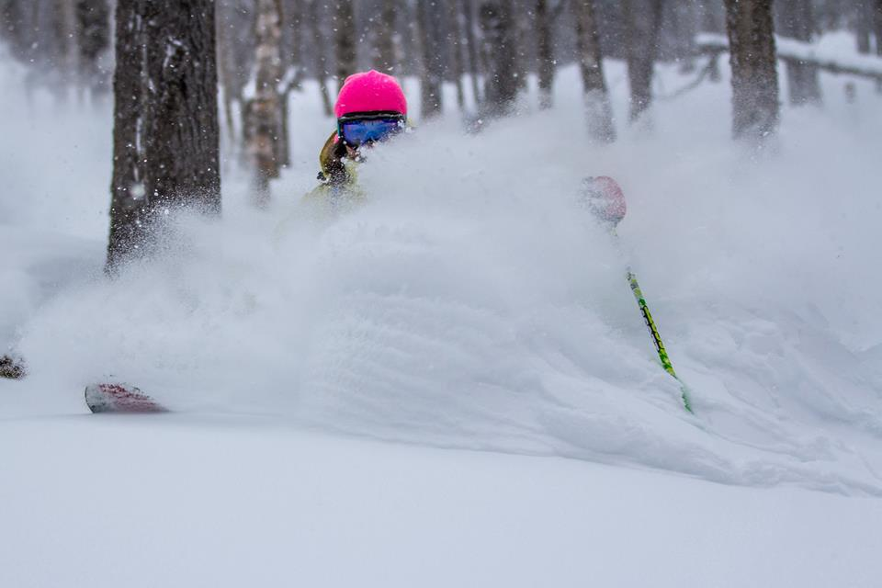
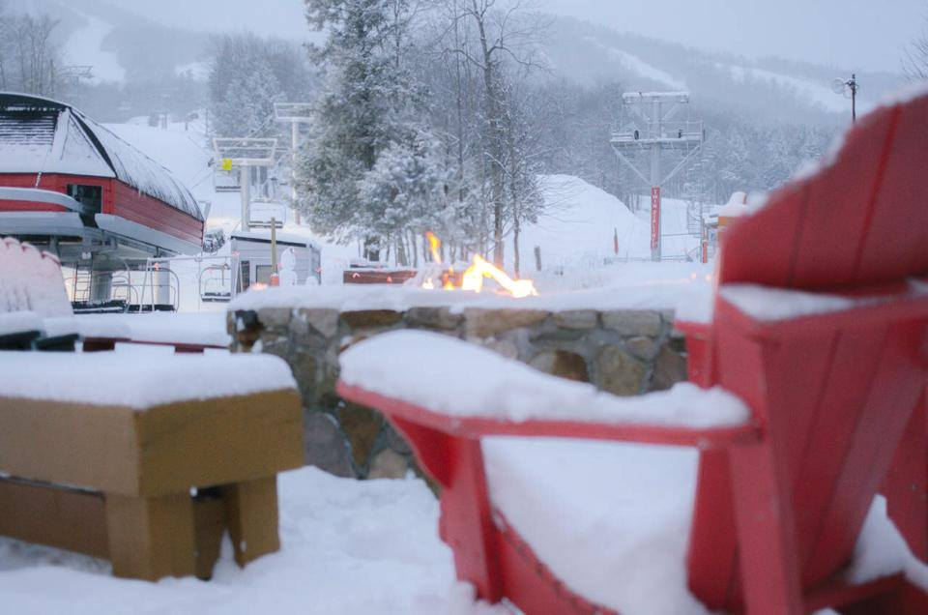
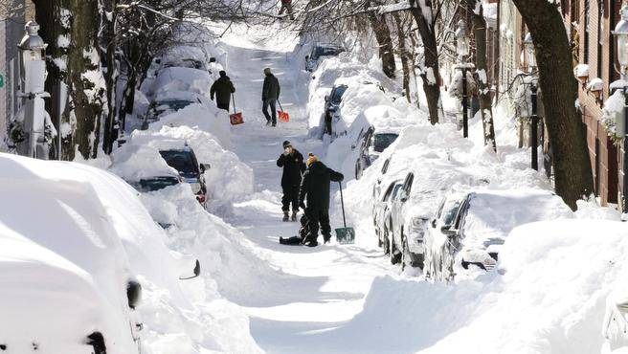
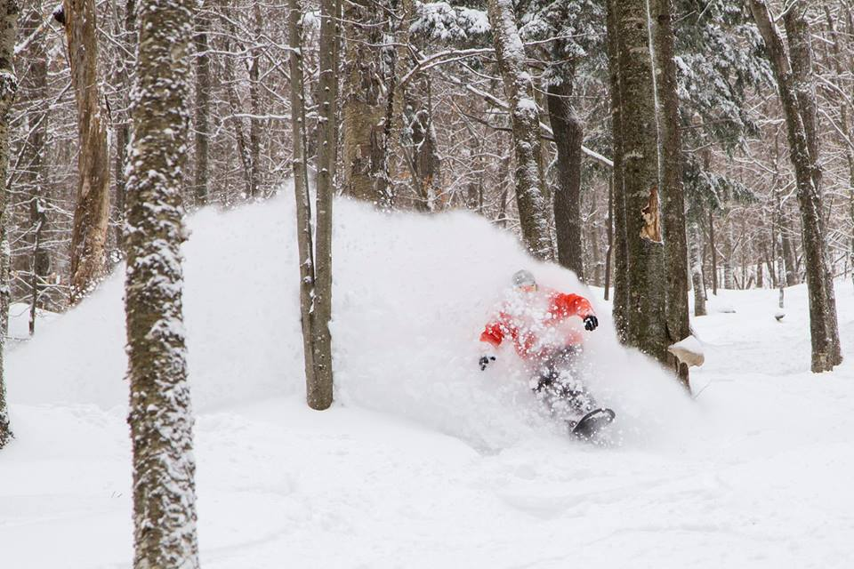
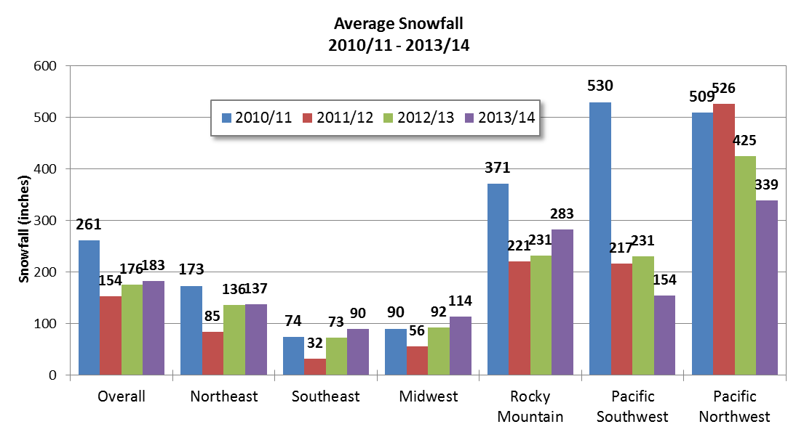
Consistent cold = Great Snow!
Notes:
As you can see from this four-year snow chart, with the exception of California .. Where the snow really never fell … the snow that did fall last year, and it stuck around for a while, thanks again to the clod. In fact, in some areas, the heavy snow really wore out its welcome. Especially in the Northeast Metropolitan areas.. Show photo of Boston. Digging out in Boston last February. Meanwhile, at Loon Mountain they were enjoying this .. However, all the snow – and the cold too - was indeed a welcome sight for the New England Resorts, which combined had a total economic impact of more than $2.5 Billion on the region. When you add in Snowmobiling, cross country skiing and other forms of winter tourism, that amount grows to more than $4 Billion.

Slide 6
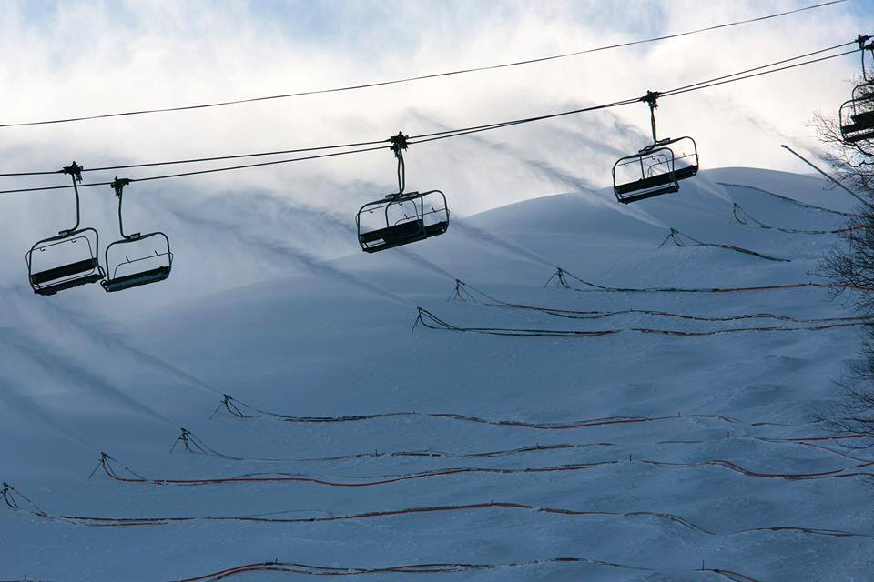
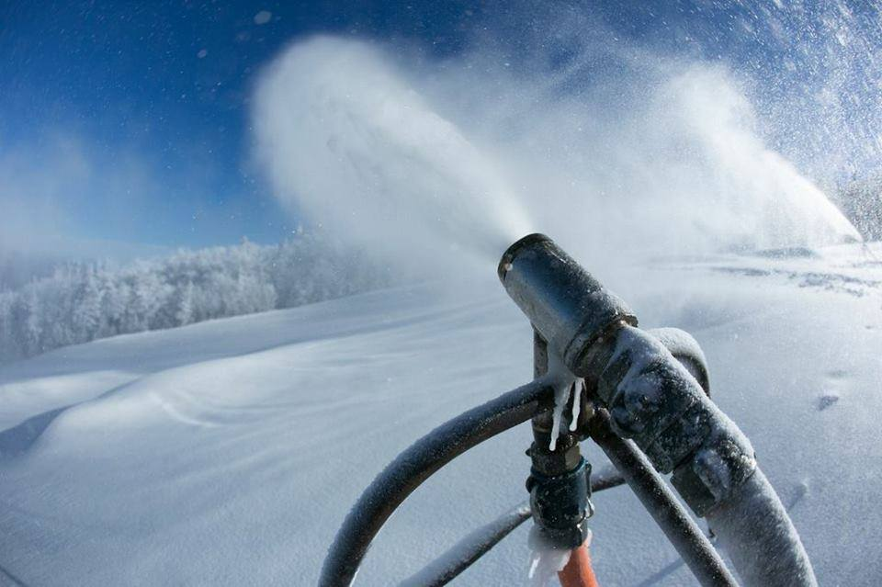
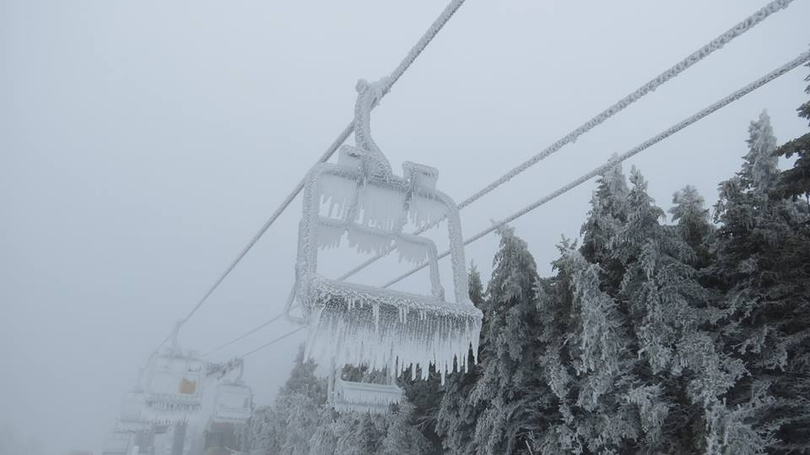
Notes:
Weather is our business! New England ski areas rely on accurate forecasting for a number of business-related decisions. Most importantly, scheduling snowmaking operations. But also for staffing, and predicting anticipated skier/snowboarder attendance. For instance, if a Nor'easter is rolling into Boston on a Friday night, Saturday numbers may drop significantly just because folks don’t want to drive through the storm. However, it means that Sunday could be much busier than originally anticipated.
But … depending upon the storm track, as we so often see here in New England, it could all go South in a big hurry (Iced Chairlift image). It took more than 8 hours of hammering to remove all the ice from this lift and return it to normal operation. Add in snowcat time for re-grooming, and that’s a closed lift and numerous trails for an entire day.
How do resorts forecast? They use a number of tools. From on-mountain Weather Stations – including on-board weather stations now built into snowguns, or contracted weather forecasting, and ... reading, listening an watching the forecasts that those of you in this room produce.

Slide 7
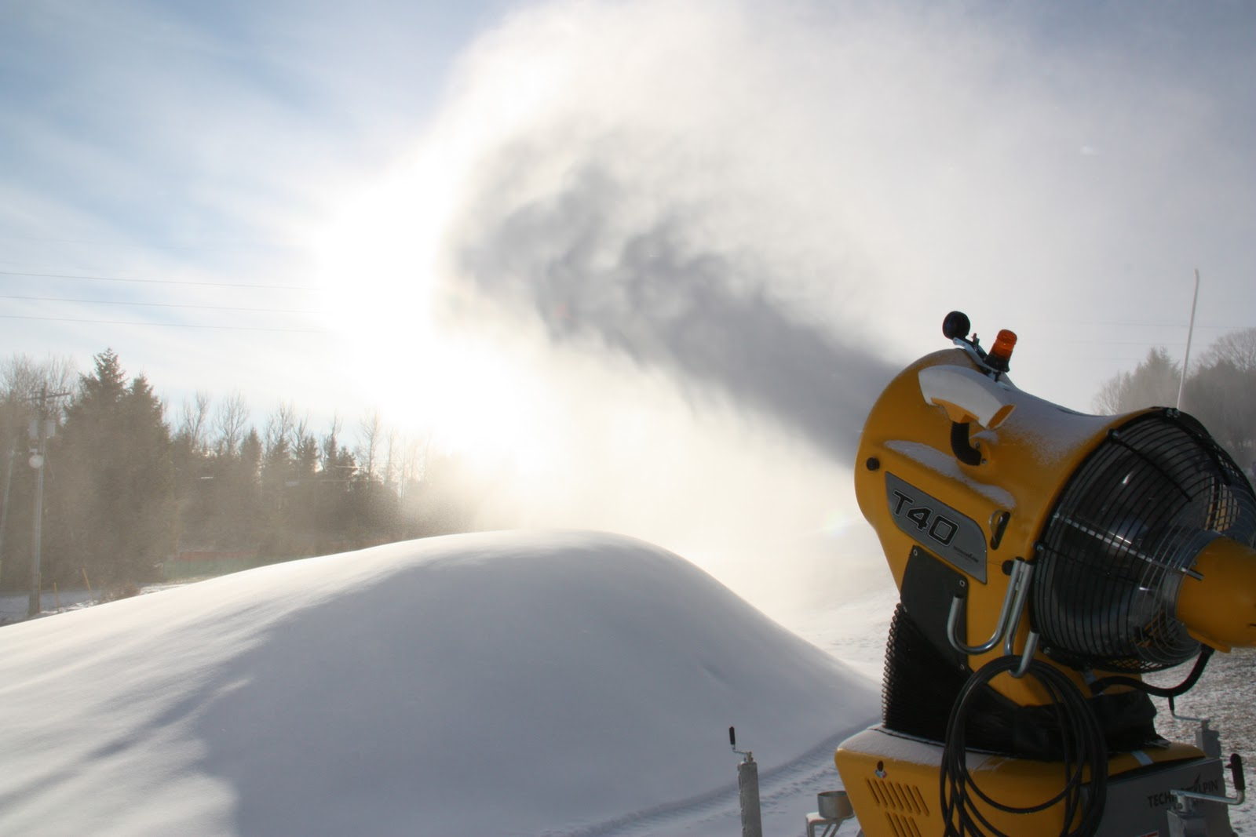
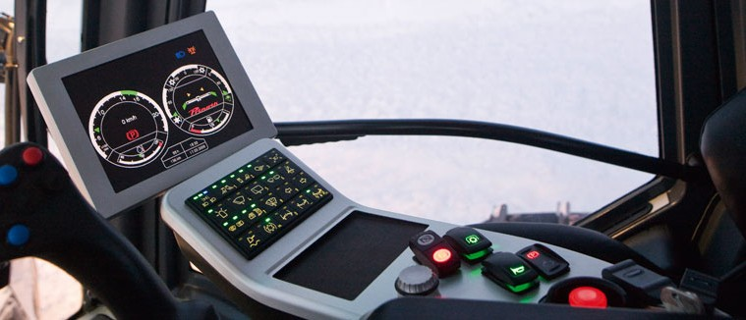
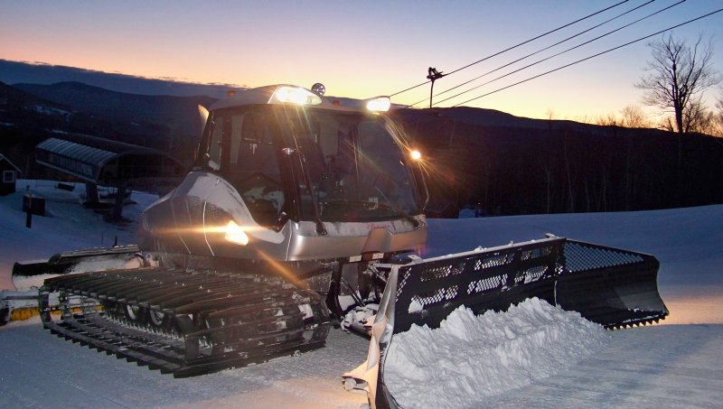
Combating the Weather
Snowmaking & Grooming
Notes:
Ski areas and the mountain environments provide ideal locations for meteorologists to use for informative weather-related stories on how to dress appropriately; unique outdoor jobs; the science of snowmaking; and snow grooming technology just to name a few. Ski Resorts have a number of tools at their disposal for combating weather situations, and are always more than happy to provide a tour to visiting meteorologists. Operationally, snowmaking has become more energy efficient and new technology has allowed resorts to make more snow in variable conditions – and it’s quite a science, especially when a resort is balancing energy demands on the grid, temperatures, humidity and wind sped and direction. Grooming technology has advance just as fast as snowmaking technology, with GPS enable snowcats outfitter with depth-finders for placing, sculpting and finishing off the snow surface. Resorts across New England have invested millions of dollars in these tools and are always eager to show them off. So always feel free to reach out and ask when you visit.

Slide 8
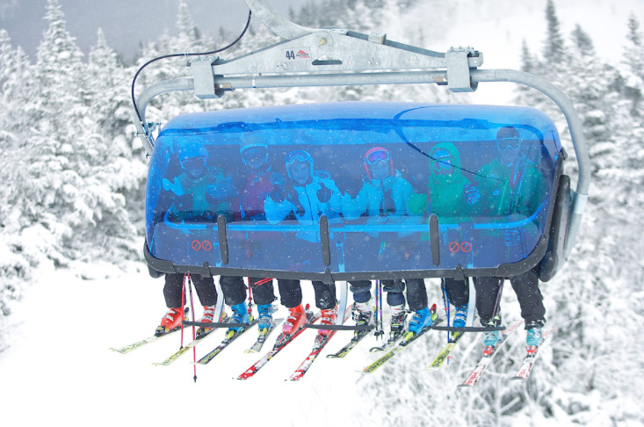
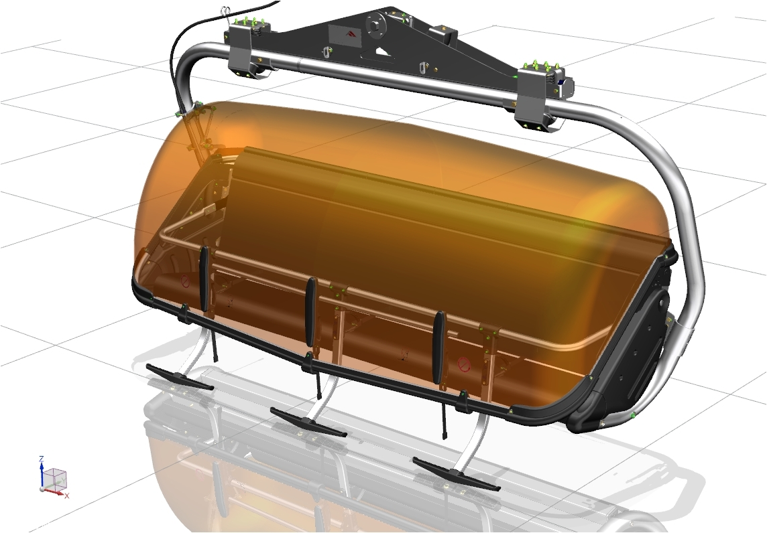
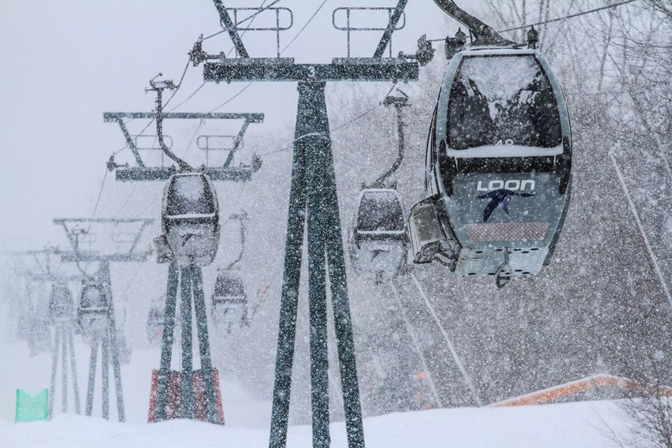
Combating the Weather
Gondolas & Bubble Chairs
Notes:
From a guest standpoint, the biggest advancement has been enclosed lifts, such as Gondola and covered chairs. While a number of resorts throughout New England have gondola’s – including Stratton, Stowe and Killington in Vermont; Sunday River in Maine, and Loon Mountain in New Hampshire among others, the Bubble Chair is quickly become a favorite among skiers and resorts, due to the fact that you don’t have to remove your equipment. Mount Snow installed the Blue Bird Express a few season’s back, and this summer Okemo upped the Bubble Chair game with a new six-seat lift that features heated seats! If you haven’t had the chance to visit a resort and check out just how one of these lifts work, check it out this winter. Again, resorts are always eager to show how these things work.

Slide 9
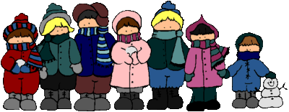
Resorts have invested Millions …
So Why Aren’t More People Skiing?
Price?
Afraid of injury?
Don’t like winter?
Too cold?
Too much snow?
Notes:
There are a number of reasons when folks don’t ski or ride. Winter is the bastard step-child of the seasons. Summer gets all the glory – lather up the sunscreen, head outside and soak up the warmth. Spring is a sure sign summer is coming… and fall throughout New England is lit up with Mother Nature’s fireworks. But Winter … it’s too cold, too snowy, too this and too that. But just like you apply sunscreen before heading outside in the summer, folks need to layer up before heading outside to enjoy winter. And that is the key message … dress FOR winter to get outside and enjoy it!

Slide 10
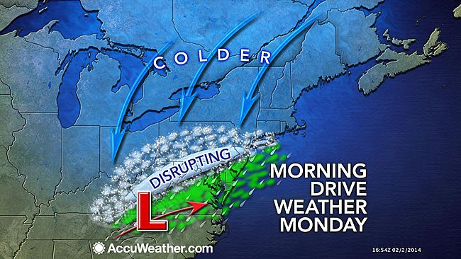
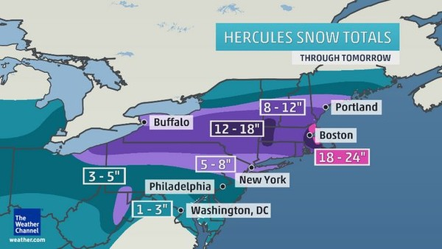
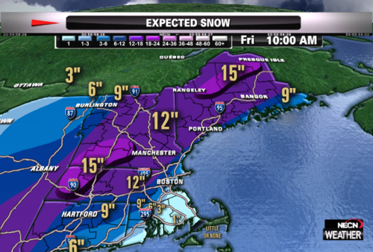
How Best To Present Winter!
Notes:
So how do we best present winter? Or have we over-sensationalized the weather and its just too late? We have 24-hour weather channels, weather apps at our fingertips and weather making headlines everyday. But it is how we present winter weather that has huge implications on how the public perceives winter. Why to we present winter as a cruel, cold, and dangerous excuse not to go outside? If we’re spending $4 Billion on skiing, snowmobiling and winter activities in New England, it can’t be all that bad ... right?

Slide 11
Game Changer?
Notes:
Who knows what this is? If you have an iPhone 6 or a Samsung Galaxy smartphone, you have a mini-weather station in your pocket. Will smartphones with build in barometers have a similar impact on weather forecasting they way they have with real-time traffic data? In a few years there will be at least 100 millions smartphones over North America with pressure sensors. This technology will have significant impact on weather forecasting … especially in Northern New England! Currently, outside of the major metro areas, there are very few pressure observation stations in Northern New England. But … when you get thousands of tech-savy skiers and riders on the slopes, you will have access to an extraordinary density of pressure observations from Mount Snow Vermont, to Cannon Mountain, New Hampshire and all the way up to Sugarloaf, Maine. This latest generation of Smartphones, and the skiers and riders who use them, has the potential to describe small scale atmospheric structures to predict key weather features. PressureNet is a mobile app currently available for Android phones, and currently in Beta Testing for iPhones.

Slide 12
Where do we go from here?
Plan/dress for winter weather!
Encourage outside play!
Go skiing!
Enjoy Winter!
Weather Scholarship
Notes:
Two-way communication between the New England meteorology community and the ski industry is critical so both sides have a clear understanding of how the weather information is presented to the public, so they can make factual and safe decisions on how they may wish to spend their leisure time during the winter – be it driving, skiing, sledding, snowmobiling, making a snowman! Remember, winter activities represent more than $4 billion in economic impact. Resorts have numerous tools from weather stations, to webcams, to story ideas on how to dress for the weather and get outside and enjoy it. Ski Resorts are in the Weather Business, we need snow, we need cold … but remember this, it’s never too cold to ski … and there is no such thing as poor weather … only dressing poorly for the weather!
Finally, the 73 ski areas in New England will be funding a Meteorology scholarship for the 20115-16 school year and beyond. We will be forming a committee of Meteorology professionals and resort representatives to build, review applications, and award recipients. If you are interested, please stop by our booth. Thank you.

