Slide 1
Rediscovering the Dew Point
Milton MA
October 24, 2015

Slide 2
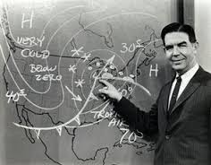
Don Kent – WBZ, Channel 4
Bob Copeland – WHDH/WCVB, Channel 5

Slide 3
Dew Point : The temperature to which the air would have to cool in order to reach saturation.
The temperature to which a given air parcel must be cooled at constant pressure and constant water vapor content in order for saturation to occur. (AMS Meteorology Glossary)

Slide 4
Project Objectives
Create a Database of Dew Point Averages and Extremes for each Day of the Year.
Use six long-term climate sites in Southern and Central New England.
Make this information available to all.

Slide 5
Step 1: Get Data at Climate Data Online ww7.ncdc.noaa.gov/CDO/dataproduct/

Slide 6
…and Import Data into EXCEL
Six major climate sites in Southern New England:
Boston, Worcester, Warwick,
Windsor Locks, Bridgeport, Concord NH.
For each site, there are well over
400,000 observations from the
late 1930’s to 2014

Slide 7
Step 2 : Quality Control / Assurance
Data problems :
Human mismeasurements
Broken equipment
“Dirty mirror”
Solution: Write program within EXCEL
Look for large hourly jumps in the dew point value
Outlier long-term high & low values for Calendar Day
Compare outlier events with dew points at surrounding sites

Slide 8
Erroneous Data Worcester MA May 9, 2000
Time (GMT) | ORH |  |  | BED | FIT | ORE | CEF | BAF | BDL
0954 | 65 |  |  | M | M | 63 | 59 | 63 | 63
1054 | 67 |  |  | M | M | 63 | 61 | 63 | 64
1154 | 68 |  |  | M | M | 63 | 63 | 66 | 64
1254 | 71 |  |  | M | M | 64 | 64 | 64 | 65
1354 | 72 |  |  | M | M | 64 | 64 | 64 | 65
1454 | 74 |  |  | 66 | M | 64 | M | 63 | 63
1554 | 77 |  |  | 66 | 63 | 64 | 59 | 63 | 63
1654 | 75 |  |  | 64 | 63 | 63 | 57 | 63 | 65
1800 | 84 |  |  | 63 | 63 | 63 | 57 | 63 | 65
1854 | 84 |  |  | 64 | 63 | 61 | 57 | 63 | 64

Slide 9
Erroneous Data Worcester MA May 9, 2000
Time (GMT) | ORH | Regional Average |  | BED | FIT | ORE | CEF | BAF | BDL
0954 | 65 | 62 |  | M | M | 63 | 59 | 63 | 63
1054 | 67 | 63 |  | M | M | 63 | 61 | 63 | 64
1154 | 68 | 64 |  | M | M | 63 | 63 | 66 | 64
1254 | 71 | 64 |  | M | M | 64 | 64 | 64 | 65
1354 | 72 | 64 |  | M | M | 64 | 64 | 64 | 65
1454 | 74 | 64 |  | 66 | M | 64 | M | 63 | 63
1554 | 77 | 63 |  | 66 | 63 | 64 | 59 | 63 | 63
1654 | 75 | 63 |  | 64 | 63 | 63 | 57 | 63 | 65
1800 | 84 | 62 |  | 63 | 63 | 63 | 57 | 63 | 65
1854 | 84 | 62 |  | 64 | 63 | 61 | 57 | 63 | 64

Slide 10
Step 3 : Statistics to be Used
Temperature
Daily High and Low
Calculate Average
Long Term Values
Record High and Low
Long Term Daily Average

Slide 11
Step 3 : Statistics to be Used
Dew Point
Daily High and Low
Calculate Daily Average
Long Term Values for each Calendar Day
Extreme High and Low
Long Term Daily Average
 | January 2, 1995 | January 2, 2000 | January 2, 2005
Highest Dew Pt | 40 | 50 | 29
Average Dew Pt | 35 | 45 | 22
Lowest Dew Pt | 30 | 40 | 15

Slide 12
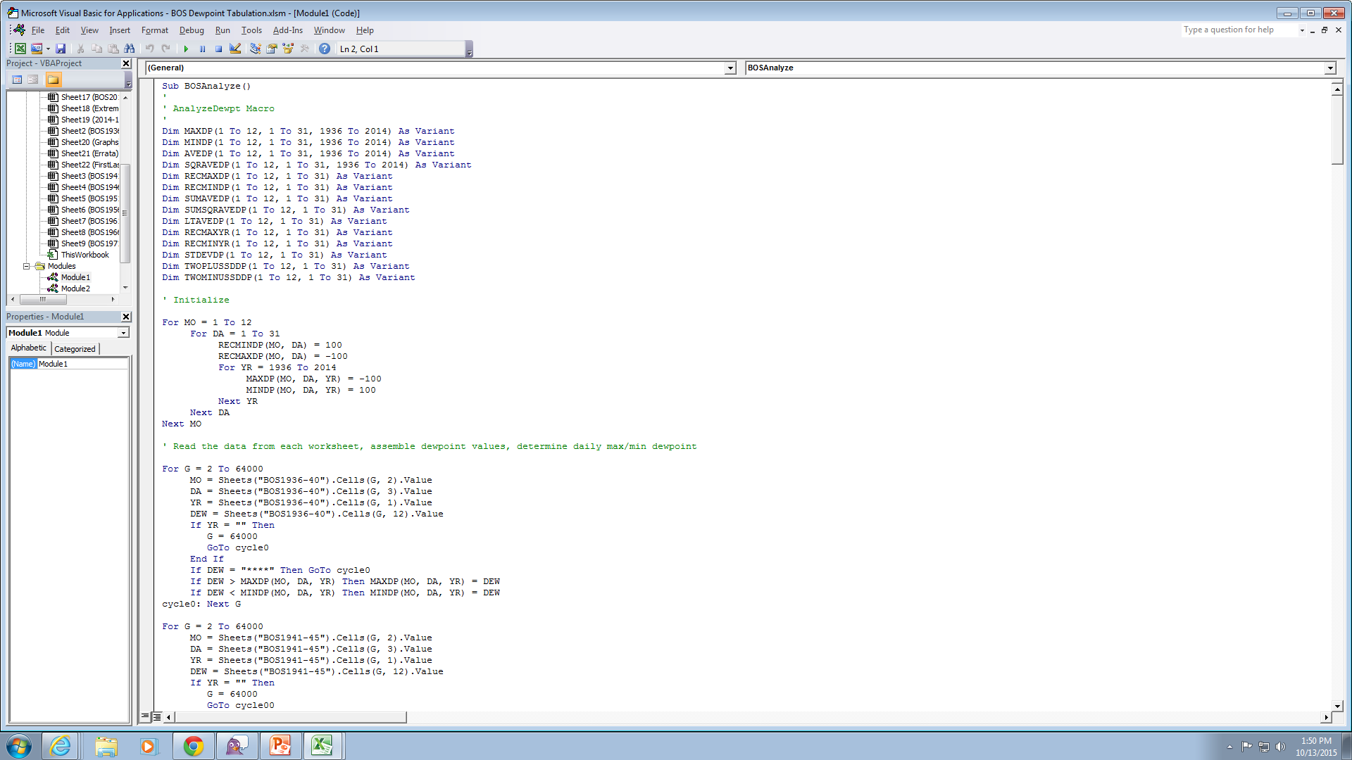
Step 4 : Analyze the EXCEL Data

Slide 15
Equations for Average Dew Points
Boston:
y = 39.51 - 19.3 * cos(2π(DOY)/366) - 10.2 * sin(2π(DOY)/366)
Providence-Warwick
y = 39.98 - 19.6 * cos(2π(DOY)/366) - 10.4 * sin(2π(DOY)/366)
Windsor Locks
y = 38.74 - 20.7 * cos(2π(DOY)/366) - 10.3 * sin(2π(DOY)/366)
Bridgeport
y = 41.53 - 19.7 * cos(2π(DOY)/366) - 10.5 * sin(2π(DOY)/366)
Worcester
y = 36.58 - 20.2 * cos(2π(DOY)/366) - 10.5 * sin(2π(DOY)/366)
Concord NH
y = 35.90 - 21.3 * cos(2π(DOY)/366) - 10.4 * sin(2π(DOY)/366)

Slide 16
NWS Taunton Dew Point Climatology
www.weather.gov/box/dewpointclimo

