Slide 1
Weather Emergency Room
Saving Lives, Minimizing Damage
Elliot Abrams, CCM
AMS Fellow
Sr Vice Pesident
Chief Forecaster
AccuWeather, Inc.

Slide 2
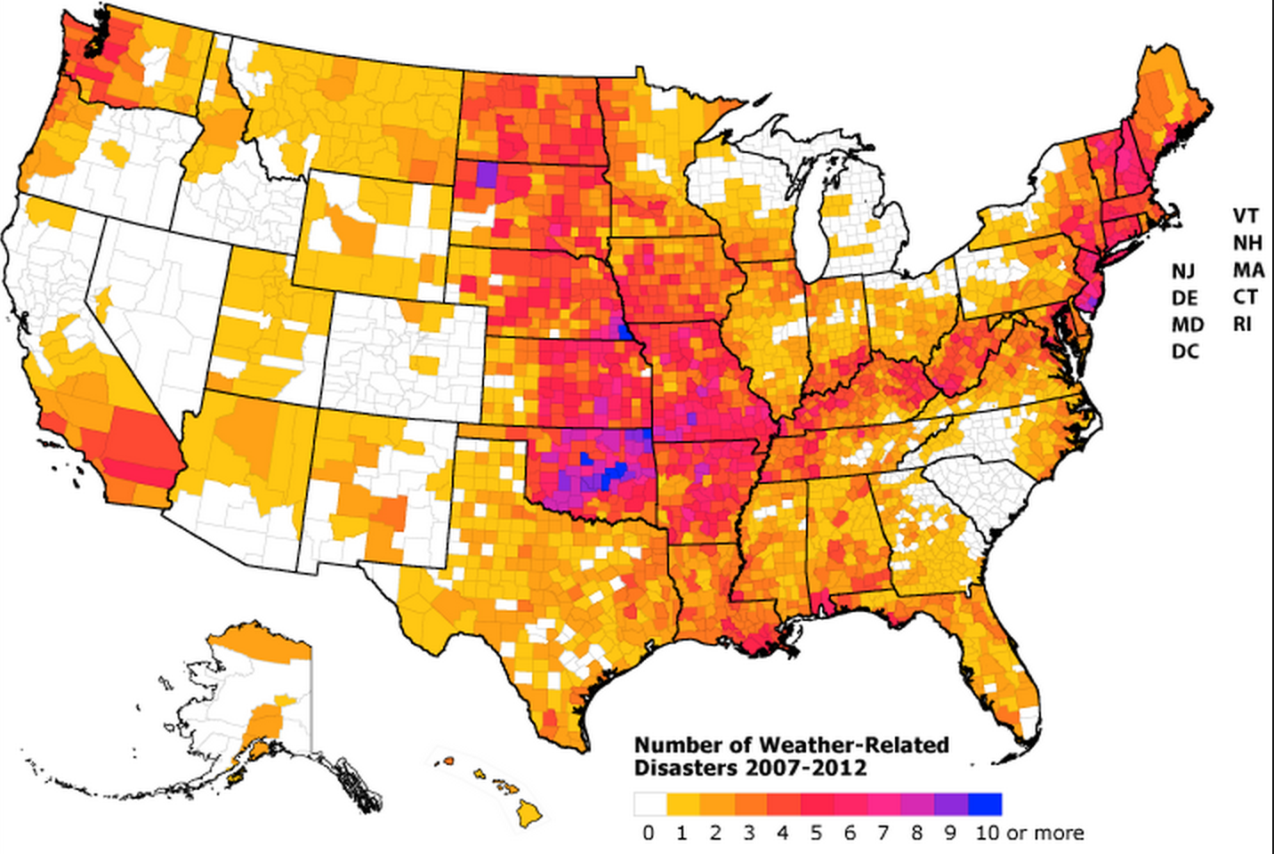

Slide 3
Each Year (on average) the United States Experiences:
100,000 thunderstorms
…10,000 severe
1,000 tornadoes
5000 floods
2 landfalling deadly hurricanes
as well as
Fog, smog, snow squalls, freezing drizzle, frost, rapid temperature changes, stifling heat, hyperborean cold, high winds, wild fires, rush hour sun glare, sudden showers, whiteouts, street flooding, uncertainty in forecasting, social media assistance …and threat… … …

Slide 4
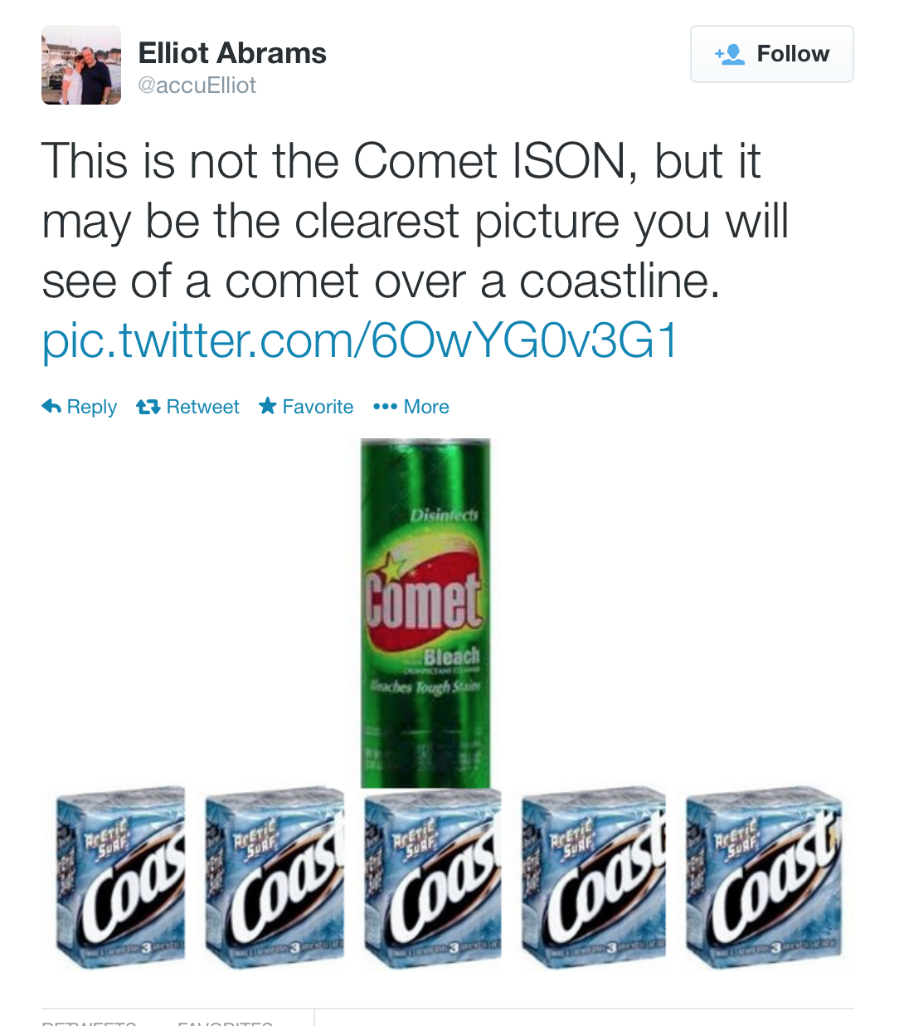

Slide 5
Most forecasts, whether for severe or routine events, short term or long range are issued for areas and populations, but do not directly target a specific person, activity or task*.

Slide 6
* Some forecasts are issued for specific groups and/or events/venues, etc.
But, the issuing person, firm or agency may not know what info each individual or group needs:
It’s just put out there.
Workers at events have varying roles and potentially different management structures.
How do you know if the most useful information reaches those who can actually use it.
Key details may or may not get through to those who must make critical decisions
Decision makers may not recognize the implications of what is being forecast. Actionable items, urgency???

Slide 7
When a well qualified meteorological consultant works with an engaged and proactive customer, limitations can be mitigated or removed.

Slide 8
Example: Two Winters Ago and the Polar Vortex

Slide 10
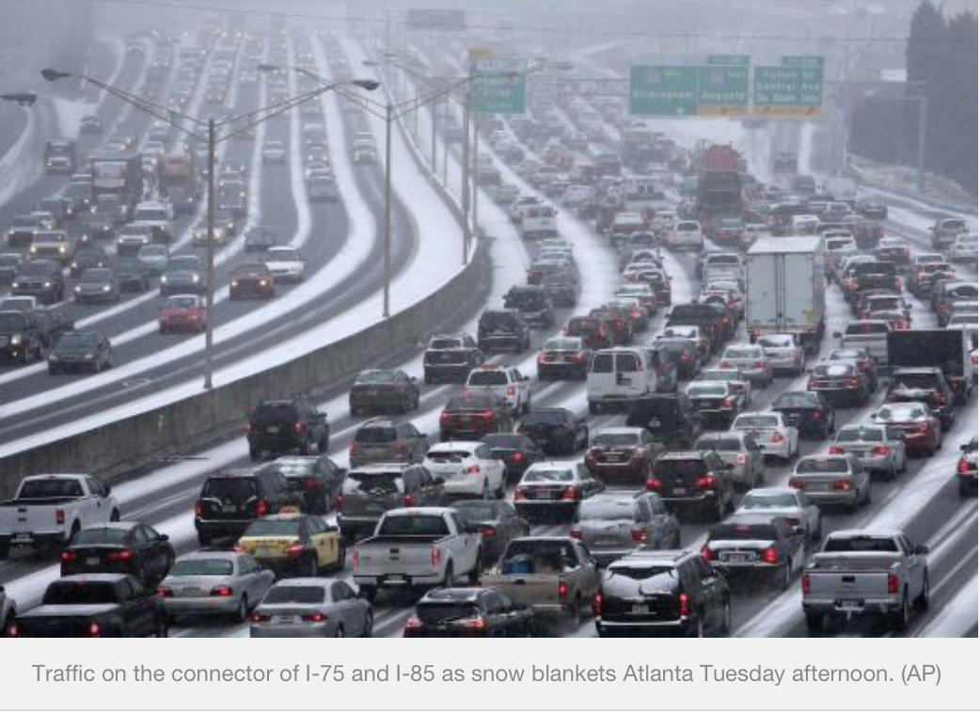

Slide 11
Sudden Trouble

Slide 12
After blaming bad forecasts for Atlanta’s gridlock nightmare in a 2 inch snow storm on January 28, 2014 Governor Nathan Deal announced he was appointing a severe weather warning and preparedness task force.
What do you think?
What kind of experts should be on such a board?
Role of Local Governments
Role of America’s Weather Enterprise?
How would they have done things differently?
What specific objectives and milestones should they set?
How should they measure success / failure?
Other questions?

Slide 13
Data Sources Explode
Conventional text data
Ubiquitous model availability
Twitter and Facebook observations
Web cams
Lightning maps
Advanced radar imagery, dual-pol advances in such things as identifying different types of precipitation.
Innovative IR scales to highlight clouds that were poorly detected
Public, private and hybrid surface data

Slide 16
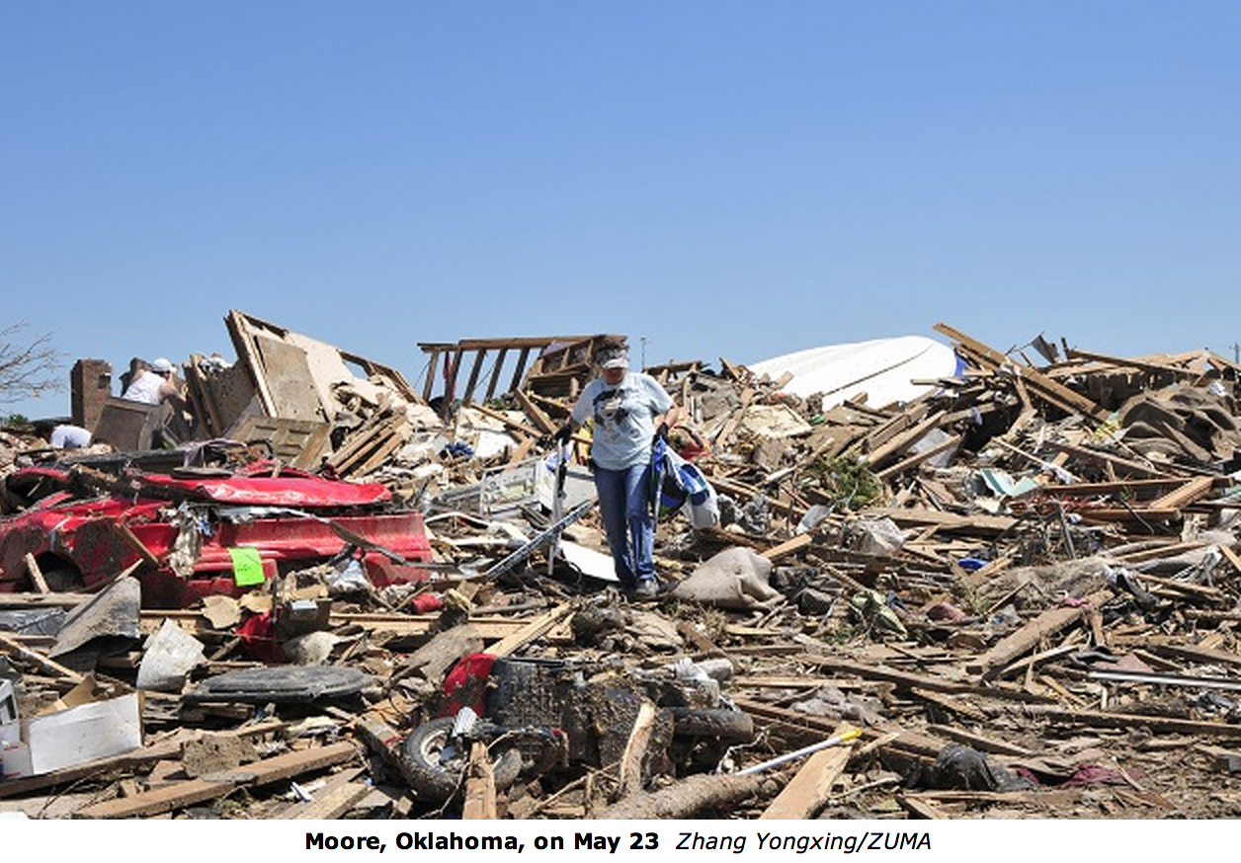

Slide 17
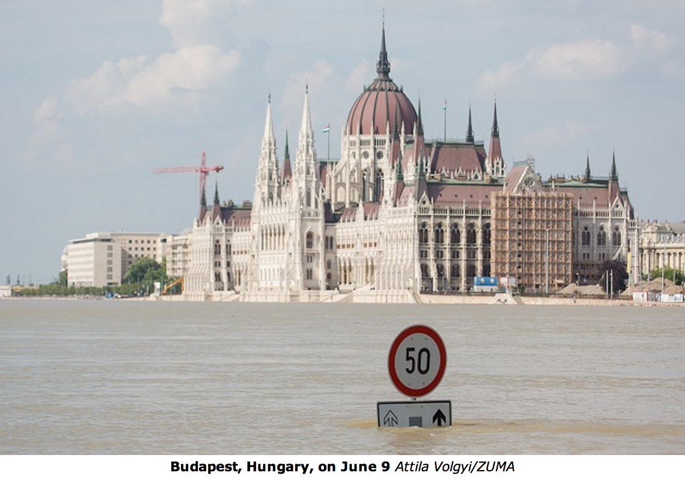

Slide 18
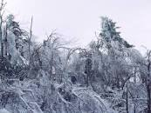
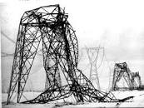
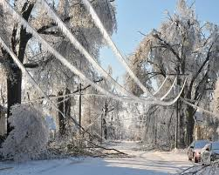
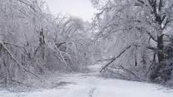
Ice Storms

Slide 19
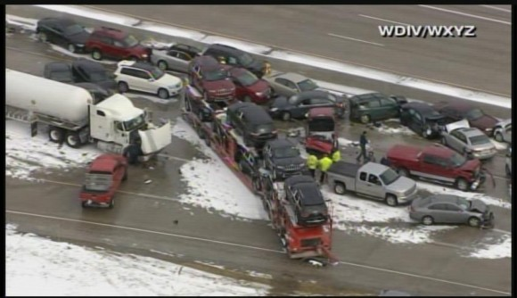
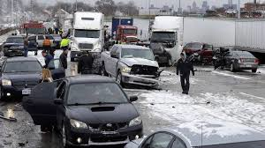

Slide 20
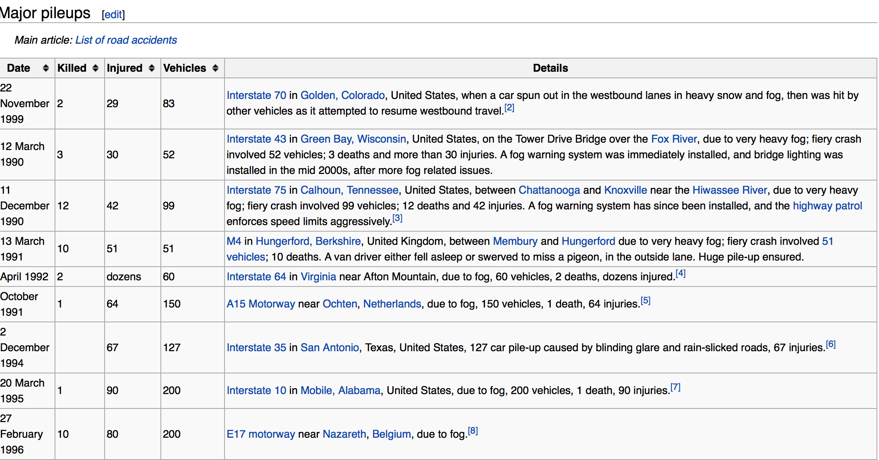

Slide 21
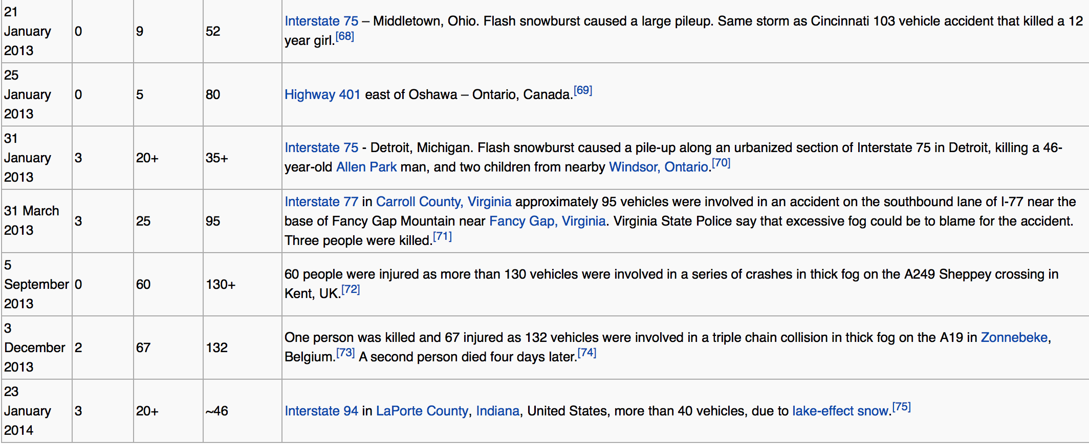

Slide 22
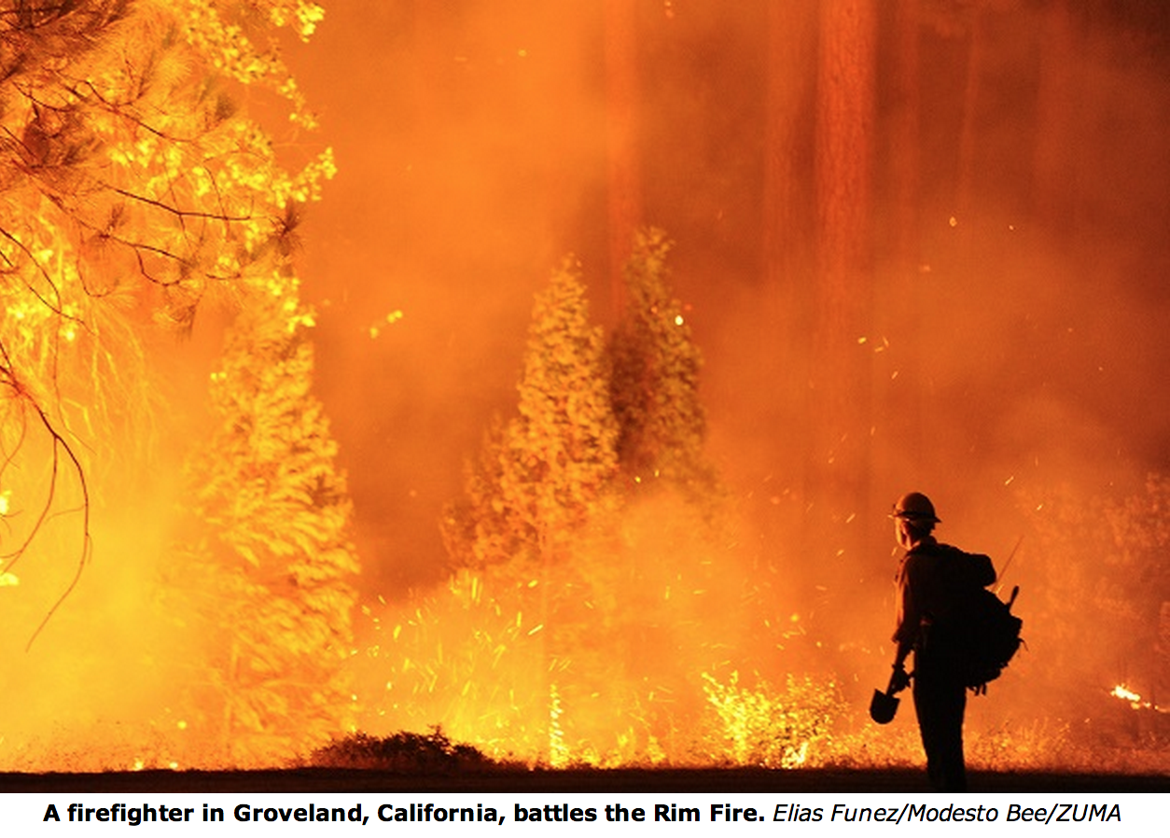

Slide 23
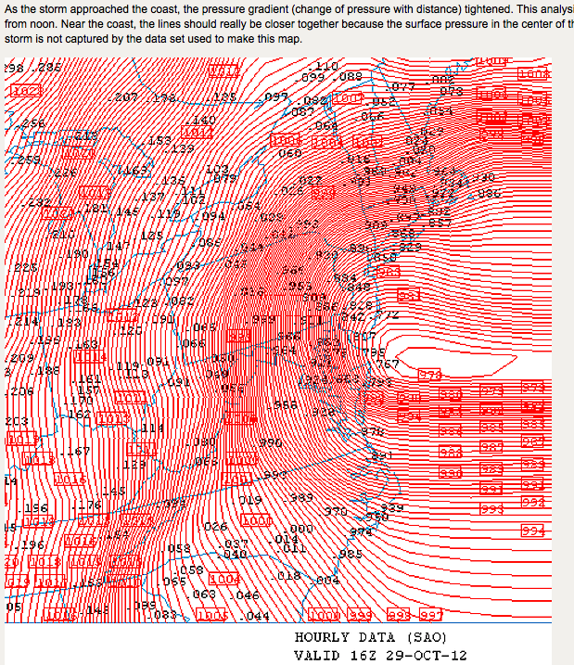

Slide 24
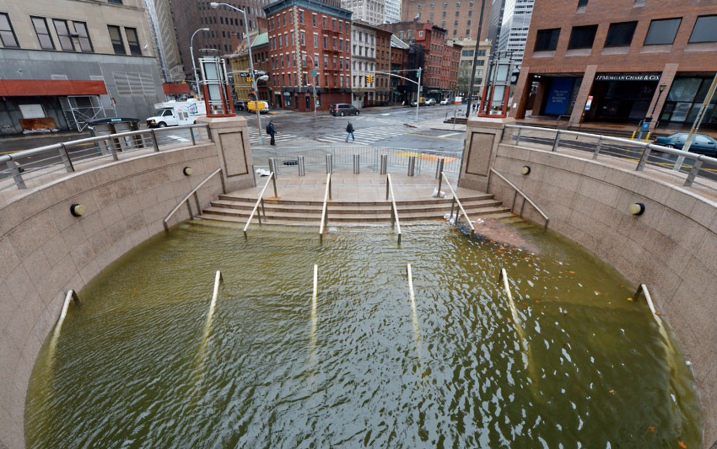
Nature Rules!

Slide 25
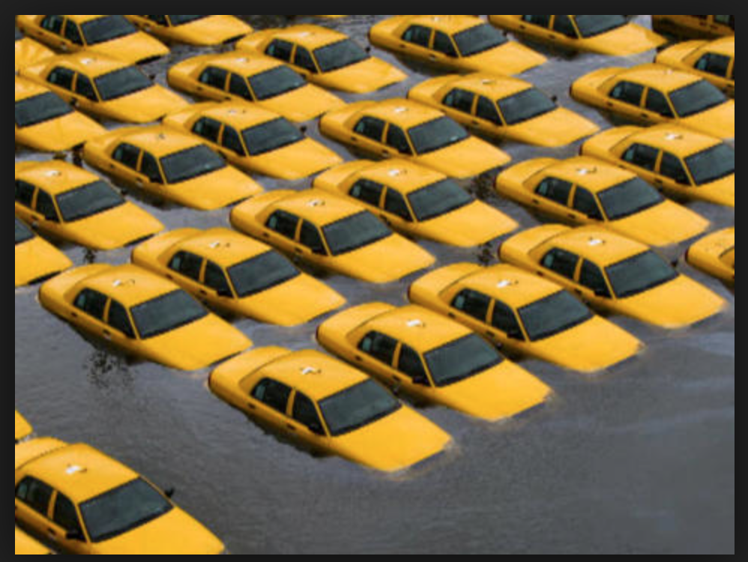
Nature Rules!

Slide 29
We Have Come A Long Way

Slide 30
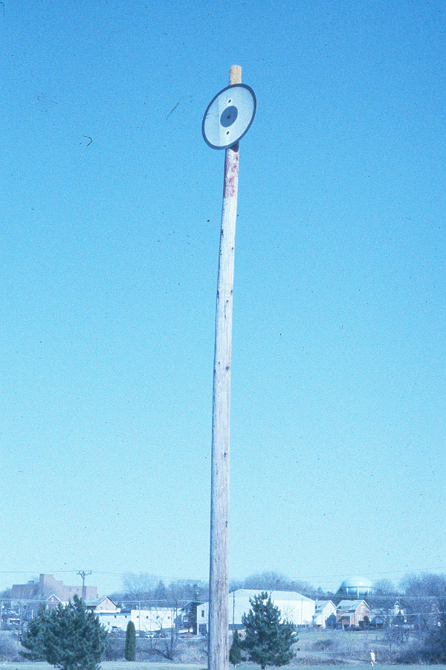

Slide 31
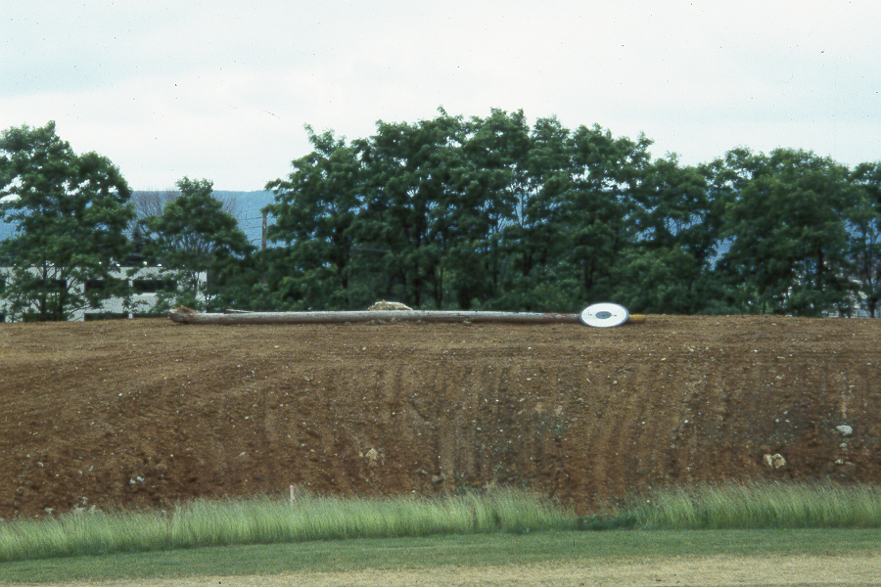

Slide 32
Summary
Convergence of ability to accurately predict and ability to change more details of an operation in less time. Slice and dice.
Potential for individual businesses, Local and state governments to obtain tailored forecasts at an acceptable cost
In an emergency, increased capability to adjust immediate term forecasts allows decision makers to make mid-course corrections in very little time.
Mitigate what cannot be prevented or diverted.

Slide 33
Success Requires
Pre-planning with staff and customers
Set performance expectations
Your capabilities must match agreed-on customer expectations
Recognize and disclose limitations
Establish rapport and communication with customers and colleagues.
Ability to think and act quickly when lives and property are on the line. If you offer a service, can you deliver?
Ability to to establish and enhance commercial viability

Slide 34
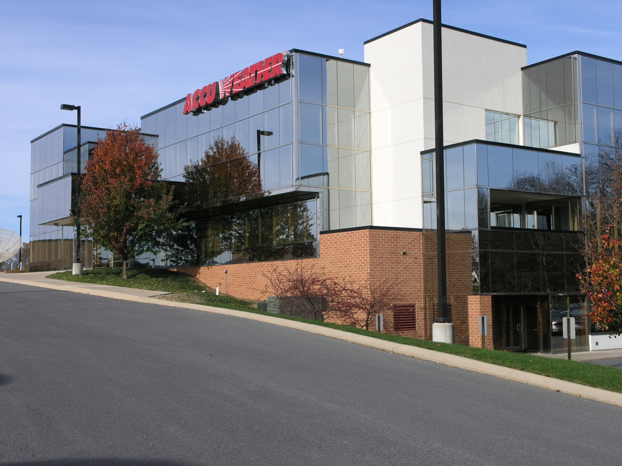

Slide 35
