Slide 1
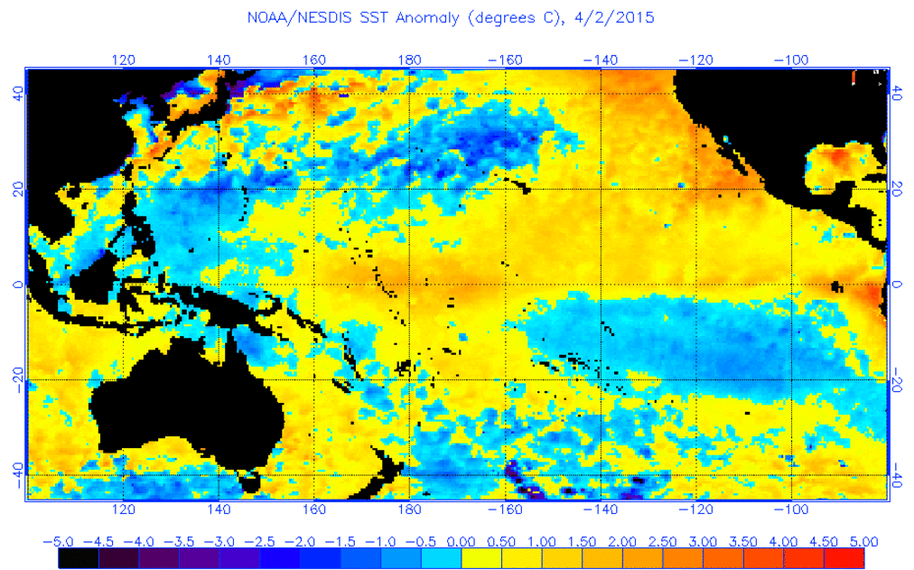
Examining Major El Nino Events: Impacts on Precipitation and Flood Potential in the Northeast United States
David R. Vallee Hydrologist-in-Charge NOAA/NWS/Northeast River Forecast Center
david.vallee@noaa.gov http://weather.gov/nerfc

Slide 2
Major ENSOs in the Northeast
Overview of “What it is”
Examining the “many faces” of ENSO
Variations in Precipitation Departures
Impacts on Flood Potential

Slide 3
So What Is the El Nino/Southern Oscillation?
A recurring climate pattern involving changes in the temperature of waters in the central and eastern tropical Pacific Ocean and the patterns of sea level pressure, lower- and upper-level winds, and tropical rainfall across the Pacific basin.
On periods ranging from about two to seven years, the surface waters across a large swath of the tropical Pacific Ocean warm or cool by anywhere from 1°C to 3°C, compared to normal.
This irregular oscillation between warm and cool patterns, referred to as the ENSO cycle, directly affects rainfall distribution in the tropics and can have a strong influence on weather across the United States and other parts of the world.
El Niño and La Niña are the extreme phases of the ENSO cycle; between these two phases is a third phase called ENSO-neutral.

Slide 4
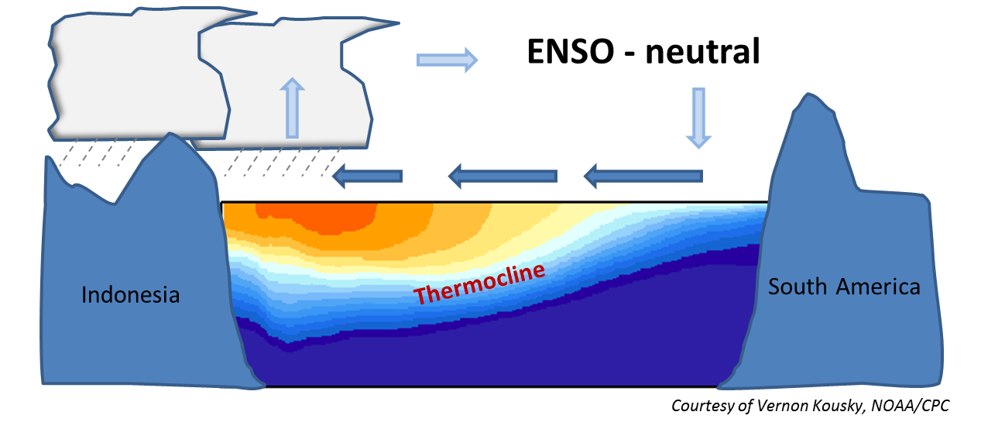
Normal Conditions
Normally, strong trade winds blow from the east along the equator, pushing warm water into the western Pacific Ocean.
Notes:
Ocean surface temperatures across the tropical Pacific contribute significantly to the observed patterns of tropical rainfall and tropical thunderstorm activity. The heaviest rainfall is typically observed across Indonesia and the western tropical Pacific, and lightest rainfall is normally found across the eastern equatorial Pacific.
The mean patterns of sea surface temperature and equatorial rainfall are accompanied by low level easterly winds (east- to- west flow) and upper level westerly winds across the tropical Pacific. Over the western tropical Pacific and Indonesia this wind pattern is associated with low air pressure and ascending motion, while over the eastern Pacific it is accompanied by high pressure and descending motion. Collectively, these conditions reflect the equatorial Walker Circulation, which is a primary large-scale circulation feature across the Pacific.
The subsurface ocean structure is characterized by a deep layer of warm water in the western tropical Pacific, and by a comparatively shallow layer of warm water in the eastern Pacific. This warm water is separated from the cold, deep ocean waters by the oceanic thermocline, which is normally deepest in the west and slopes upward toward the surface farther east. The resulting east-west variations in mean upper-ocean temperatures result in east-west variations in sea level height, which is higher in the west than in the east.
The thermocline is the area of transition between the warmer surface waters and the colder, nutrient-rich water of the bottom in the deep ocean.

Slide 5
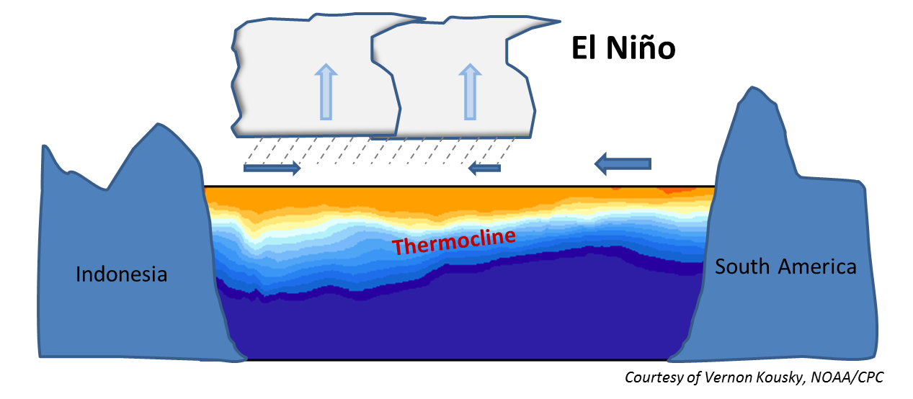
El Niño
El Niño conditions occur when abnormally warm waters accumulate in tropical latitudes of the central and eastern Pacific Ocean associated with a weakening of the low-level easterly winds. Consequently, tropical rains that usually fall over Indonesia shift eastward.
Notes:
El Niño episodes feature large-scale changes in the atmospheric winds across the tropical Pacific, including reduced easterly (east- to- west) winds across the eastern Pacific in the lower atmosphere, and reduced westerly (west-to-east) winds over the eastern tropical Pacific in the upper atmosphere near the tropopause. These conditions reflect a reduced strength of the equatorial Walker Circulation, which in strong El Niño episodes can be completely absent. During the developing phase of the El Niño, the subsurface ocean structure is characterized by an abnormally deep layer of warm water and an increased depth of the thermocline across the eastern tropical Pacific. Thus, the slope of the thermocline is reduced across the basin. In very strong El Niño episodes, the thermocline can actually become flat across the entire tropical Pacific for periods of several months. Accompanying these conditions, the sea level height is higher than normal over the eastern Pacific, resulting in a decreased slope of the ocean surface height across the basin.
The thermocline is the area of transition between the warmer surface waters and the colder, nutrient-rich water in the deep ocean.

Slide 6
La Niña Conditions
Trade winds are unusually strong blowing from the east along the equator, pushing warm water farther across the western Pacific Ocean.
La Niña conditions
Notes:
Ocean surface temperatures across the tropical Pacific contribute significantly to the observed patterns of tropical rainfall and tropical thunderstorm activity. The heaviest rainfall is typically observed across Indonesia and the western tropical Pacific, and lightest rainfall is normally found across the eastern equatorial Pacific.
The mean patterns of sea surface temperature and equatorial rainfall are accompanied by low level easterly winds (east- to- west flow) and upper level westerly winds across the tropical Pacific. Over the western tropical Pacific and Indonesia this wind pattern is associated with low air pressure and ascending motion, while over the eastern Pacific it is accompanied by high pressure and descending motion. Collectively, these conditions reflect the equatorial Walker Circulation, which is a primary large-scale circulation feature across the Pacific.
The subsurface ocean structure is characterized by a deep layer of warm water in the western tropical Pacific, and by a comparatively shallow layer of warm water in the eastern Pacific. This warm water is separated from the cold, deep ocean waters by the oceanic thermocline, which is normally deepest in the west and slopes upward toward the surface farther east. The resulting east-west variations in mean upper-ocean temperatures result in east-west variations in sea level height, which is higher in the west than in the east.
The thermocline is the area of transition between the warmer surface waters and the colder, nutrient-rich water of the bottom in the deep ocean.

Slide 7
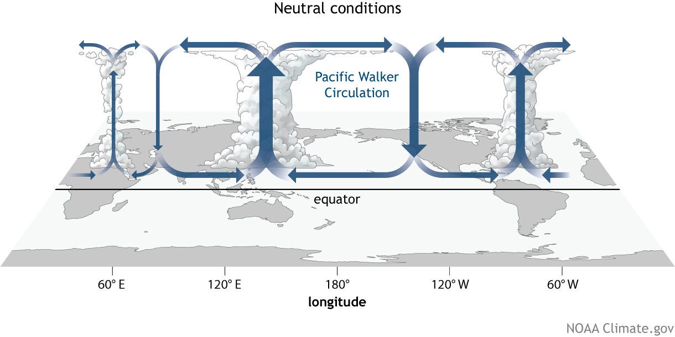
H
L
H
L

Slide 8
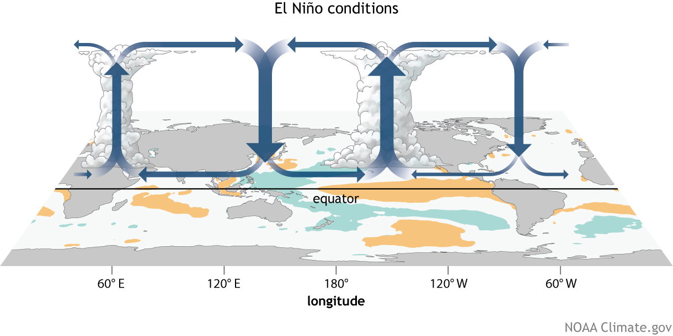
H
L
H

Slide 9
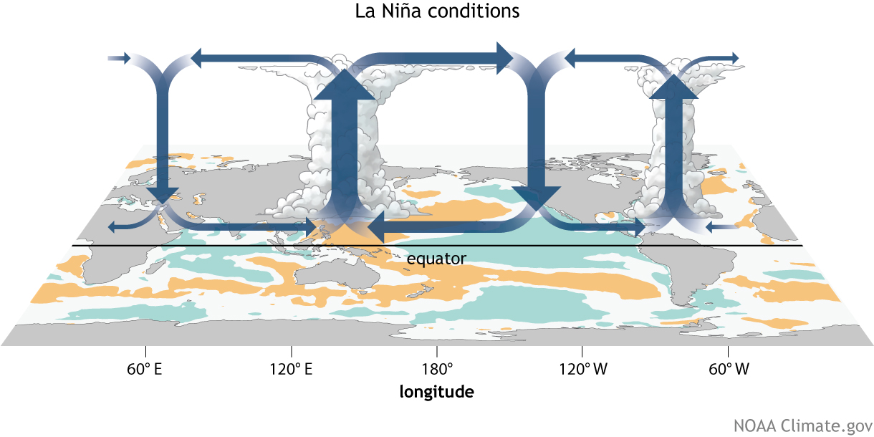
L
H
L

Slide 10
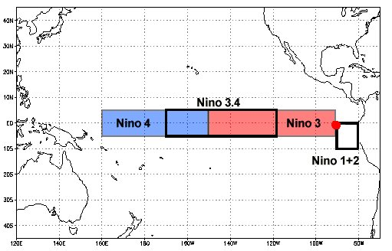
How do we tell what phase ENSO is in?
NOAA’s Climate Prediction Center has determined the average monthly sea surface temperature for a particular swath [5°N-5°S, 170°W-120°W] of the tropical Pacific Ocean by averaging measurements collected there over the 30-year period 1981-2010.
Scientists refer to that swath as the Niño 3.4 region. The observed difference from the average temperature in that region—whether warmer or cooler—is used to indicate the current phase of ENSO.
Other features that are also monitored include:
Upper level winds
Outgoing longwave radiation
Sea level pressure anomalies across the basin
Source: Climate.gov

Slide 11
All ENSO events are not alike
Bulletin of the AMS, vol 96, #6, June 2015

Slide 12
The Face of the 2015-16 El Nino

Slide 13
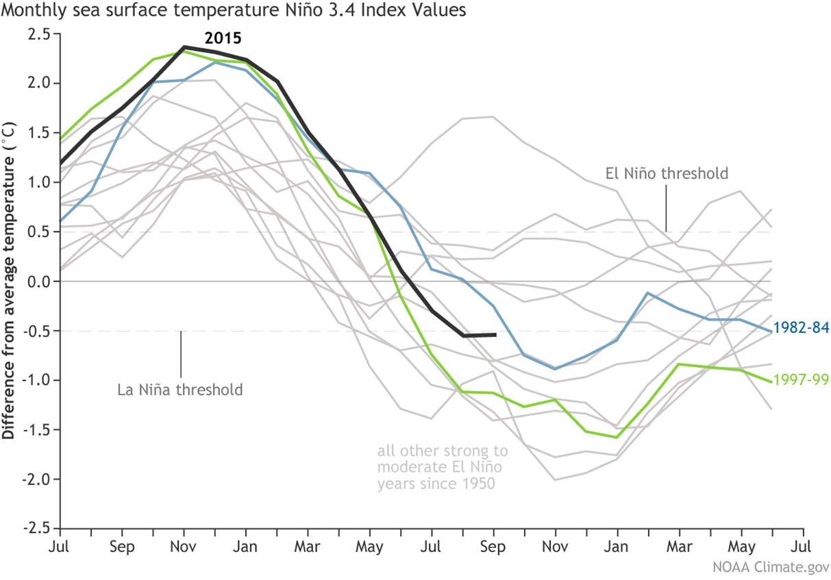
The 2015-16 event was on par with 1997 and 1982
Strong El Nino

Slide 14
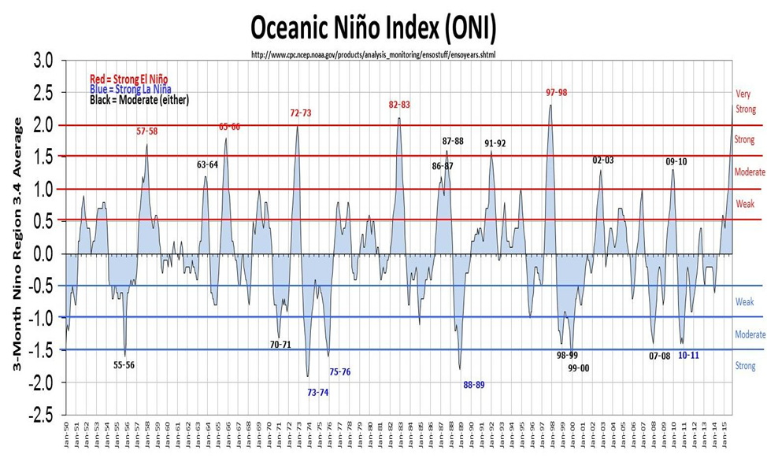

Slide 15
Local Study on Precipitation & Flood Frequency
Local research initiative to better define possible sensible impacts on precipitation and flood potential (winter/spring) across the Northeast
Premise: strongest possible correlations exist with the most significant ENSO events
Examined the top 5 warmest El Nino events
Calculated 3 month precipitation departures
Found several common theme
Dry late summer/fall
Below normal snowfall southeast New England and at or above normal inland
Wet late winter/spring
Increased spring flood potential
*One outlier year: 1965 – but the region was in the heart of its record 3 year drought!

Slide 16
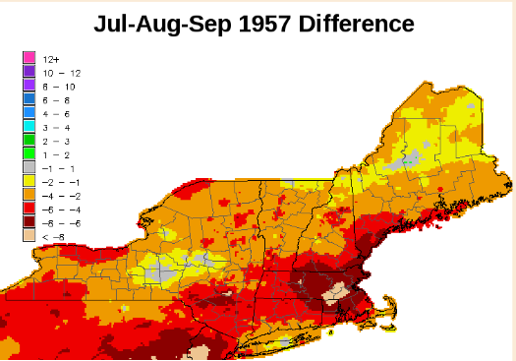

Slide 19
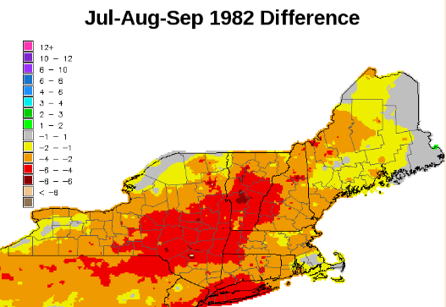

Slide 20
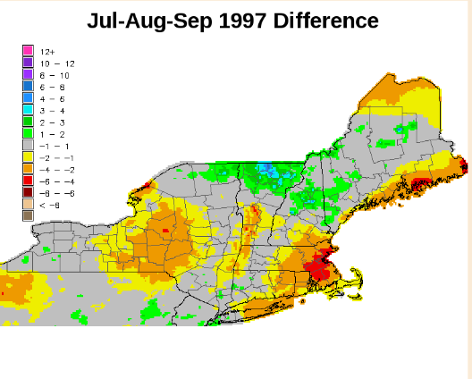

Slide 21
Winter Snowfall
Providence, RI
Boston, MA
Worcester, MA
Portland, ME
Burlington, VT

Slide 22
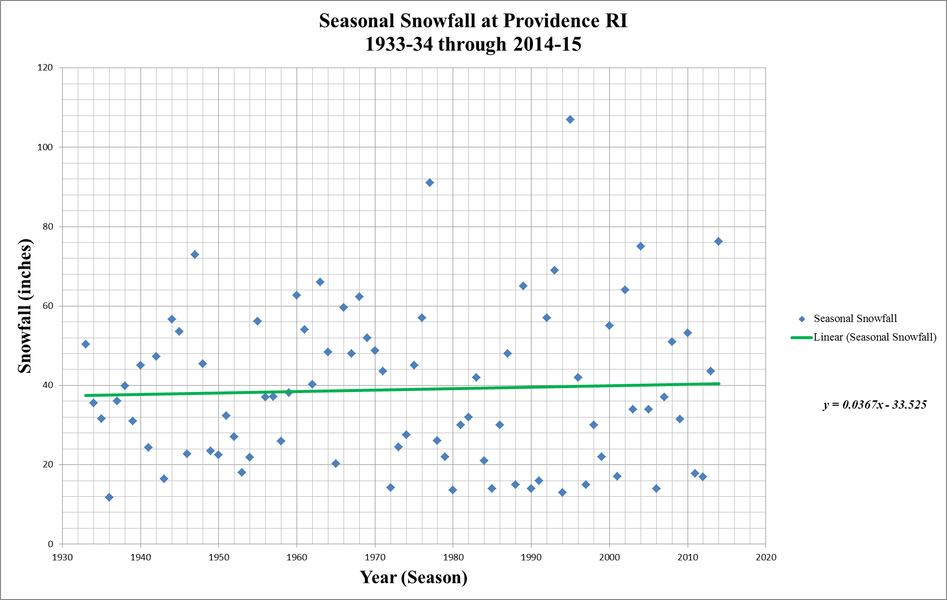
Below normal snowfall
Major ENSO season

Slide 23
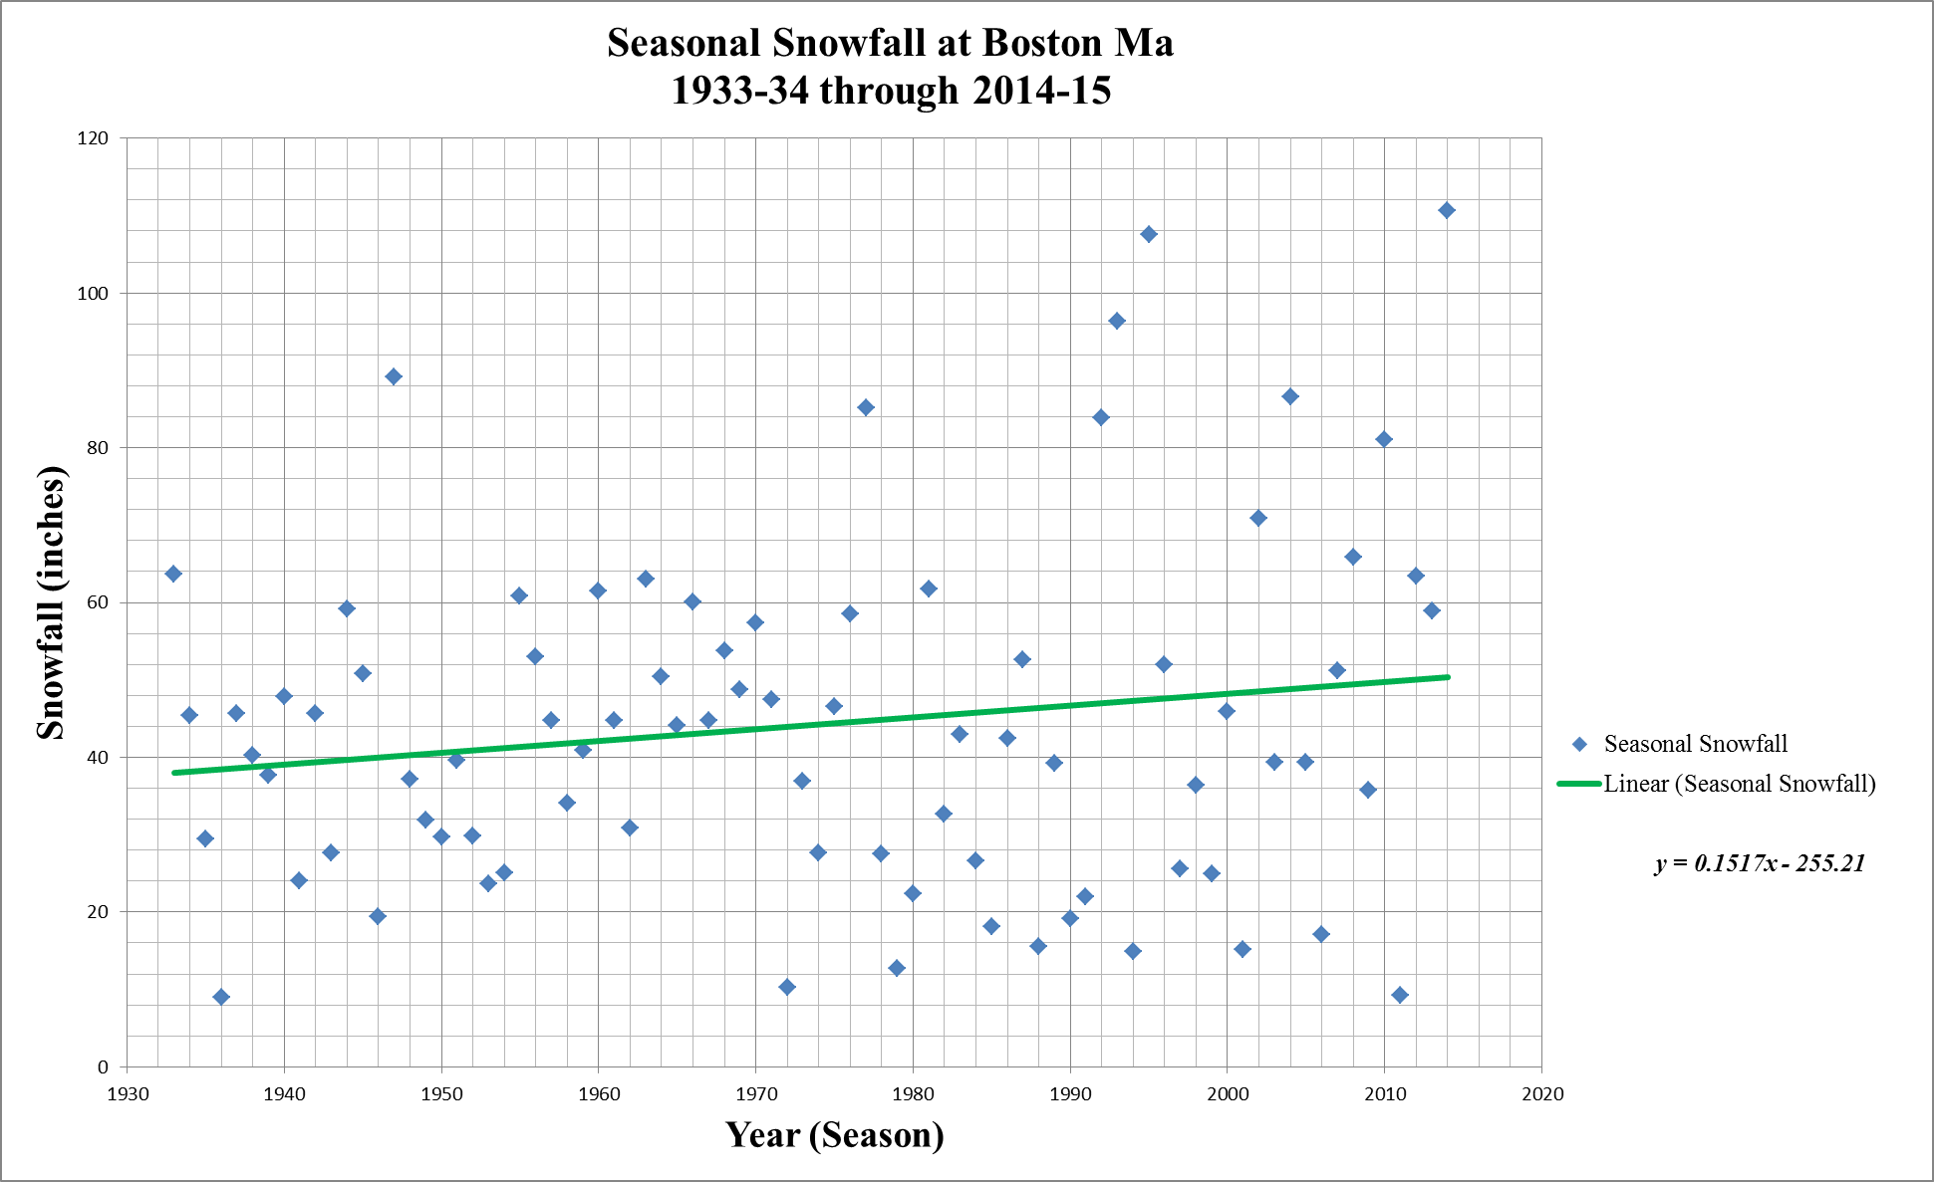
Below normal snowfall
Major ENSO season
Major ENSO season

Slide 24
Major ENSO season

Slide 25
Major ENSO season

Slide 26
Major ENSO season

Slide 27
Applying local research Albeit a very small sample size
Examined the top 5 warmest El Nino events
Calculated 3 month precipitation totals and departures from normal
Found several pronounced patterns
Dry late summer/fall
Milder than normal winter with below normal snowfall southeast New England and at or above normal away from the coast
Wet late winter/spring with an above to much above normal flood threat ??????

Slide 28
Flood Potential “Super-ENSO events >/= 1.7
Basin | Flood Potential (all categories) | Most active flood season of major ENSOs
Great Lakes | Above | 72-73
Hudson-Mohawk | Above | 97-98
Champlain | Much above | 97-98
Connecticut | Above | 97-98
Southern New England | Much above | 82-83 and 97-98
Merrimack | Above – lower Neutral – upper | 97-98 72-73
Maine | West – Much Above East - Above | 97-98 82-83
Notable events in the 1.5-1.7 range include 1986-87 and 2009-10
Both 86-87 and 09-10 ENSO were “Modoki Events” – central Pacific-based

Slide 29
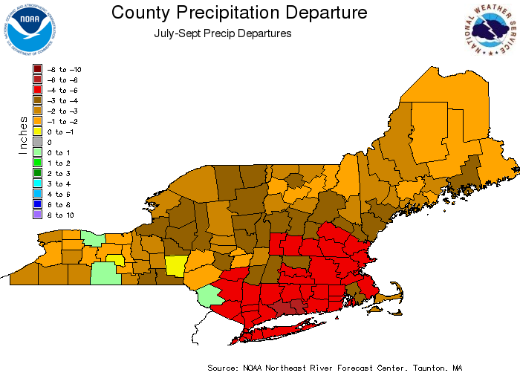
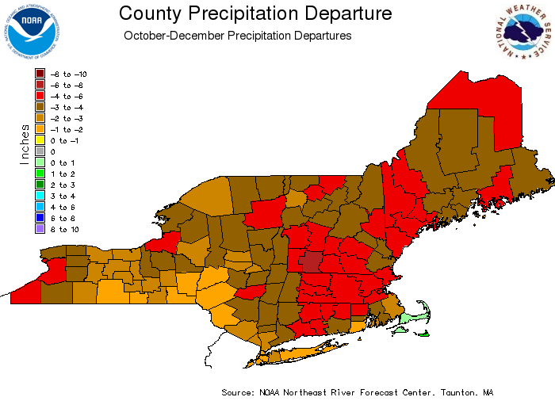
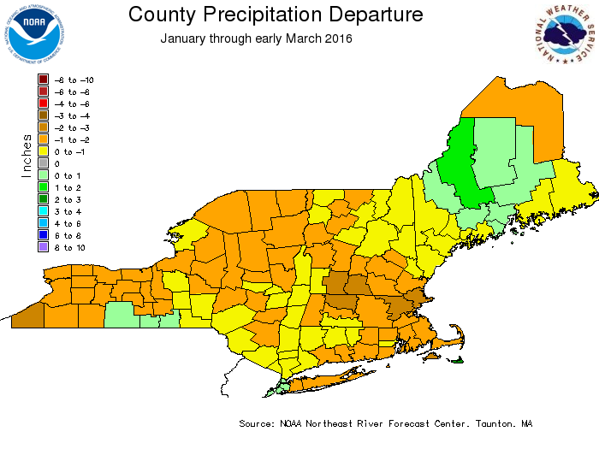
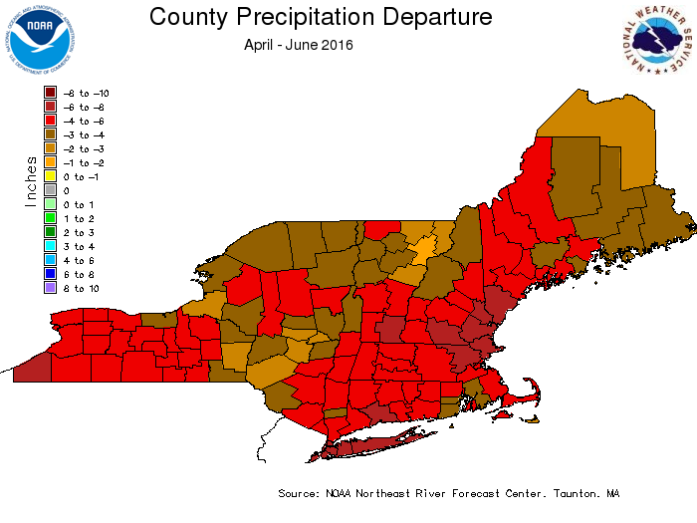
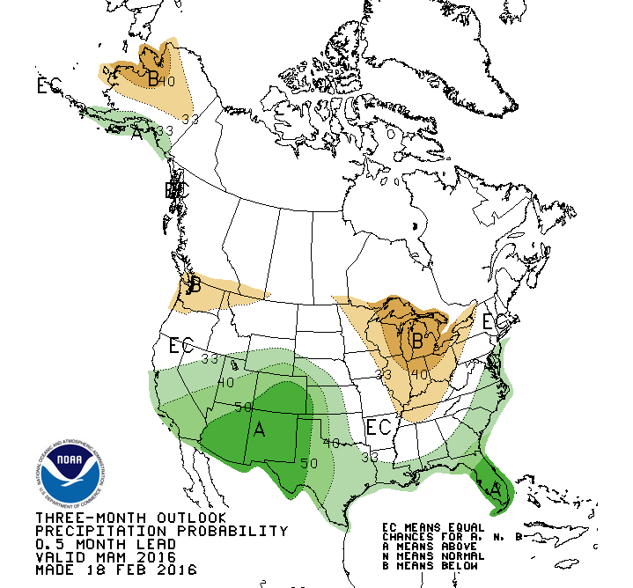
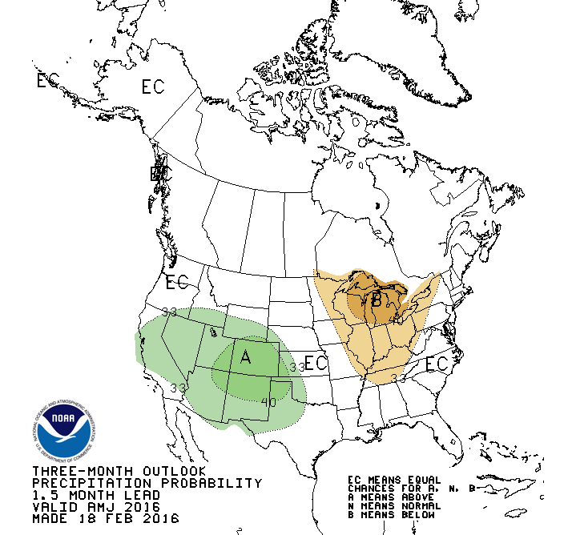
2015-2016 ENSO…
April – June ???

Slide 30
Just one significant flood episode… and that occurred in February

Slide 31
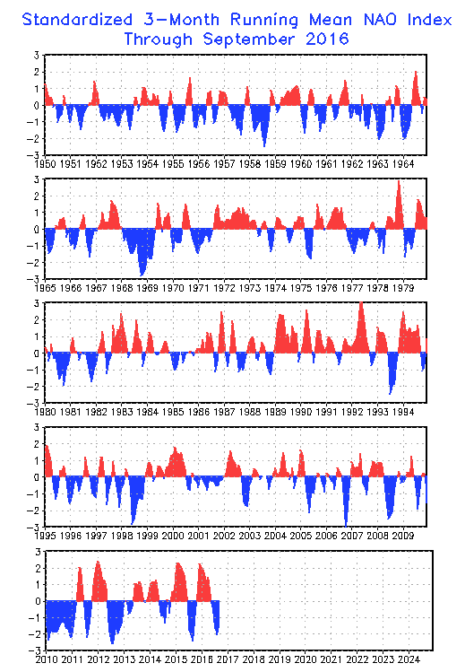
Summary
North Atlantic Oscillation Phase
ENSO is just one of several major forcing mechanisms that can drive the weather patterns in the Northeast
NAO, PNA, EPO, AO etc.
But they are all devilishly inter-connected
Sample size of 5 is very small
Some basic themes played out:
Dry summer/fall heading into ENSO
Lack luster snowfall in parts of the region
Some basic themes did not play out:
Absence of significant rainfall in the spring
Absence of late winter/spring river flooding

Slide 32
Examining Major El Nino Events: Impacts on Precipitation and Flood Potential in the Northeast United States
David R. Vallee Hydrologist-in-Charge NOAA/NWS/Northeast River Forecast Center
david.vallee@noaa.gov http://weather.gov/nerfc

