Slide 1
UMass Lowell Atmospheric Science Program
Celebrating our 50th Year!

Slide 2
UML Atmospheric Science
30 Undergraduates
5-10 M.S. Students
Revised Curriculum to meet AMS, NWS requirements
Undergraduate Research
Opportunities for Field Work: Boston Marathon
Textile Regatta
Webpage Forecast

Slide 3
Snow Squalls in New England with a Changing Climate
Dr. Frank Colby
David Coe
Beth Krajewski
Alison Stokes

Slide 4
Why Snow Squalls?
Snow Squalls happen here in Southern New England
Affect us unexpectedly – traffic jams, accidents
Climatology has not been understood

Slide 5
Webcam at State College, PA
https://www.youtube.com/watch?feature=player_detailpage&v=Qf7LXukmQJM

Slide 13
And This is What Can Happen

Slide 14
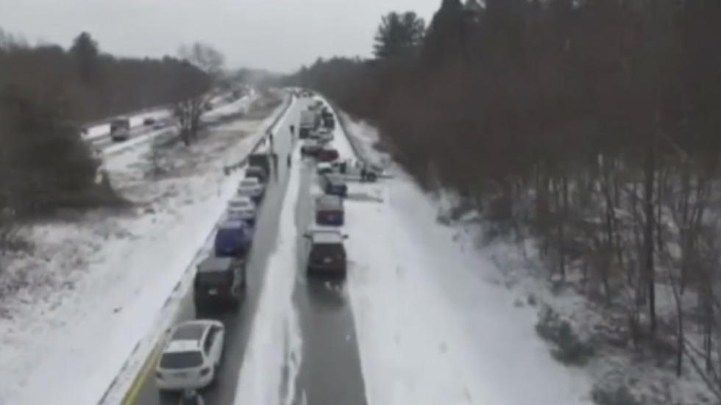
With no Warning 40 Car Pileup – 10 Injuries
From Weather.com

Slide 15
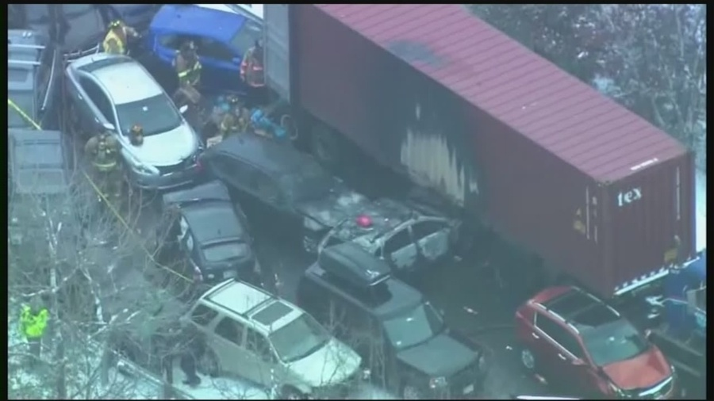
With no Warning 35 Car Pileup – 12 injuries
www.wmur.com

Slide 16
What are Snow Squalls?
Snow Squall (NWS Glossary): A snow squall is an intense, but limited duration, period of moderate to heavy snowfall, accompanied by strong, gusty surface winds and possibly lightning (generally moderate to heavy snow showers). Snow accumulation may be significant.

Slide 17
What are Snow Squalls?
Environment Canada puts out Snow Squall Watches “When conditions are favourable for the development of brief periods of very poor visibilities caused by heavy snow and blowing snow.”
Some researchers call them “Snow Bursts”

Slide 18
What are Snow Squalls?
We know that snow squalls are lines of snow showers, like a squall line but with snow instead of rain
The snow falls intensely for a short time

Slide 19
What are Snow Squalls?
They occur in many states:
NY, PA, VT, NH, ME, MA, CT, and even VA.
Very little is known about them:
Jet Stream Pattern
Typical size, duration, speed
Direction of movement

Slide 20
Background
Some recent research:
NWS paper examined observations at 3 locations: 2 in VT, and one in NY
McGill University – detailed analysis of 3 cases
Earlier Research – Weir Lundstedt (NWS) Windex (1993) and Windex 2.0 (2005)
My students and I wanted to understand the whole range of conditions and behaviors that occur with snow squalls

Slide 21
Our Snow Squall Working Definition
In NWS Observations (Metar) Data:
Sudden Snow Event
Visibility drops below 2 miles
Wind Speed Increases, often Gusts Reported
Inherent Limitation:
Events can be small in size, short in duration
Easy for events to be missed using Metar Data

Slide 22
Our Research - UMass Lowell students
Downloaded observations from National Centers for Environmental Information (formerly NCDC)
Ran computer program to find:
Low visibility
Snow
Examined output to find only sudden events
Looked at weather maps to remove large storms
Analyzed radar to confirm snow squall events

Slide 23
Scope of Research
Southern New England:
southern VT and NH
eastern NY
CT , RI, and MA
20 years: 1997 – 2016
Found 35 cases and characterized 4 types

Slide 24
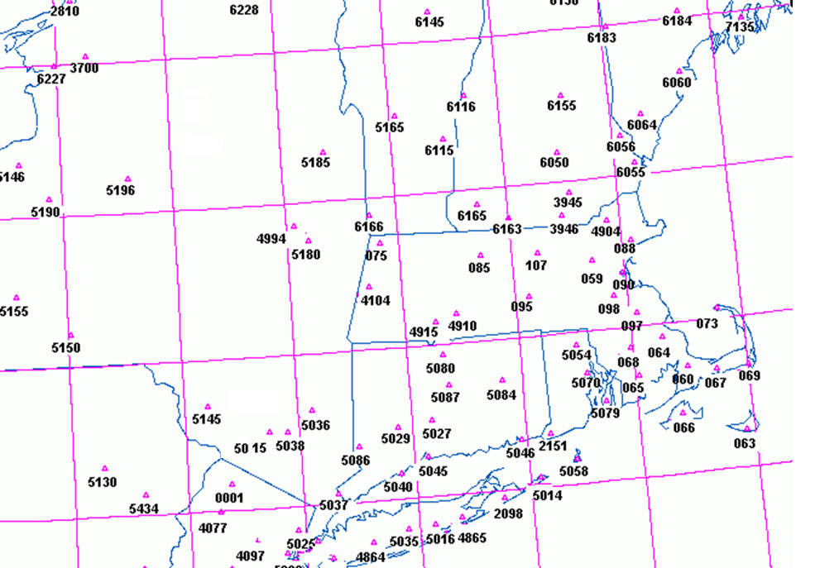
Area of Our Search

Slide 25
Snow Squall Climatology
Years:
1997: 2
1998: 0
1999: 0
2000: 0
2001: 2
2002: 1
2003: 3
2004: 4
2005: 0
2006: 3
2007: 3
2008: 1
2009: 2
2010: 1
2011: 2
2012: 2
2013: 5
2014: 1
2015: 2
2016: 1

Slide 26
Snow Squall Climatology
Months:
November 0
December 4
January 9
February 13
March 9
April 0

Slide 27
Typical Characteristics
Length: 30 – 200 miles
Width: 10 – 30 miles
Speed: 25 – 35 mph
Duration: 5 – 40 minutes
Snow Squalls – visibility can drop in < 5 minutes
and return in 5 – 10 minutes.

Slide 28
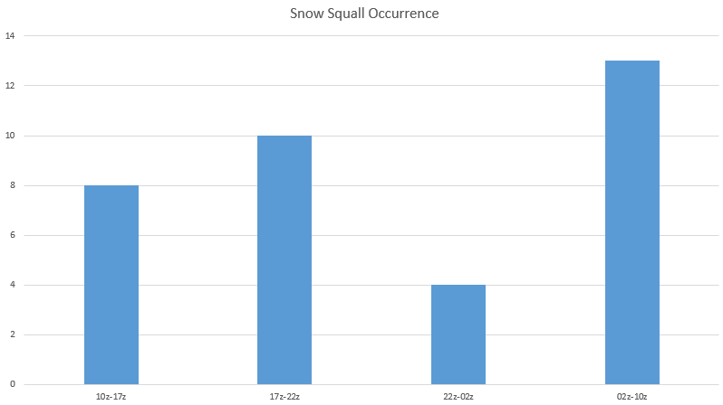
Typical Characteristics Time Snow Squall Observed
Morning Afternoon Early Evening Night/Early AM

Slide 29
Snow Squall Types
David Coe – analyzed the last 10 years of data
Found 4 types of Snow Squall behavior:
Classic: long line moves from NW to SE
Other 3 types: shorter lines
Northern – line moves from north to south
New York – line moves more from west to east
Atlantic – form over ocean, rotate around an offshore low pressure area or around a low to the NW

Slide 30
Snow Squall Examples of Types
4 Types:
Classic (22 cases): Line moves from Great Lakes, northwestern NE, or upstate NY
Northern (6 cases): Line forms in northern NE, moves S
New York (2 cases): Line forms in western NY, moves E
Atlantic Ocean (5 cases): Convection forms along coast or over the ocean, moves S, or SW, then SE, rotating around an ocean low – or forms south of Long Island and moves NE with mid-level flow.

Slide 31
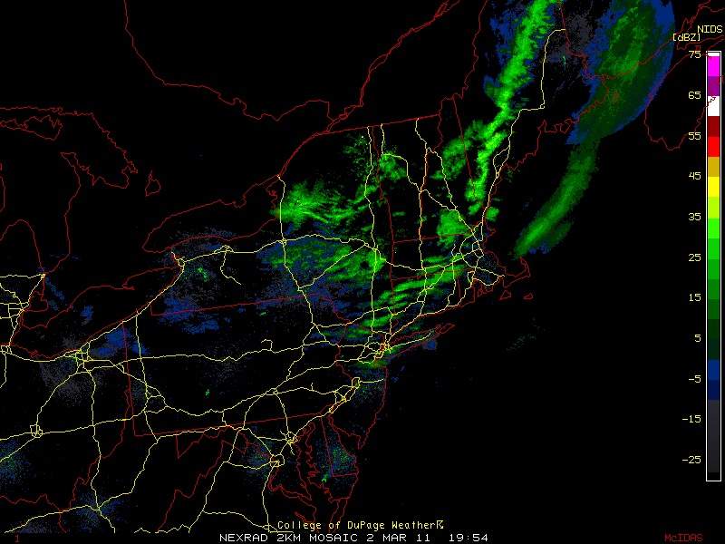
CLASSIC CASE (SW MA)
March 2, 2011 19:54 UTC

Slide 32
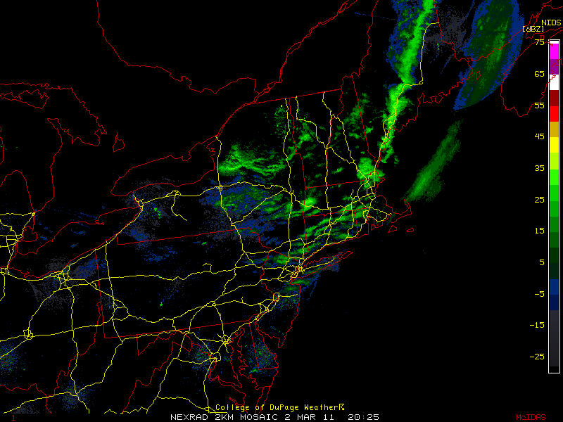
CLASSIC CASE
March 2, 2011 20:25 UTC

Slide 33
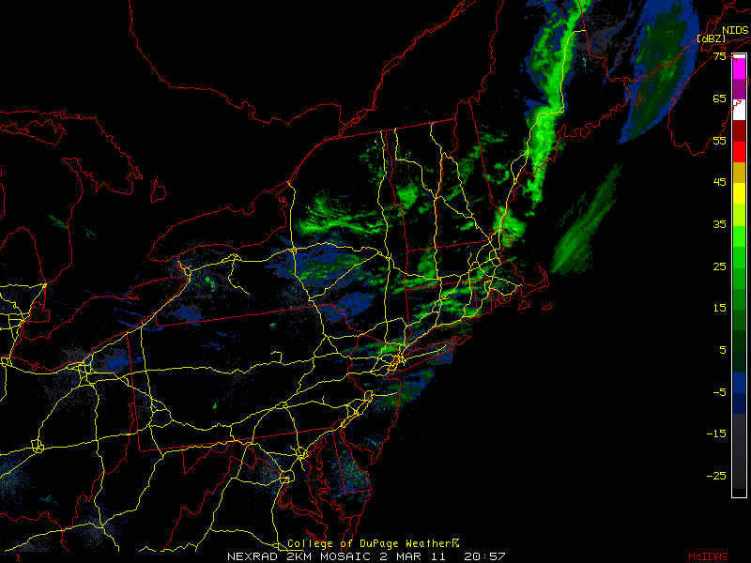
CLASSIC CASE
March 2, 2011 20:57 UTC

Slide 34
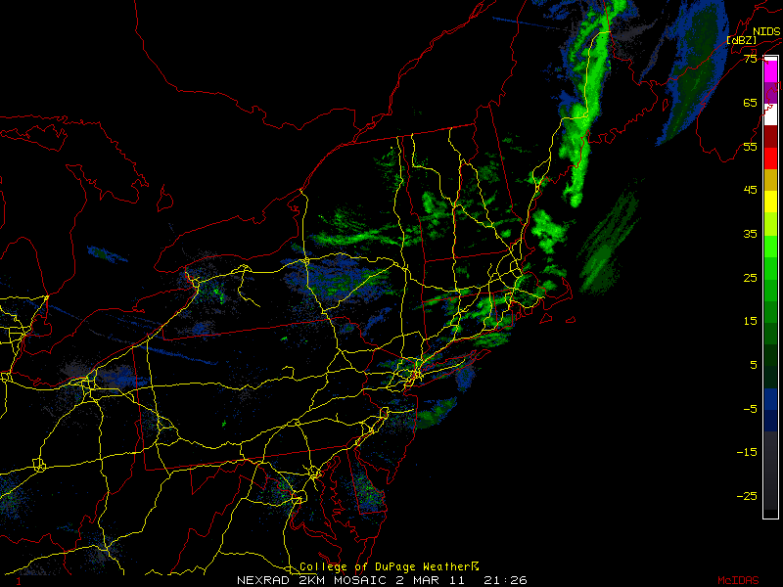
CLASSIC CASE
March 2, 2011 21:26 UTC

Slide 35
Snow Squall Examples of Types
4 Types:
Classic (22 cases): Line moves from Great Lakes, northwestern NE, or upstate NY
Northern (6 cases): Line forms in northern NE, moves S
New York (2 cases): Line forms in western NY, moves E
Atlantic Ocean (5 cases): Convection forms along coast or over the ocean, moves S, or SW, then SE, rotating around an ocean low – or forms south of Long Island and moves NE with mid-level flow.

Slide 36
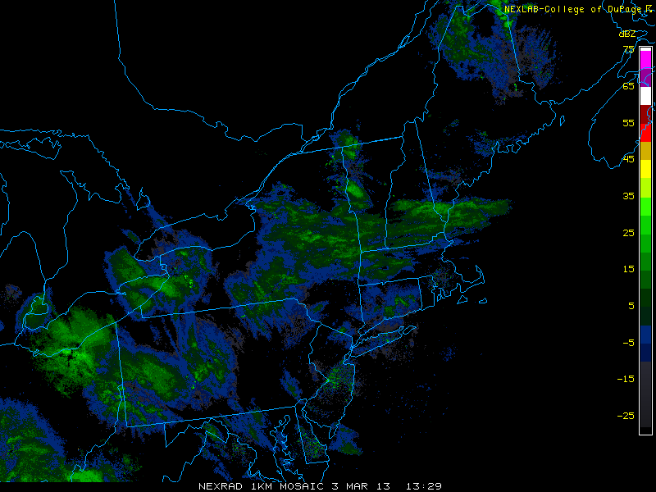
NORTHERN CASE (Eastern MA)
March 3, 2013 13:29 UTC

Slide 37
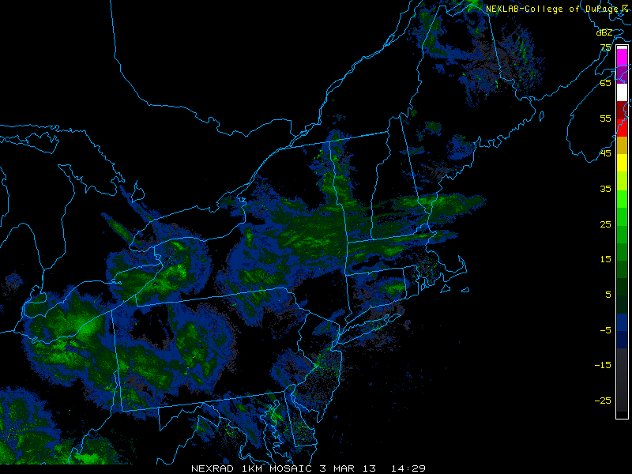
NORTHERN CASE
March 3, 2013 14:29 UTC

Slide 38
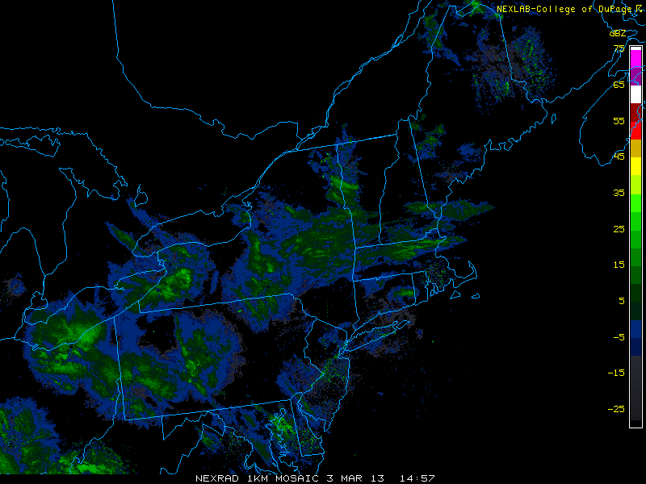
NORTHERN CASE
March 3, 2013 14:57 UTC

Slide 39
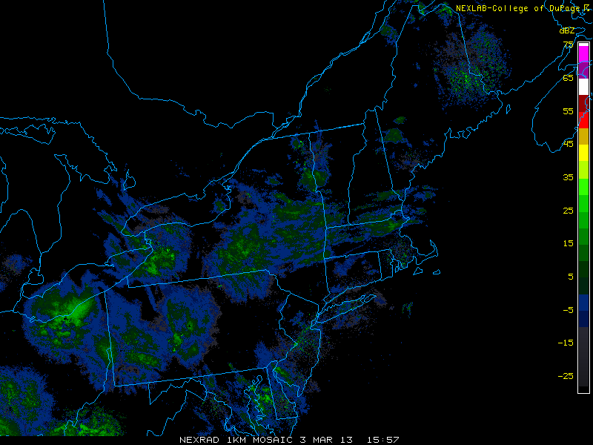
NORTHERN CASE
March 3, 2013 15:57 UTC

Slide 40
Snow Squall Examples of Types
4 Types:
Classic (22 cases): Line moves from Great Lakes, northwestern NE, or upstate NY
Northern (6 cases): Line forms in northern NE, moves S
New York (2 cases): Line forms in western NY, moves E
Atlantic Ocean (5 cases): Convection forms along coast or over the ocean, moves S, or SW, then SE, rotating around an ocean low – or forms south of Long Island and moves NE with mid-level flow.

Slide 41
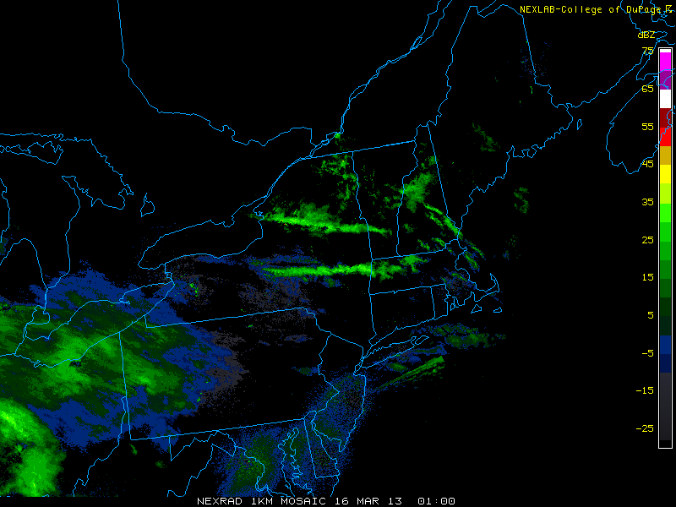
NEW YORK CASE (SW MA)
March 16, 2013 01:00 UTC

Slide 42
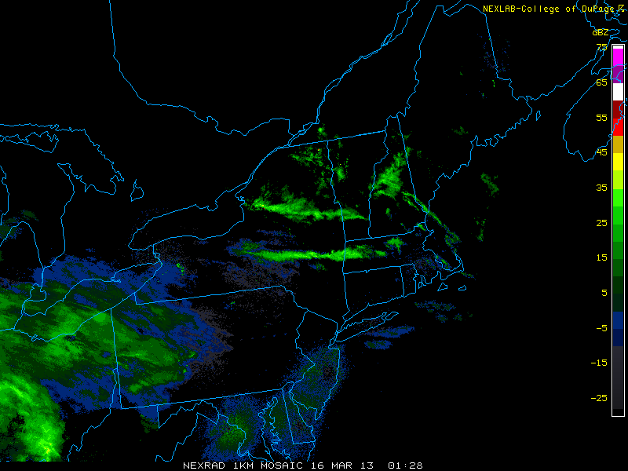
NEW YORK CASE
March 16, 2013 01:28 UTC

Slide 43
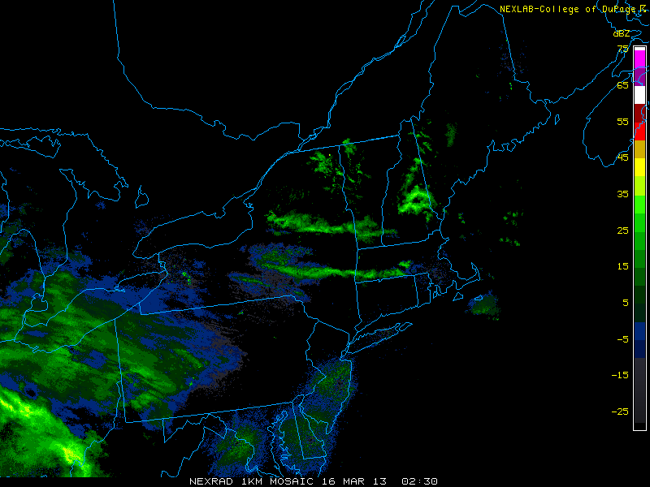
NEW YORK CASE
March 16, 2013 02:30 UTC

Slide 44
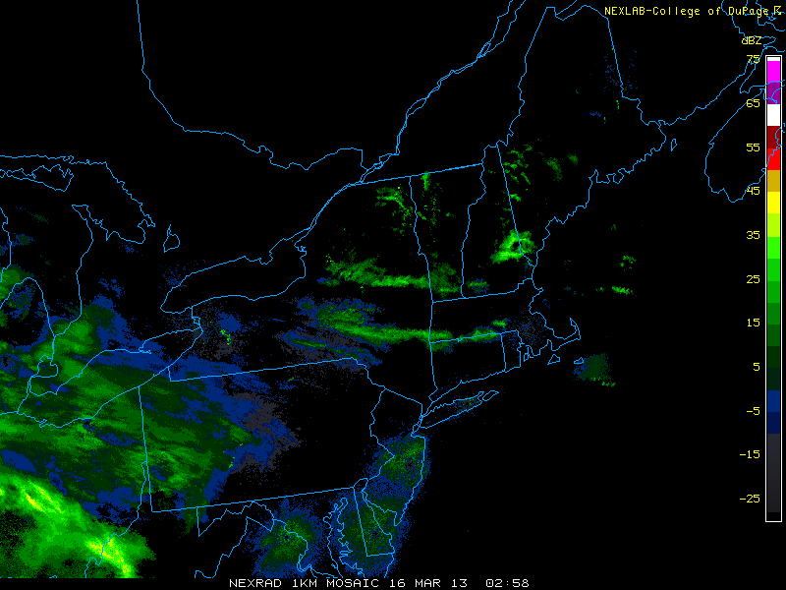
NEW YORK CASE
March 16, 2013 02:58 UTC

Slide 45
Snow Squall Examples of Types
4 Types:
Classic (22 cases): Line moves from Great Lakes, northwestern NE, or upstate NY
Northern (6 cases): Line forms in northern NE, moves S
New York (2 cases): Line forms in western NY, moves E
Atlantic Ocean (5 cases): Convection forms along coast or over the ocean, moves S, or SW, then SE, rotating around an ocean low – or forms south of Long Island and moves NE with mid-level flow.

Slide 46
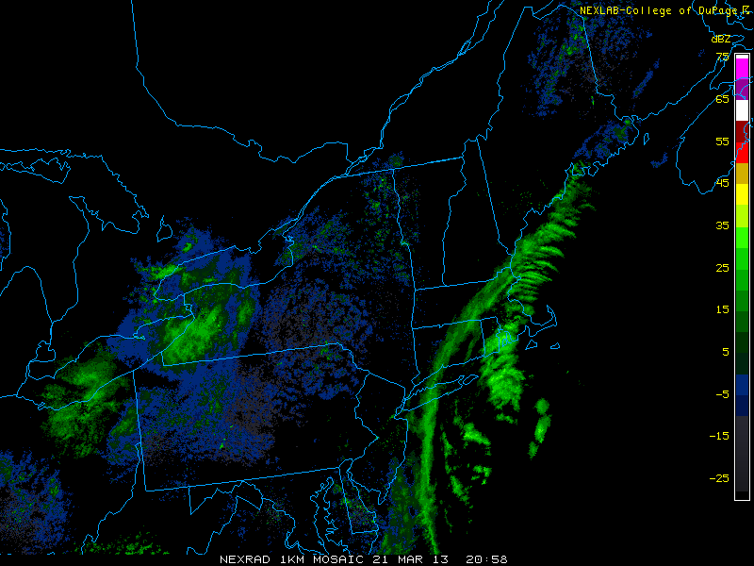
ATLANTIC CASE (Eastern, SE MA)
March 21, 2013 20:58 UTC

Slide 47
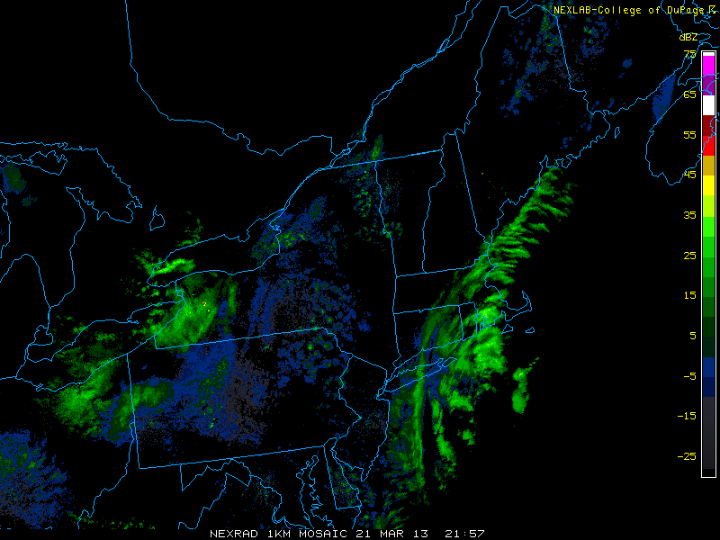
ATLANTIC CASE
March 21, 2013 21:57 UTC

Slide 48
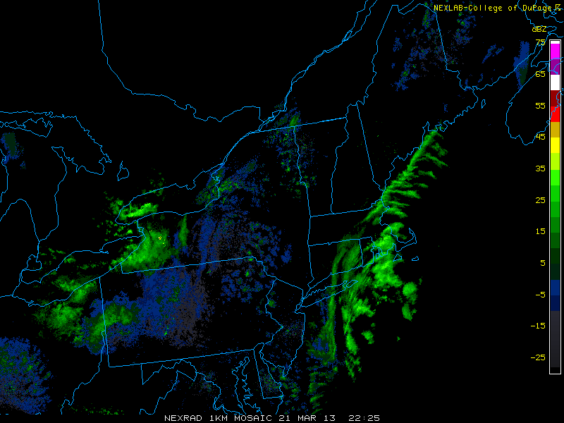
ATLANTIC CASE
March 21, 2013 22:25 UTC

Slide 49
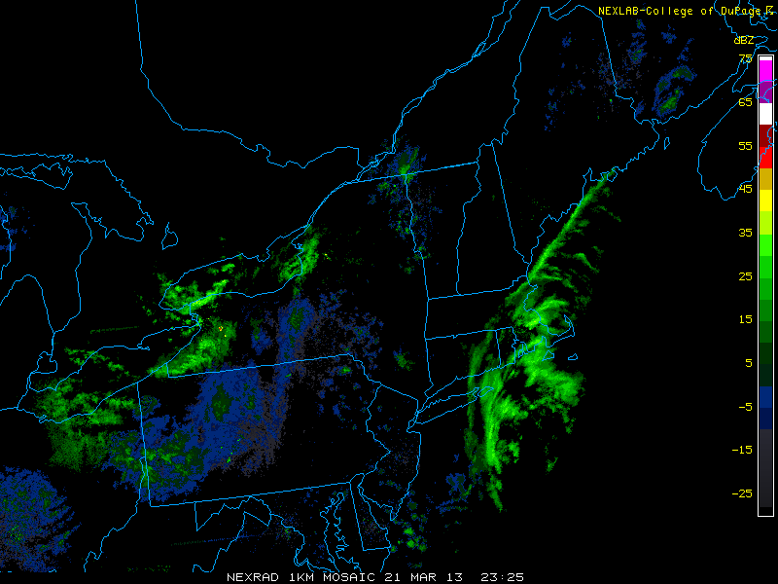
ATLANTIC CASE
March 21, 2013 23:25 UTC

Slide 50
Snow Squall Climatology Upper-Level Jet Stream
All 4 types have a trough in the vicinity of NE.
Classic and Atlantic – trough axis west of NE
Northern - closed low north of ME, trough axis east of NE
New York – slight trough west of NE

Slide 51
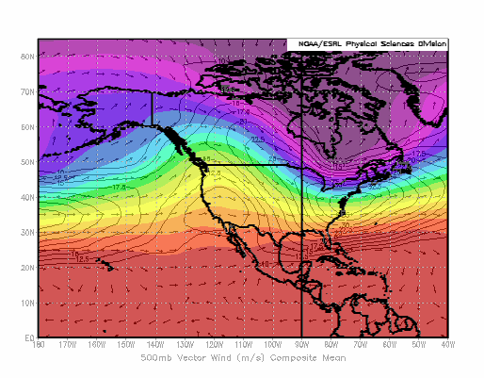
Classic 500 hPa

Slide 52
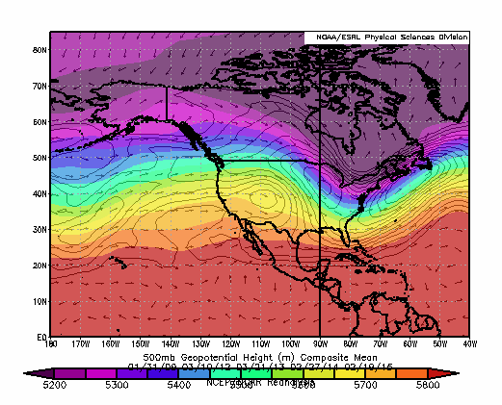
Atlantic 500 hPa

Slide 53
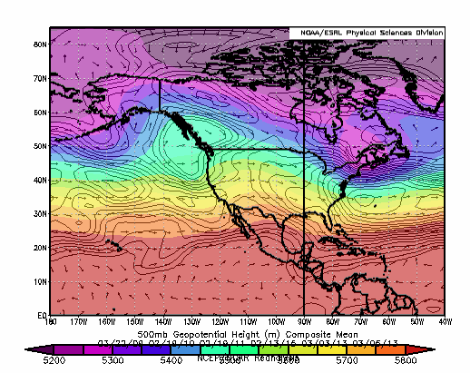
Northern 500 hPa

Slide 54
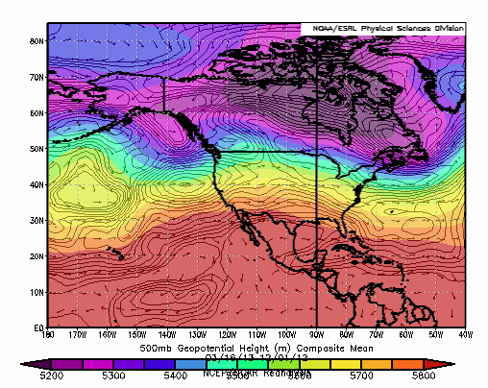
New York 500 hPa

Slide 55
Snow Squall Climatology – Surface
Classic – High over Midwest, low northeast of Maine
Atlantic – High over Midwest, low east of NE
Northern – High NW of Great Lakes, low northeast of Maine
New York – High over Midwest, low over the Great Lakes

Slide 56
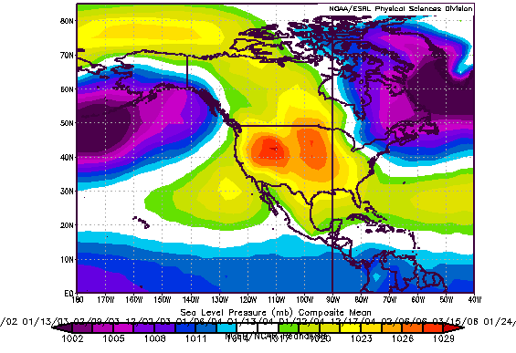
Classic MSLP

Slide 57
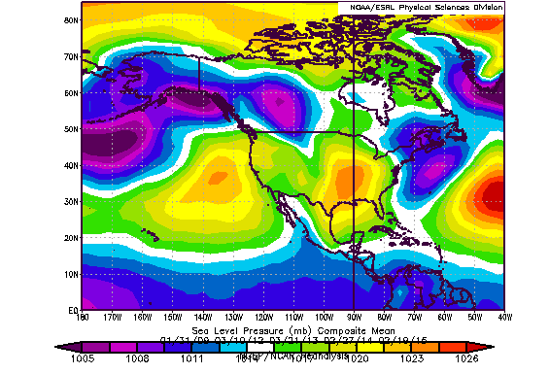
Atlantic MSLP

Slide 58
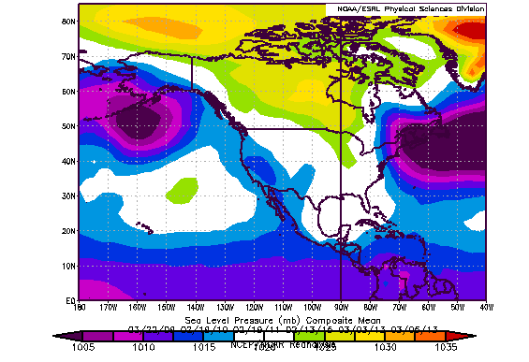
Northern MSLP

Slide 59
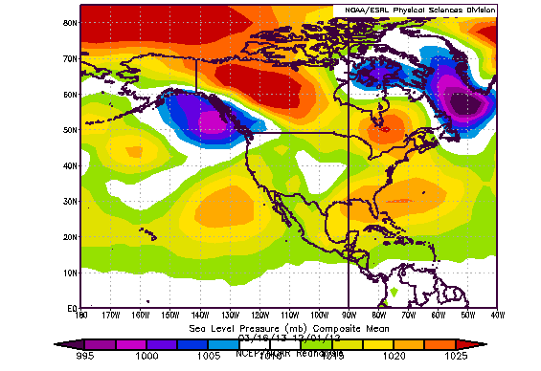
New York MSLP

Slide 60
Snow Squall Climatology
Years for Types:
Northern: 2009 – 2015
New York: 2012, 2013
Atlantic: 2009 – 2015
Classic: 1997 – 2016
15 between 1997 and 2006
3 in 2007
1 in 2008
1 in 2011
1 in 2013
1 in 2016

Slide 61
Snow Squall Climatology
Why the Shift?
Only Classic: 1997 – 2008
Mixture of 4 types: 2009 – present
3 Classic, 6 northern, 2 New York, 5 Atlantic
Changing Climate?
Normal Decadal Oscillations?

Slide 62
Final Thoughts
Snow Squalls are intense, convective snow events
They occur in Southern New England in the months of December – March
Four types – three of which have appeared only in the last 8 years
Shift in types may be related to climate change or natural decadal oscillations?

Slide 63
Future Work
Extend the climatology to the whole US, starting with the East Coast states

Slide 64
Future Work
Extend the climatology to the whole US, starting with the East Coast states
Continue to investigate connection between Climate Change and Snow Squall Patterns
Thank you! Any Questions?

Slide 65
References
Banacos , Loconto, and Devoir (NWS) – 2014
36 cases affecting Burlington and Montpelier, VT and Massena, NY
Milrad, Gyakum, Lombardo, and Atallah – 2014
2 “Snow Burst” events
Milrad, Gyakum, Atallah, and Smith – 2010
One case

