Slide 1
The Halloween Nor’easter of 1991 The No-Name Storm The Perfect Storm The Killer Storm
Meteorological recollections
(condensed highlights)
Walter Drag
Formerly NWS BOS-BOX 1989-2010, since then, PHI

Slide 2
Acknowledgements
Frank Rosenstein- NMC extended branch
Numerous forecasters within and adjacent BOS
Natural Disaster Survey Report
MPC-OPC for the imagery loops
Cardone et al (Evaluation of the Contemporary Ocean Wave models …
Glenn Field and staff for tirelessly copying data for this presentation

Slide 3
Acknowledgements
NCEI (CWC): Meteorologists Scott Stevens and Axel Graumann IR satellite imagery to support John Spillane’s encountered highly adverse conditions
ECMWF: Tim Hewson for the ECMWF N. American forecast imagery from 12z 10/25
Bill Babcock WFO BOX – CHH RAOB
Mitchell Gaines – Met intern PHI for some ppt guidance
Mathieu Ouellet Oceans Science Branch Fisheries and Oceans Canada (44137,44139)
Joseph M. Sienkiewicz Chief, Ocean Applications Branch,
NOAA/NWS Ocean Prediction Center

Slide 4
Overview
Western Atlantic from the Maritimes to FL and Puerto Rico
(10/28-11/1)
*surge and coastal flooding (BOS worst Wed aftn Oct 30, CT-NY-NJ morning 31st, MD-VA-NC afternoon 31st). Lost homes, lengthy road closures-infrastructure damage and multiple high tide cycles of tidal flooding to varying degrees (w little of the typical preceding rains).
YET: NCDC CPI adjusted does not rank this storm in its yearly table 1980- (Katrina #1 153B, Sandy #2 68B, Andrew #3 46B, various droughts & floods, Matthew 20B, Bob 2.7B, est 1938 5B)
*HOWEVER: MARINE was the much bigger story…USCG SAR 75 mariners in distress. (13 deaths including 8 at sea)

Slide 5
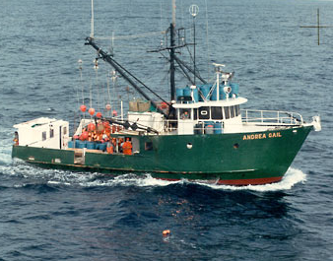
The ANDREA GAIL

Slide 6
Surge relationships
ET 33mb pressure drop (1” mercury) = 1ft surge
Remainder surge is wind and Ekman transport
Tropical (much tighter pressure gradient
25mb pressure drop (.75” mercury) = 3 ft surge
50mb pressure drop (1.5” mercury) = 6.5 surge
100mb pressure drop (3” mercury) =14 ft surge
Remainder surge is wind and Ekman transport
Bays and inlets with special enhancements wind related.

Slide 7
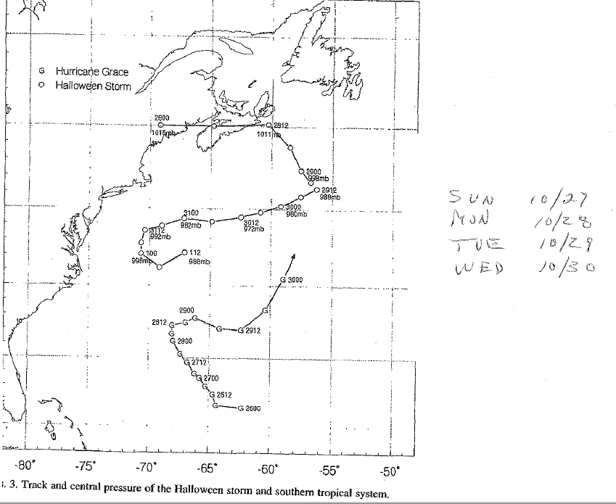

Slide 8
Satellite loop 55 sec-1:55
https://youtu.be/0FevyOcqMN0

Slide 9
Loop 925MB left 500MB right
www.opc.ncep.noaa.gov/perfectstorm/mpc_ps_js.shtml

Slide 10
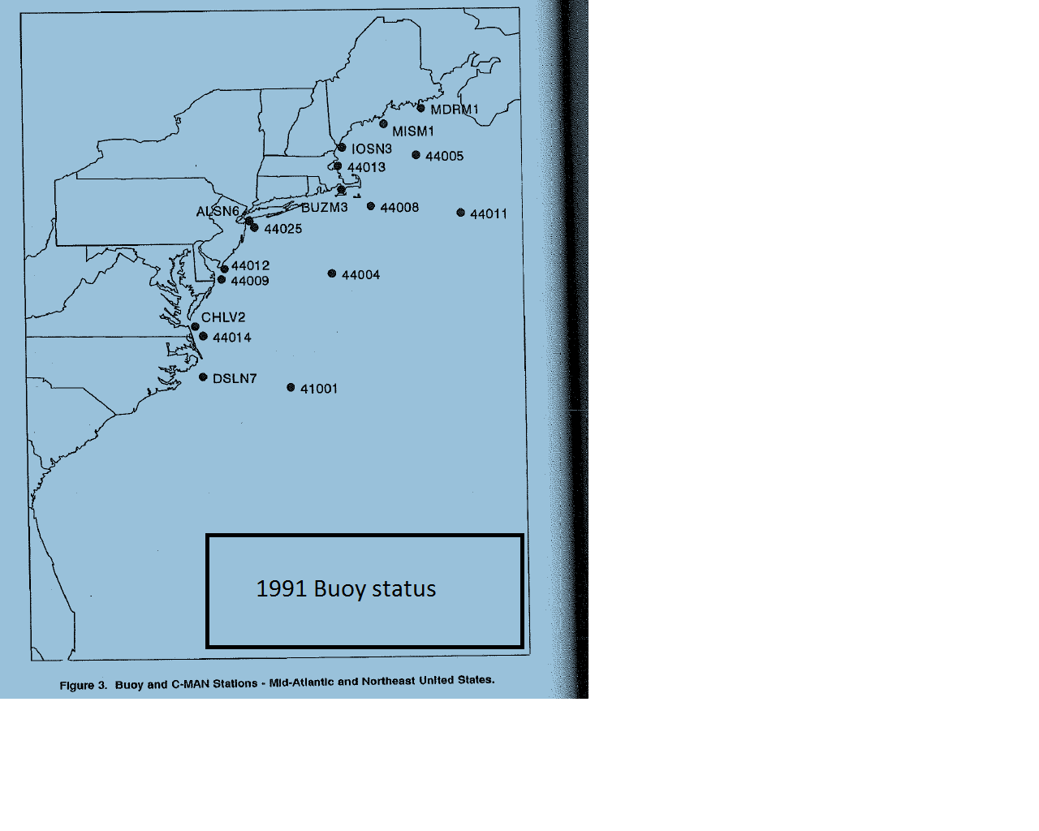
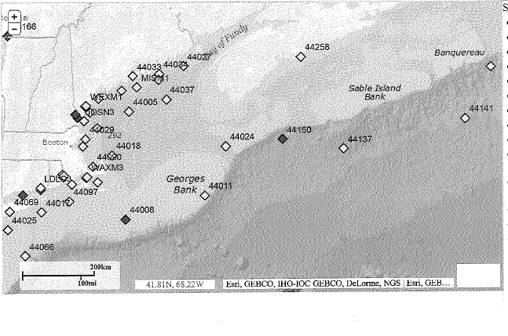
Buoy comparison then and now
44139
2016 buoy status

Slide 11
Buoy documentation: Scotian plateau 44137 44139
Peak sig WH exceeded 50 ft.
Max crest-trough amplitude near 100 ft, both PS & Superstorm of March 1993. (exceeded 100 year existing estimated design of wave ht by 50%)
Extreme storm waves are mathematically capable about 2X of highest third (sig wave height HS). Hindcasts validated!
Cardone Journal of Atmospheric and Oceanic Technology 1996 Vol 13 pp198, 201

Slide 12
Closer to home 44011, 44008, 44013
44011 41.1 66.6 HS 39 15z/30 (170 E of HYA)
(50g67kt)
44008 40.5 69.5 HS 31’ 00z/31 (54 SE ACK)
(53g67kt)
44013 42.4 70.6 HS 30’ 02z/31 (16E of BOS)
(44G55kt)
Could have been worse along New England coast!!! Just like Sandy could have, along NJ-LI-CT coasts.

Slide 13
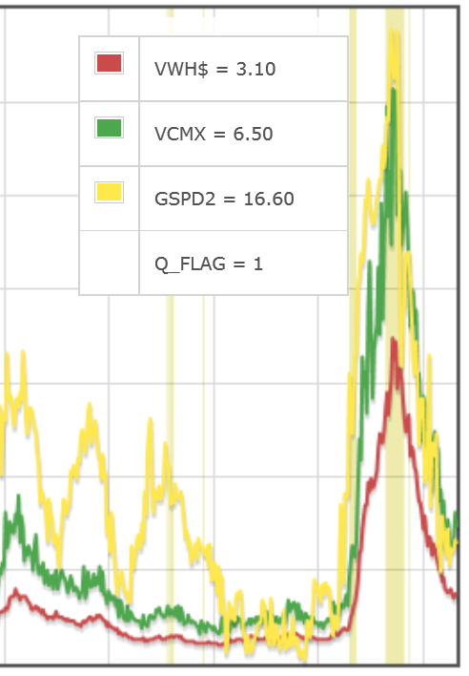
44137 East Scotian Slope Sig WH (m), Highest WH (m), Gust (m/s)
35
25
15
5
Oct 28
Oct 31

Slide 14
44139
23z/28 6 feet, max 11 feet G 38 kt
01z/29 20 feet, max 51 feet G48 kt
The time section follows

Slide 15
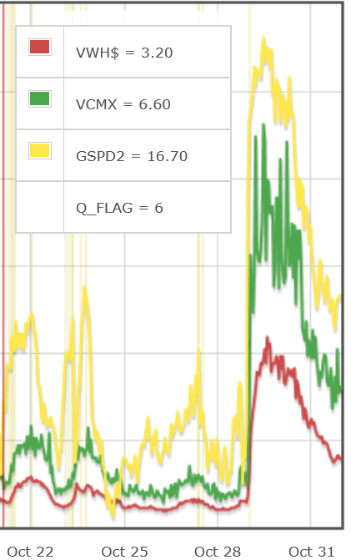
44139 (44.3N 57.3W) AG 44.0 56.6 Sig WH(m), Max WH(m) Gust(m/s)
25
15
5

Slide 16
Andrea Gail possibilities
Hatch open (too much load), center of gravity shift,
lost engine power?
Buoys show unusually rapid degradation of conditions from routine to violent to extreme. Winds and seas from the northeast or east , would have been on the stern of the westward heading Andrea Gail. Conditions changed explosively.
Vince Cardone diagnosed a low level jet that developed WSW in the NE flow and migrated at a resonance speed that would move with the swell it generated. Such resonance (trapped or dynamic fetch) would account for the extremely rapid degradation of seas.

Slide 17
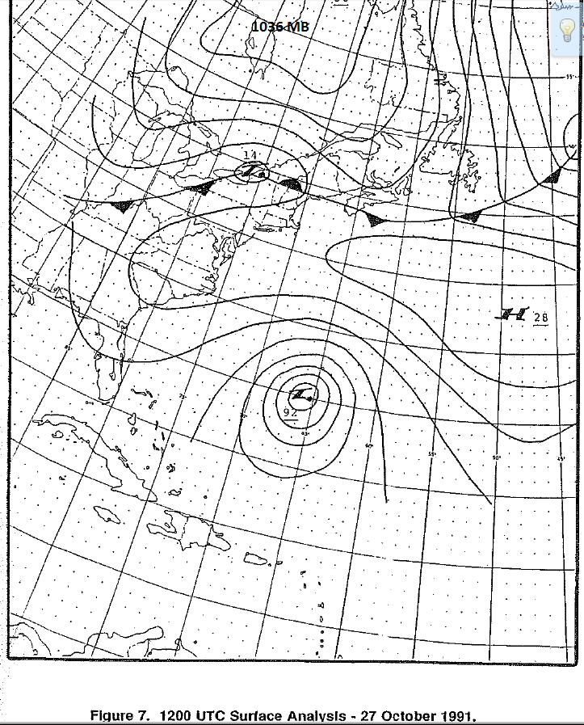
12z/27 Sunday morning syn gradient

Slide 18
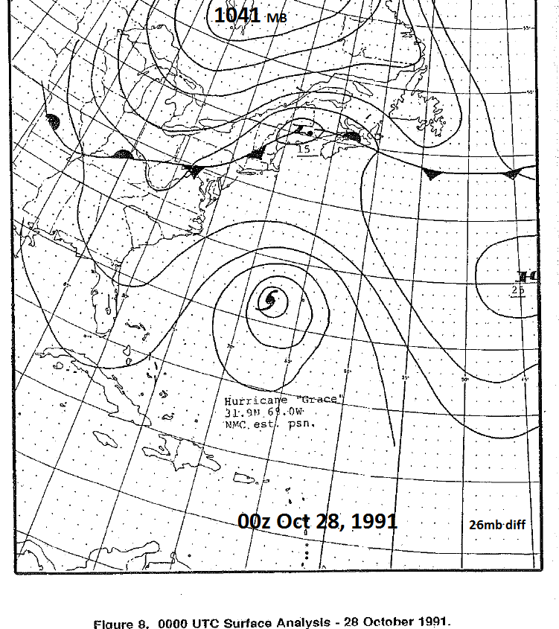
00z/28 - Sunday eve

Slide 19
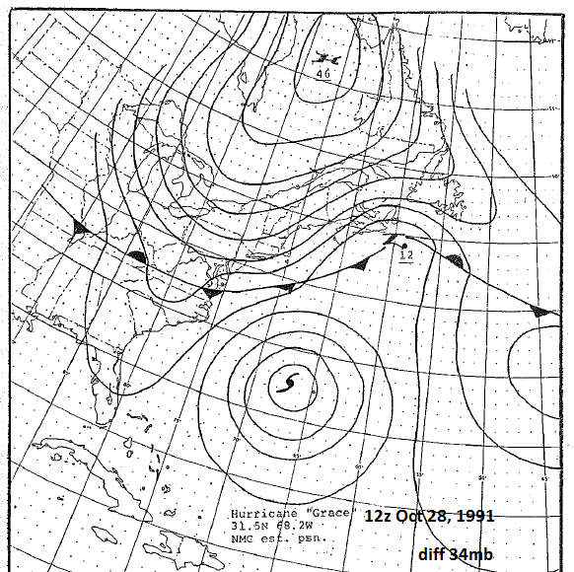
12z/28 Monday morning

Slide 20
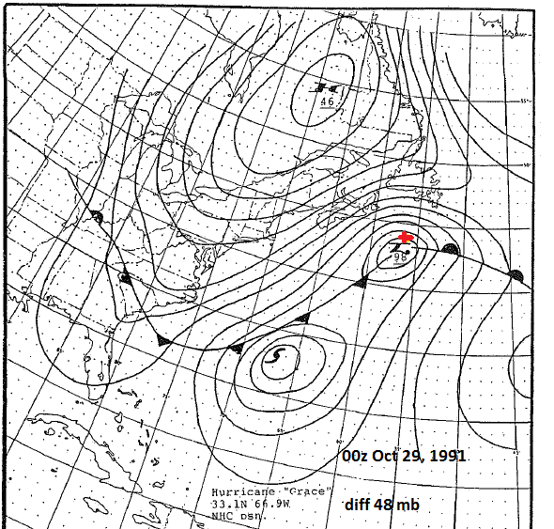
00z/29 Monday evening (AG lost 44/56)

Slide 21
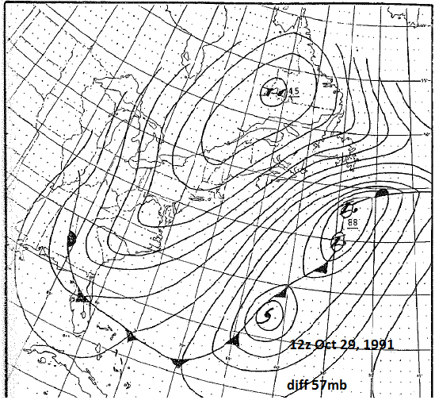
12z/29 Tuesday morning

Slide 22
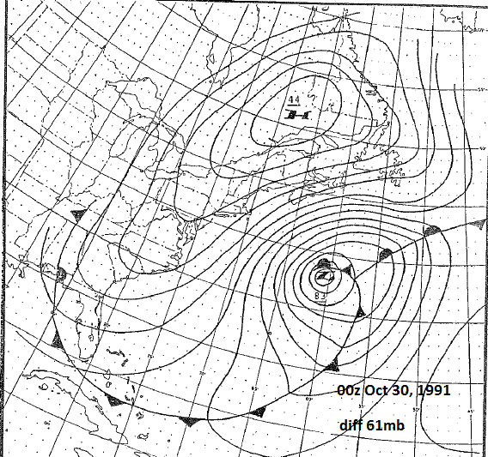
00z/30 Tuesday evening

Slide 23
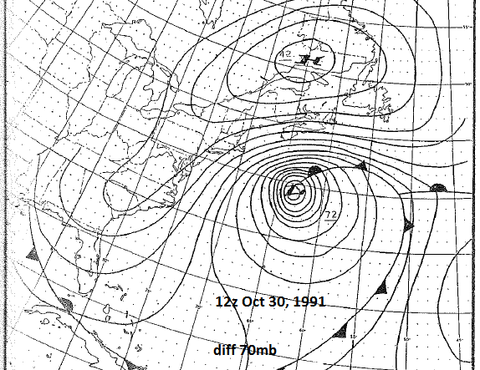
12z/30 Wednesday – our day

Slide 24
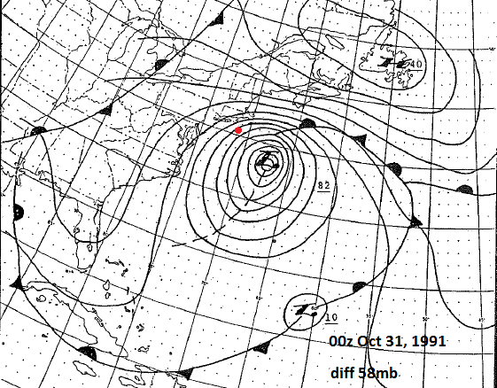
00Z/31 (Wed eve) – H60 ditch 60 se MTK

Slide 25
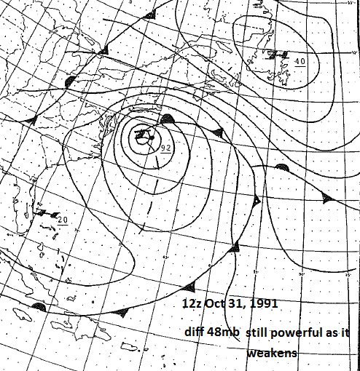
12z/31 (Thursday morning)

Slide 26
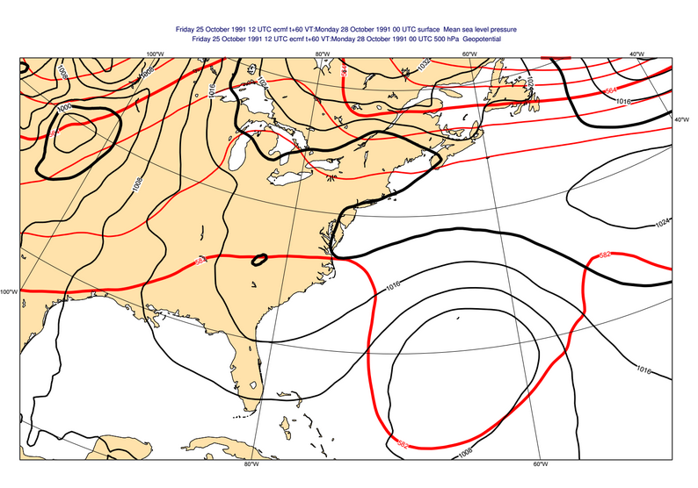
EC 12z 25 60 hr fcst 00z 28 500mb sfc

Slide 27
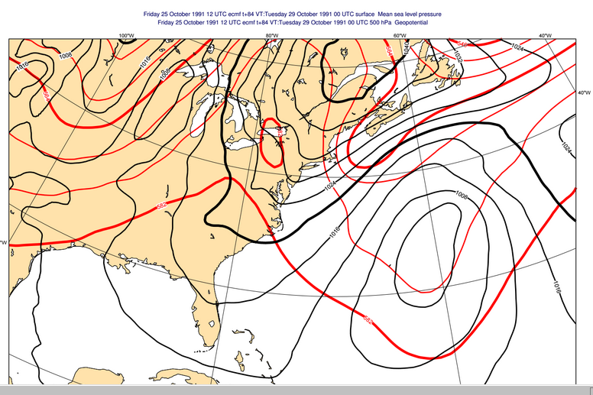
EC 12z 25 84 hr fcst 00z 29 500mb sfc

Slide 28
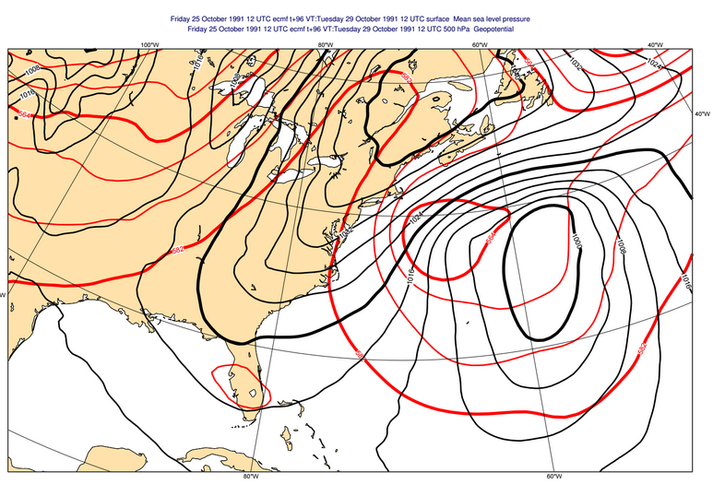
EC 12z 25 96 hr fcst 12z 29 500mb sfc

Slide 29
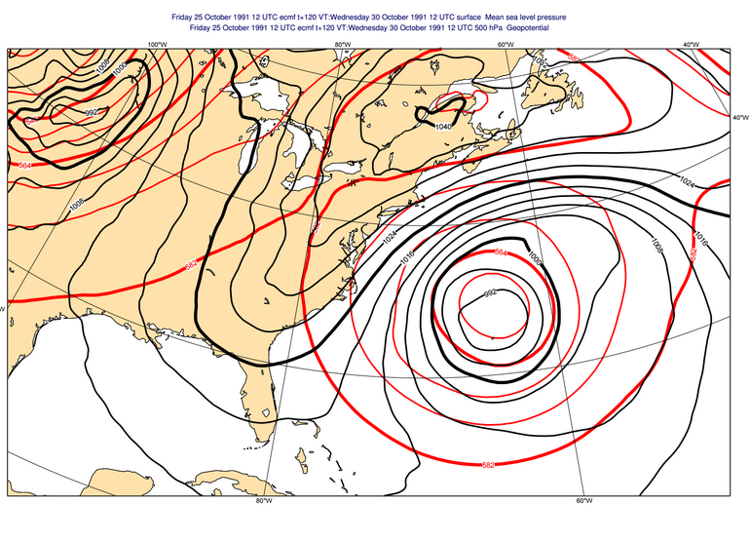
EC12z 25 120 hr fcst 12z 30 500mb sfc

Slide 30
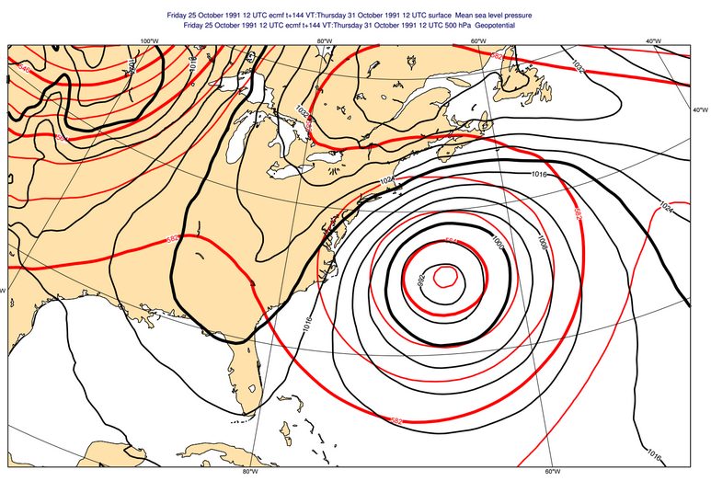
EC 12z 25 144 hr fcst 12z 31 500mb sfc

Slide 31
Final stages
On the 31st, MSP endured a historic Blizzard.
Meanwhile, the Perfect Storm began evolving over warmer water back to an unnamed Hurricane on Nov 1 spinning itself down on Nov 2 near Nova Scotia.
Grace Cat 2, unnamed Hurricane Cat 1.

Slide 32
The unnamed Hurricane of Nov 1, 1991

Slide 33
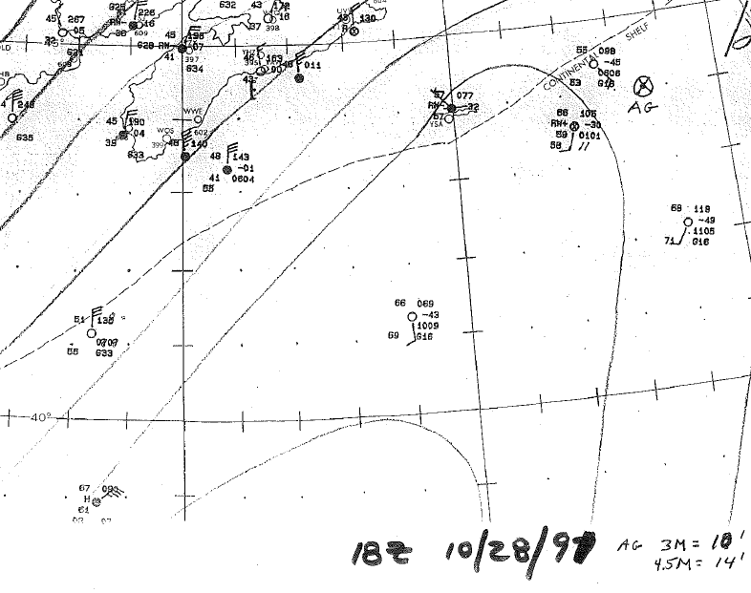
18z/28 WFO BOS Analysis

Slide 34
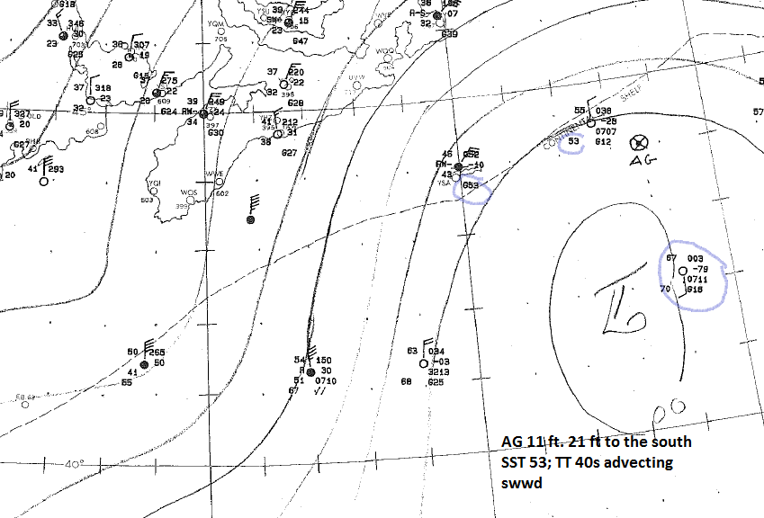
00z/29 WFO BOS analysis (AG lost contact)

Slide 35
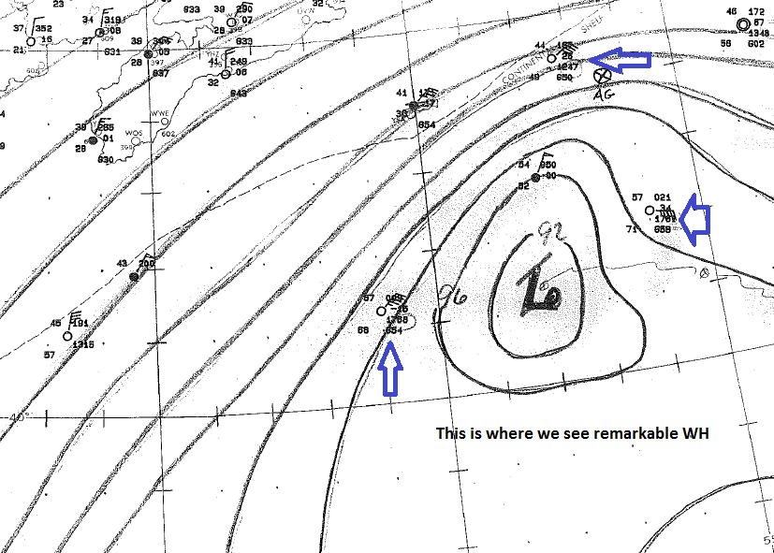
00z/30 WFO BOS Analysis

Slide 36
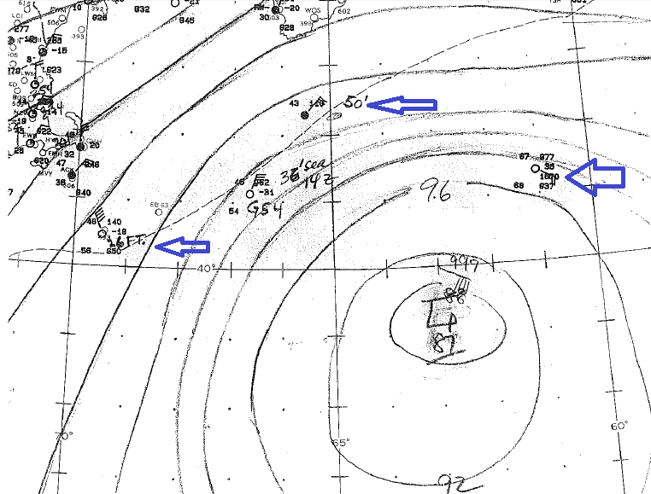
12z/30 WFO BOS Analysis

Slide 37
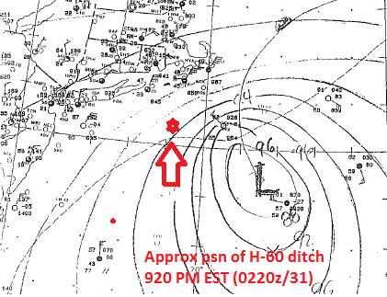
00z/31 WFO BOS Analysis (H-60 ditch)

Slide 38
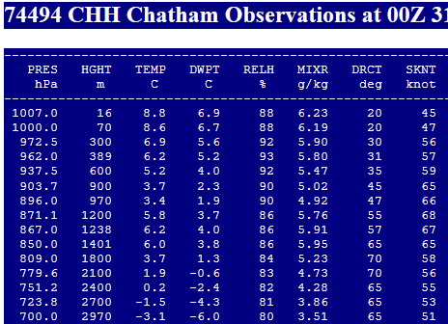
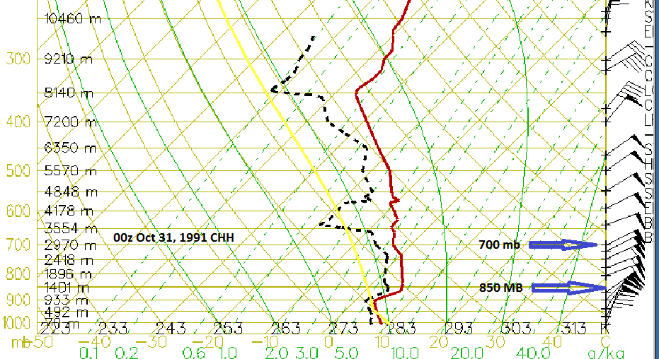
CHH sounding and SGL 00z Oct 31, 1991

Slide 39
60 southeast Montauk 0220z/31
Limited available data
44008 to the east. Lowest pressure ~992MB at 01z, sustained NW at 00z becomes NE by 02z 45-55kt, gusts ~ 65 kt, ~30ft seas 9-11 second period, Air 55-57F, SST 55F
44025 to the west of the ditch: NNE 30-35kt gust 40-45kt, seas around 14kt 7-9 second period. Air 55F, SST 59F.
Knowing those conditions: It is worthy to read
The Perfect Storm pp174-178 to appreciate the extraordinary training of the PJ’s.

Slide 40
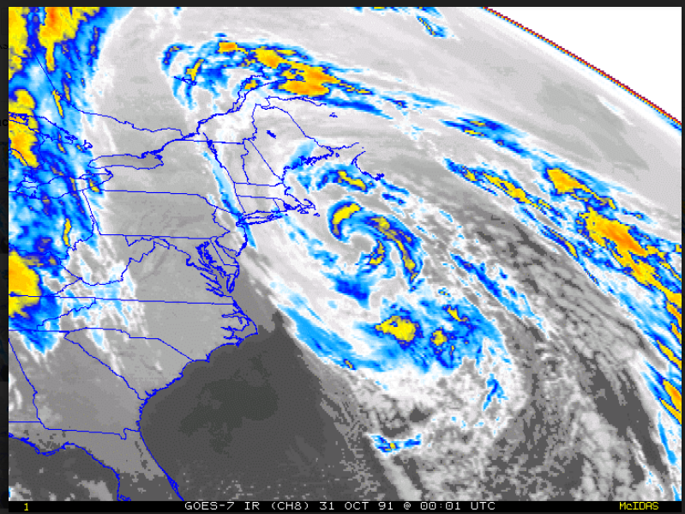
Sequence every 30 min: IR 7PM EST (0001z/31) in flight attempted rescue

Slide 41
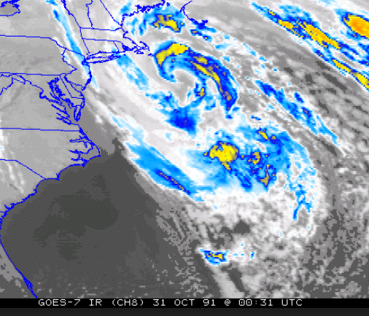
IR 730 PM EST (0031z/31) in flight attempted rescue

Slide 42
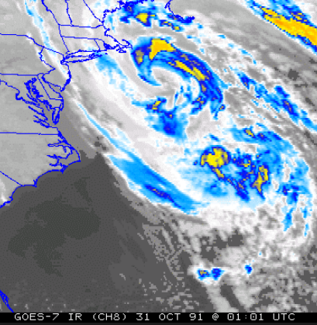
IR 8 PM EST (0101z/31) in flight attempted rescue

Slide 43
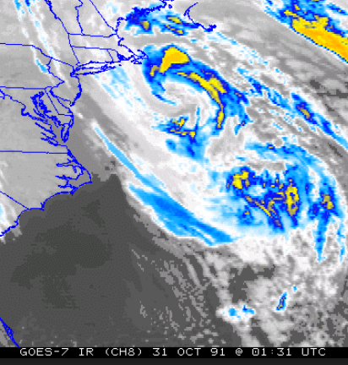
IR 830 PM EST (0131z/31) in flight attempted rescue

Slide 44
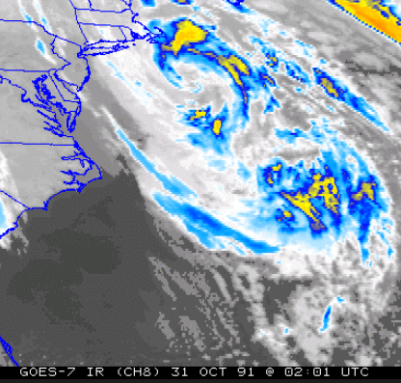
IR 9 PM EST (0201z/31) in flight attempted rescue

Slide 45
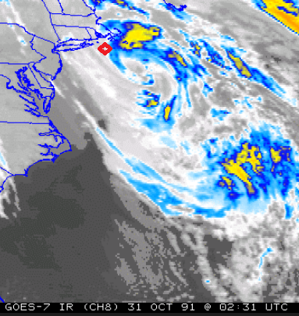
IR 930 PM EST (0231z/31) rescuers forced to ditch (red)

Slide 46
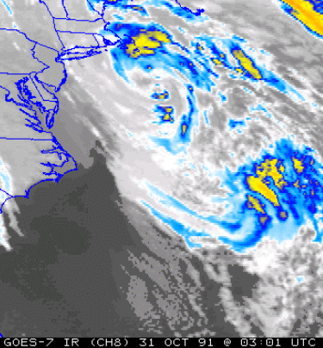
IR 10 PM EST (0301z/31)

Slide 47
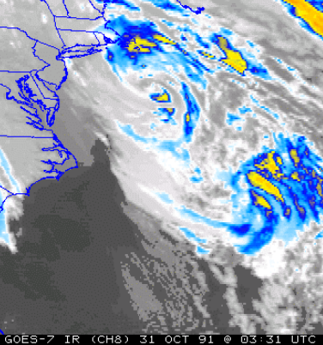
IR 1030 PM EST (0231z/31)

Slide 48
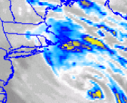
IR 11 PM EST (0401z/31)

Slide 49
5 minutes for questions/comments/shares.

