Slide 1
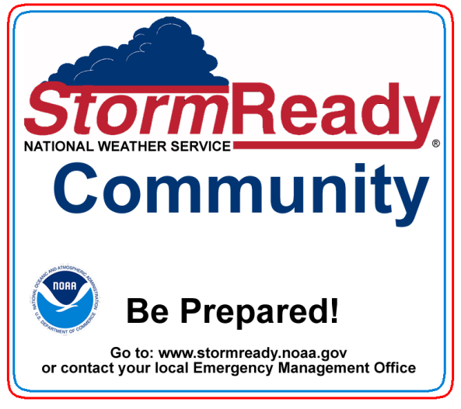
StormReady Rhode Island Initiative
Building community resilience in the face of increasing vulnerability to extreme weather & water events
Presented by
Pete Gaynor & Stephen Conard

Slide 2
Agenda
Purpose
What is the StormReady program?
Goals & Benefits
How the SRRI Initiative Works
How the SRRI Community Liaison assists Local EMDs
How the Process Actually Works
Insights, Best Practices, Challenges & Recommendations
What’s Next?
Questions?
2

Slide 3
Purpose
To share information, insights, best practices, challenges and recommendations about our community preparedness effort, entitled StormReady Rhode Island with weather professionals in order to better achieve statewide resilience.
3

Slide 4
What is the StormReady Program?
StormReady is a nationwide program that helps communities better protect their citizens during severe weather from tornadoes to tsunamis.
The program encourages communities to take a proactive approach to improving local hazardous weather operations.
StormReady provides emergency managers with clear-cut guidelines on how to improve their hazardous weather operations.

Slide 5
What is the StormReady Rhode Island Initiative?
StormReady Rhode Island (SRRI) initiative is a forward-leaning community preparedness project that encourages all Rhode Island communities to proactively protect their citizens during severe weather.

Slide 6
Goals
Goal 1 of the StormReady Rhode Island initiative is to improve community preparedness in order to save lives and property--before, during and after a disaster.
Goal 2 of the StormReady Rhode Island initiative is to become the first state in the nation to have 100% participation from all cities and towns in Rhode Island.

Slide 7
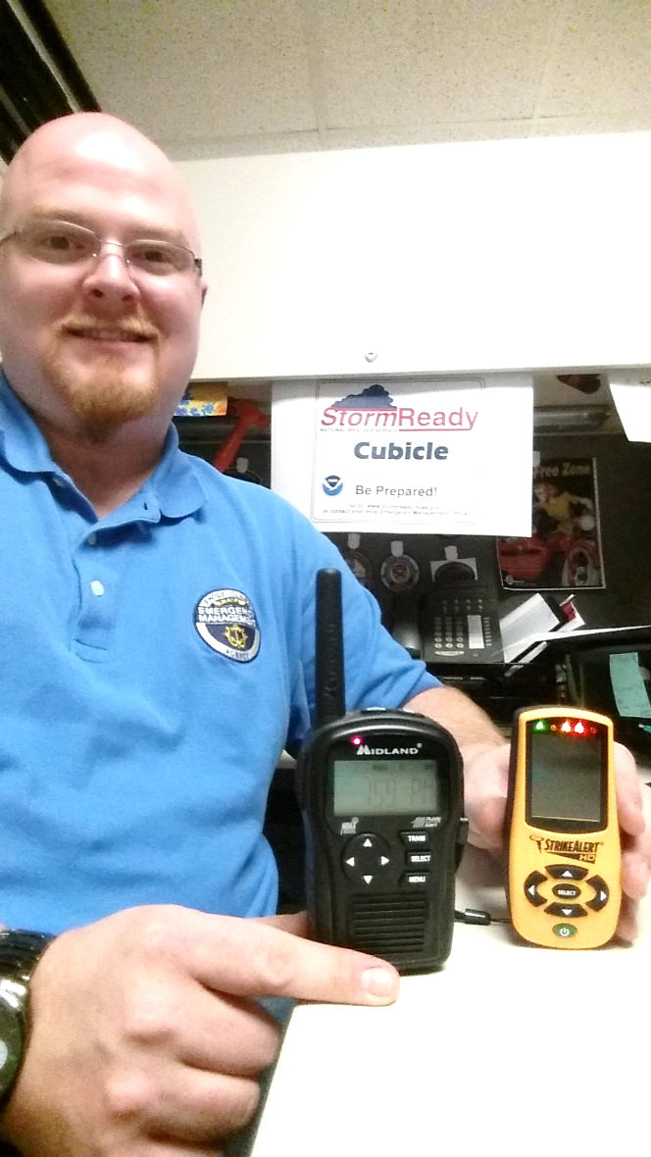
Tangible Benefits
Receive an extra $2,500 no-match EMPG Award
Receive up to four (4) NOAA Weather Radios per community
Receive up to four(4) Hand-held Lightning detectors
CRS Program - 25 points for StormReady

Slide 8
How the SRRI Initiative Works
RIEMA dedicated an employee to be the SRRI Community Liaison – Stephen Conard.
RIEMA incentivized the initiative by offering a $2500, no match Emergency Management Program Grant (EMPG) award for successfully achieving the StormReady designation.
Worked in close collaboration with the National Weather Service (NWS) Taunton Office, RIEMA and NWS stream-lined the application and approval process.

Slide 9
How the SRRI Community Liaison assists Local EMDs
Assists each community through the entire application and approval process.
Provides a partially completed StormReady Application for each community.
Provides NOAA Weather Radios & Hand-held Lightning Detectors per community, if required.
Provides a Hazardous Weather Operations Plan template for each community.

Slide 10
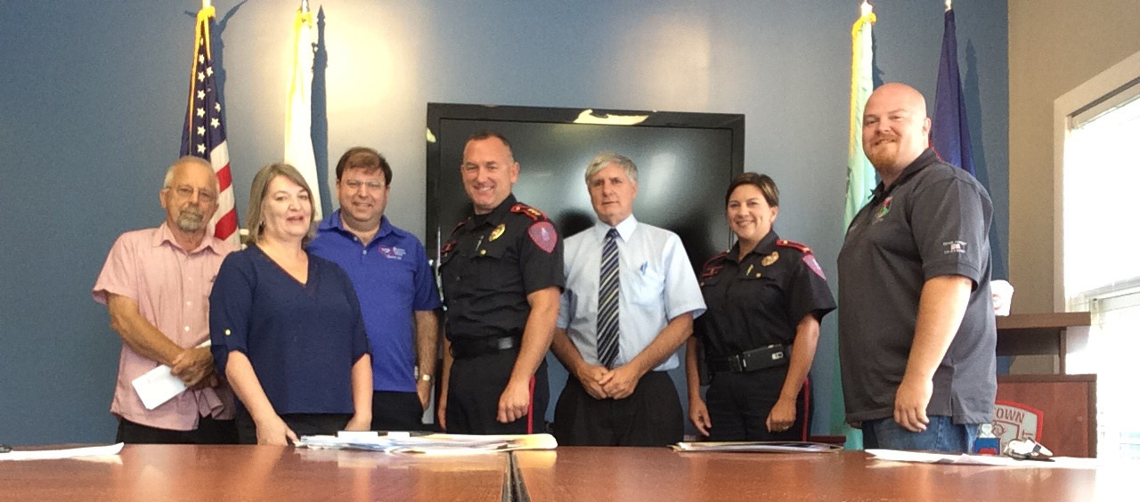
How the Process Actually Works
Develop Packet for community visits
Meet with the EMD
Meet with Glenn
Conduct Final Review & Approval Meeting
Process Grant Assurance packet
Town of Jamestown
10

Slide 11
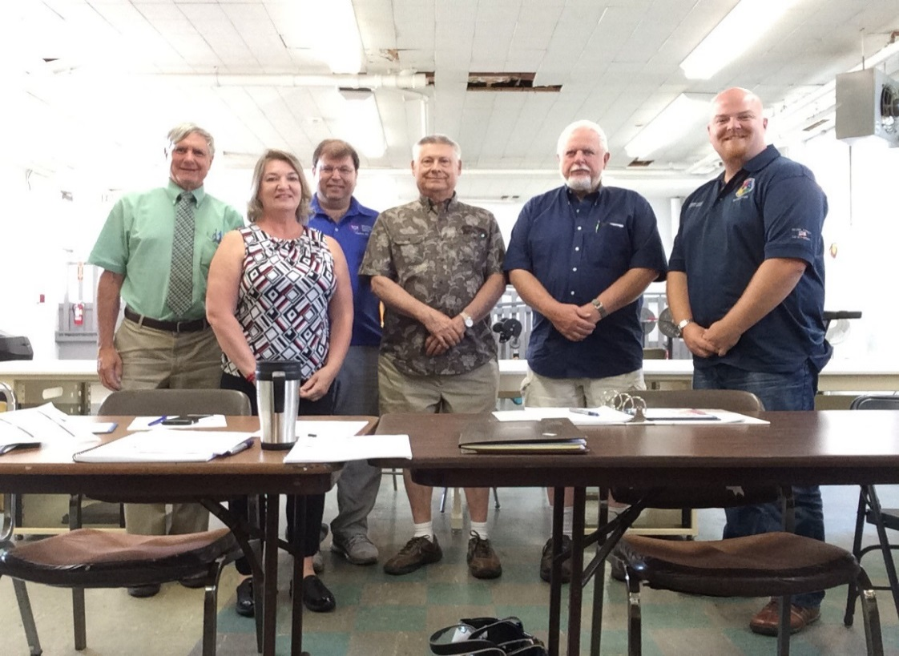
Insights
Resources
Time Management
Town of North Smithfield
11

Slide 12
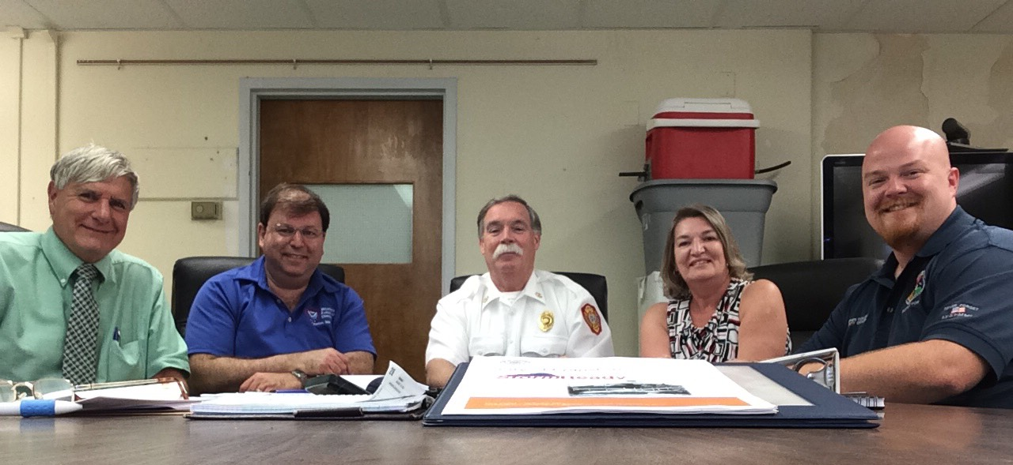
Best Practices
Changed formats when new advisories released
City of Cranston
12

Slide 13
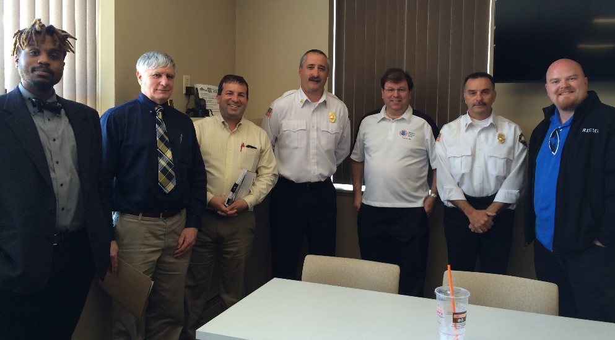
Best Practices
Re-utilized SOP and Annexes
City of Woonsocket
13

Slide 14
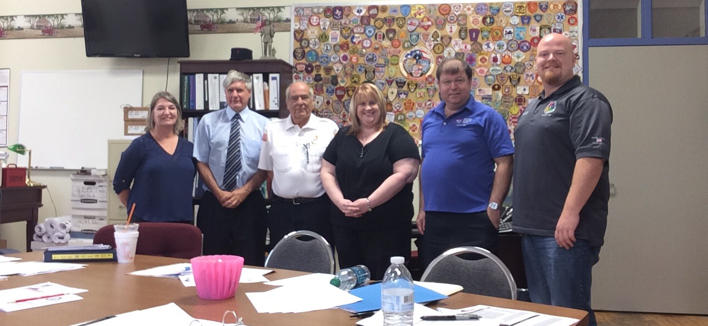
Best Practices
Pre – Weather Service meetings are CRUCIAL
Town of Warren
14

Slide 15
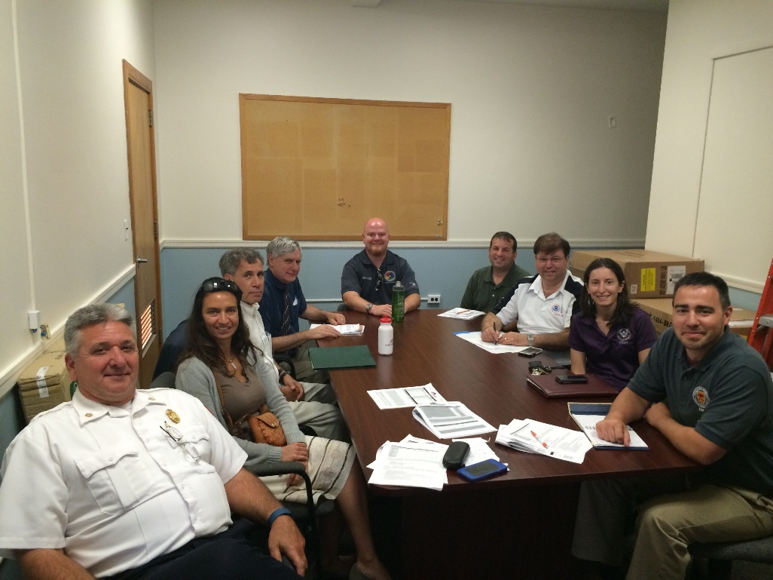
RI StormReady Communities
Burrillville
Central Falls*
Cranston
Hopkinton
Jamestown
Middletown
North Smithfield
Pawtucket*
Portsmouth
Providence
*Pawtucket and Central Falls have a combined Emergency Management under the title PCF
Town of West Warwick
17 of 39
15

Slide 16
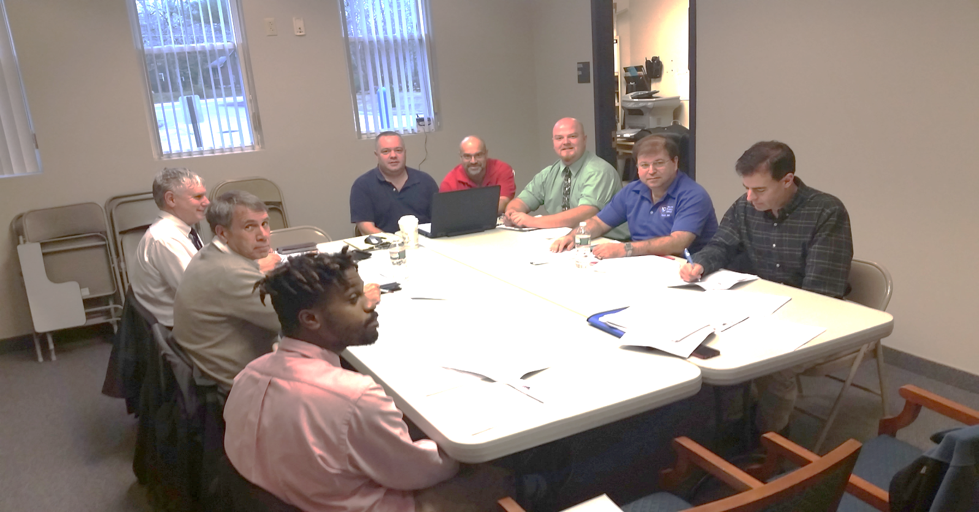
RI StormReady Communities
Scituate
Smithfield
Tiverton
Warren
West Warwick
Westerly
Woonsocket
Town of Hopkinton
16

Slide 17
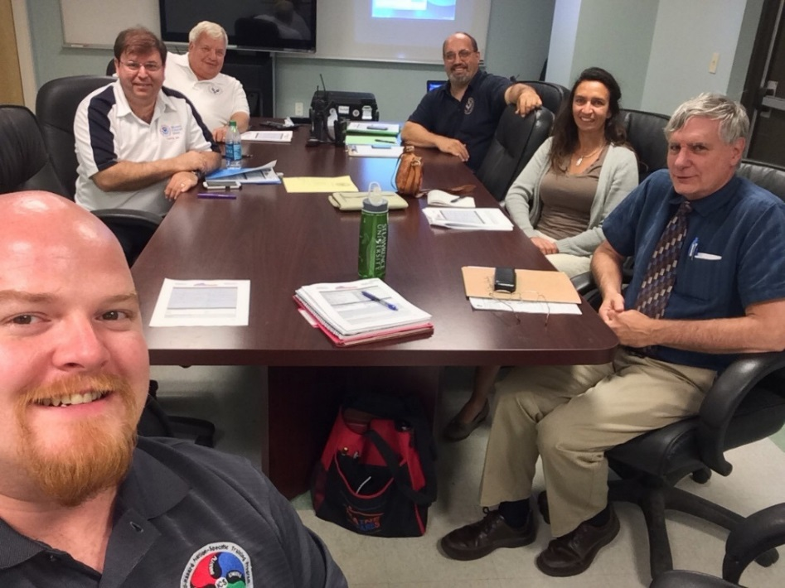
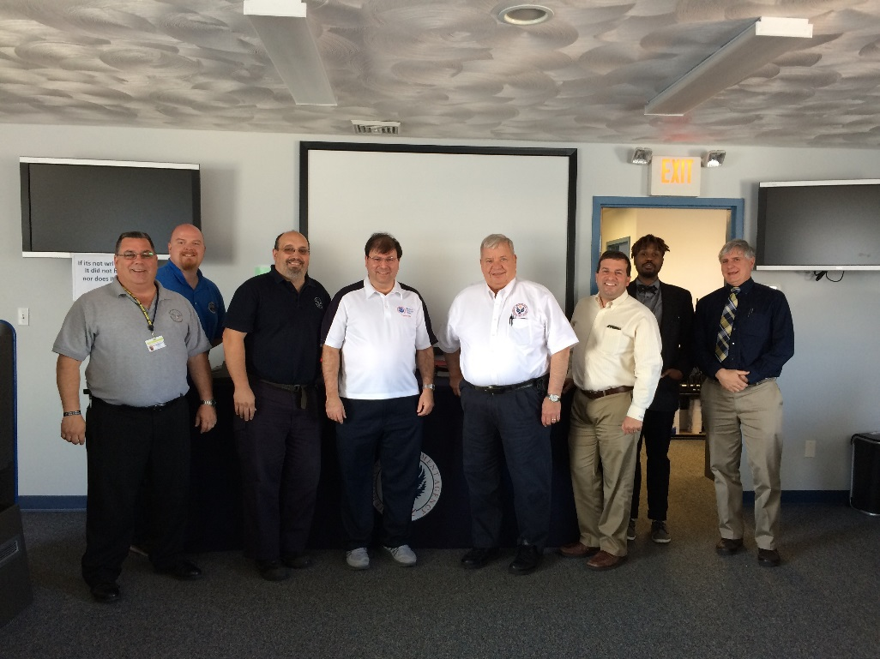
Challenges
Time management
Those pesky storms
City of Central Falls
City of Pawtucket
17

Slide 18
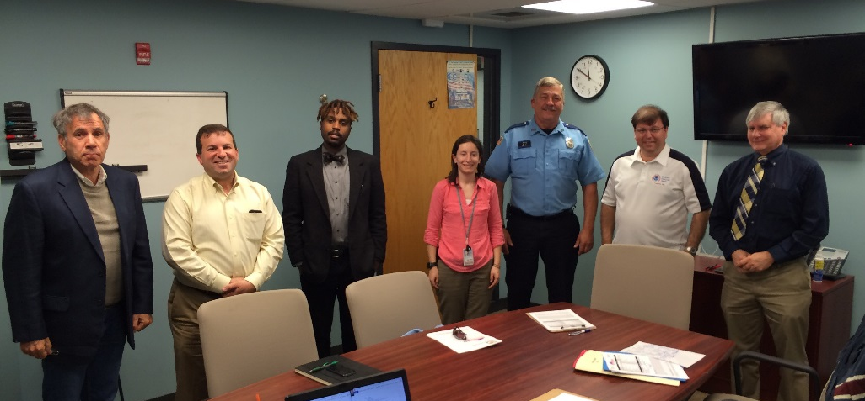
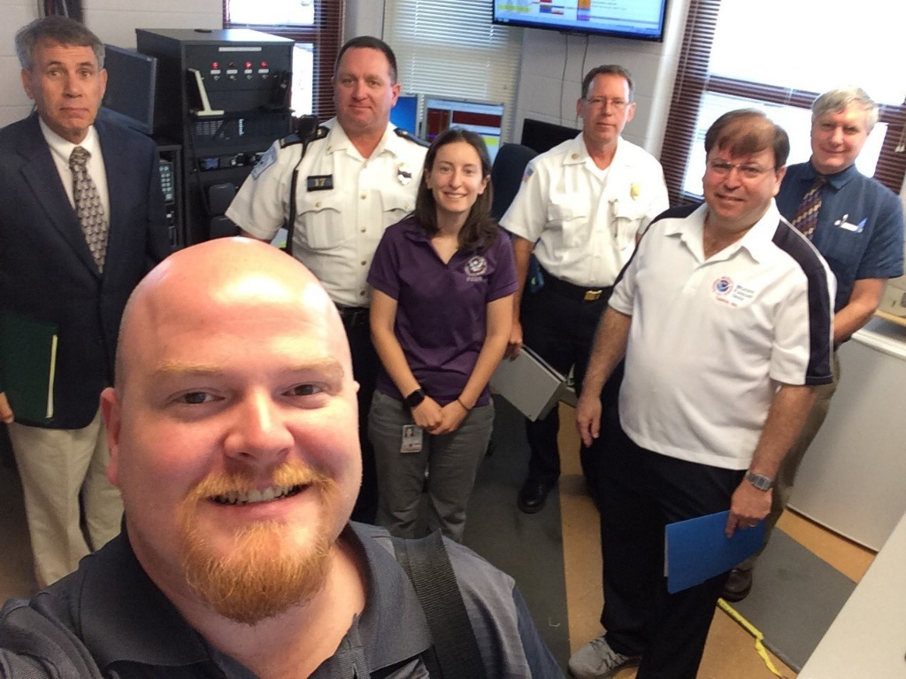
Challenges
Financial issues
Town of Burrillville
Town of Middletown
18

Slide 19
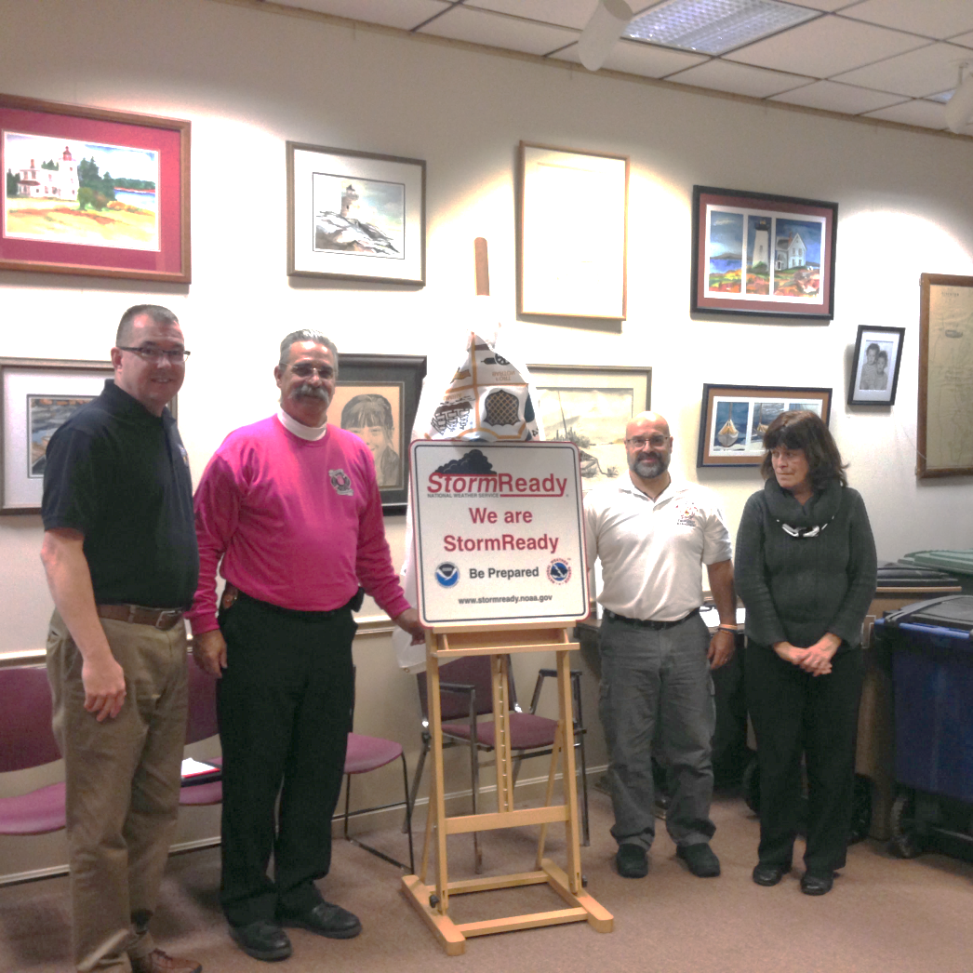
Recommendations
Commit a staffer to program
Support their progress
Be upfront and concise with stakeholders
Town of Tiverton
19

Slide 20
What’s Next?
Upon completion of the 39 cities and towns becoming StormReady, Rhode Island will apply to be a StormReady State!
State
20

Slide 21
Questions & Contact Information
Director Pete Gaynor, CEM®, Director
Phone: 401.626.6256
E-Mail: peter.gaynor@ema.ri.gov
Stephen Conard, CEM®, SRRI Community Liaison
Phone: 401.462.7102
E-Mail: stephen.conard@ema.ri.gov
Twitter: @RhodeIslandEMA
Facebook: facebook.com/rhodeislandema
Web: riema.ri.gov
21

