Slide 1
Northeast US Tornadoes and Tornado Debris Signatures
Ryan Hanrahan / WVIT-TV
NBC Connecticut
Southern New England Weather Conference
October 29, 2016

Slide 2
About Tornadoes in the NE US
Since the dual-pol WSR-88d upgrade in 2012 there have been 54 tornadoes in New York, New Jersey and New England.
Tornadoes are relatively rare but can be destructive and deadly (1953, 1979, 1989, 2011, etc.)
Communicating the risk and danger posed by tornadoes can be challenging here since they don’t happen with great regularity.

Slide 3
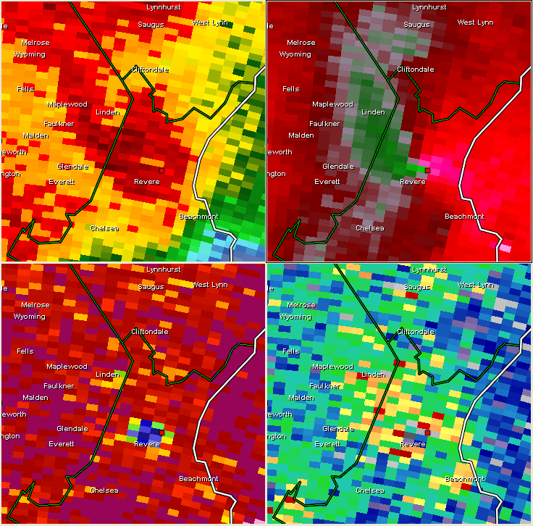
Doppler Radar & Tornadoes
Doppler radar allows us to determine the radial velocity of targets (rain, hail, etc.)
Strong inbound velocities next to strong outbound velocities suggest rotation or spin of a thunderstorm.
Notes:
Check to change rotational vs convergent signatures

Slide 4
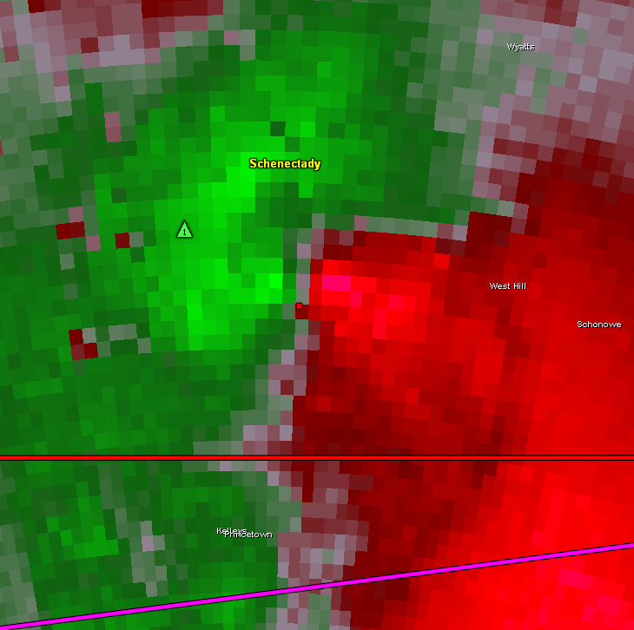
Velocity Signatures
Vrot = (Max Outbound + Max Inbound) / 2

Slide 5
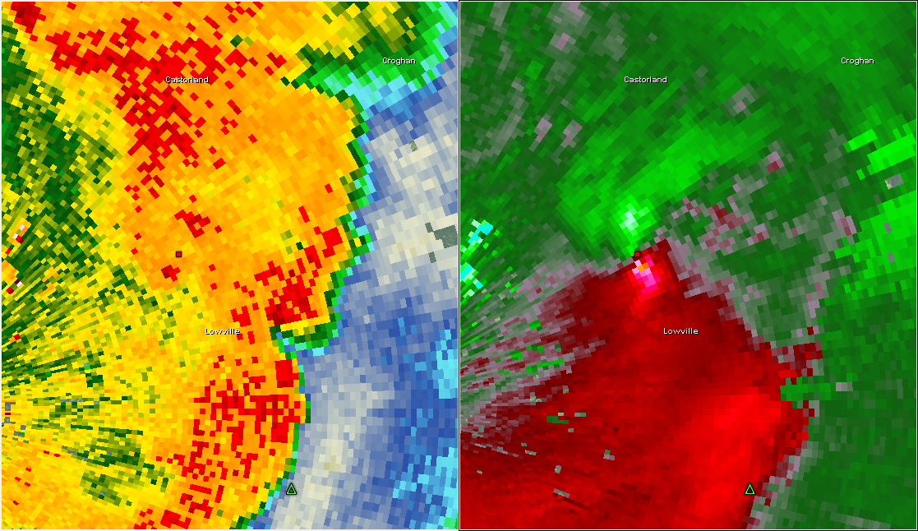
Not All Velocity Signatures are Equal
38kts inbound
88kts outbound

Slide 6
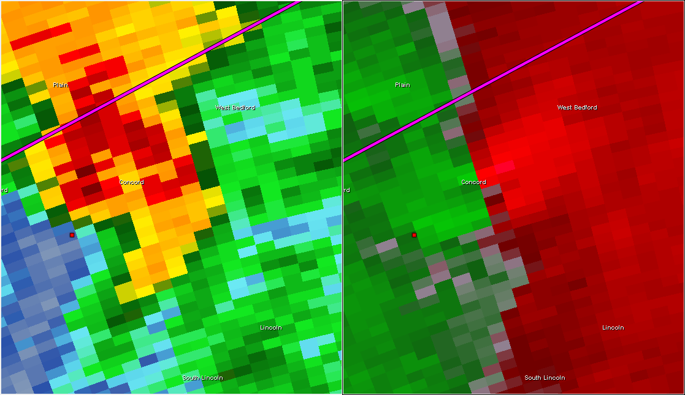
Not All Velocity Signatures are Equal
36kts outbound
36kts inbound

Slide 7
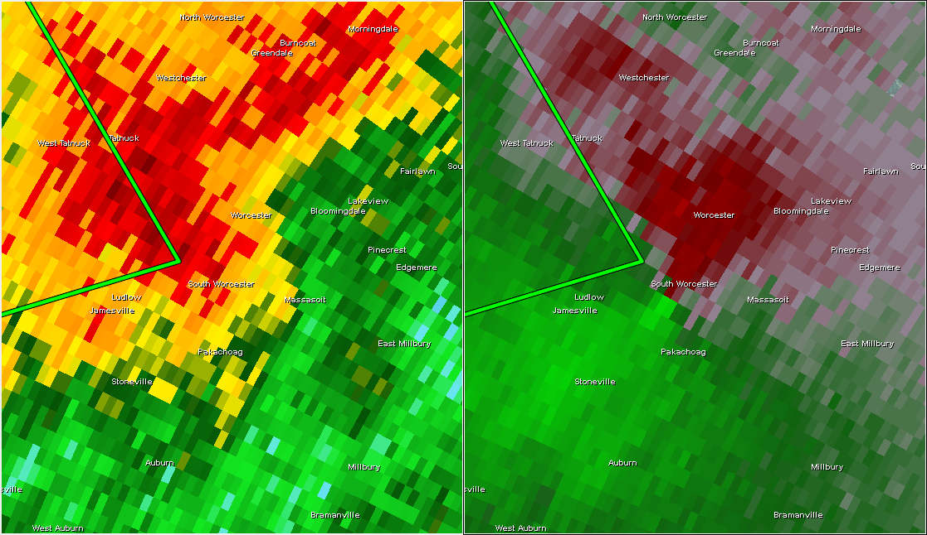
Not All Velocity Signatures are Equal
12kts outbound
33kts inbound

Slide 8
Velocity Signatures
Immediately prior to tornadogenesis 14 of 54 (26%) had no discernible low level rotation
 | Vrot Prior
Mean | 26.6 knots
Median | 25.5 knots

Slide 9
Velocity Signatures
During life of the tornado 10 of 54 (18%) had no discernible low level mesocyclone.
 | Vrot Max
Mean | 30.7 knots
Median | 29.5 knots

Slide 10
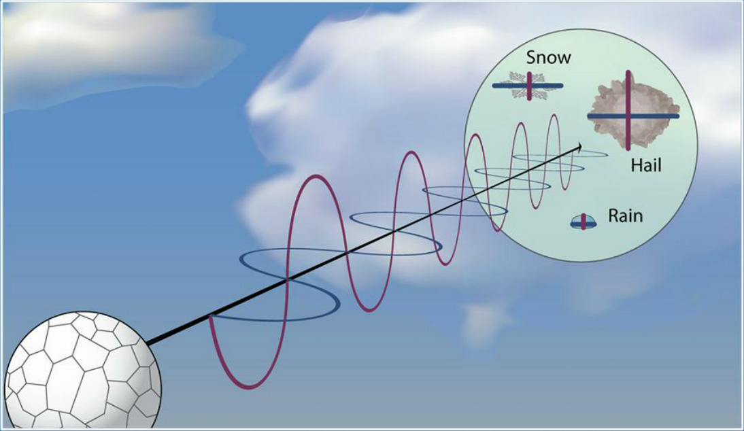
What is Dual Pol Radar?
Radar sends out 2 pulses – a horizontal and a vertical pulse.
This allows us to determine size, shape and variety of targets.
We can also discriminate between meteorological and non-meteorological targets.
Notes:
Add in the WDTB schematic of dual pol

Slide 11
What’s a Tornado Debris Signature?
Large variability in shapes of tornado debris produces a unique signature on dual pol radar.
Tornado debris also “tumbles” through the air as it falls. This tumbling motion makes the radar think it is detecting a spherical object.

Slide 12
What’s a Tornado Debris Signature?
A TDS can be used as confirmation a tornado is occurring – it’s as good as a spotter report!
A TDS can’t give lead time – once a TDS has appeared the tornado is already doing damage.

Slide 13
TDS Detection – Step By Step
I like using 4-panel radar charts on GR2Analyst.
You need reflectivity, velocity, and correlation coefficient. In my 4th panel I use either differential reflectivity or normalized rotation.
Radarscope works too – but it can be tricky.
Reflectivity
Velocity
CC
ZDR

Slide 14
TDS Detection – Step #1
Using Storm Relative Velocity identify an area of rotation - Strong inbound velocity next to strong outbound velocity.
This tells you that a storm is rotating/has a mesocyclone.

Slide 15
TDS Detection – Step #2
Confirm there is sufficient reflectivity (Z >30 dbz) co-located with the low level mesocyclone.

Slide 16
TDS Detection – Step #3
Correlation Coefficient tells us how similar target are to one another.
Steady rain/snow CC = 0.95-1.0
Rain & Melting Hail CC = 0.9-1.0
Biological Scatters CC – 0.5-0.9
Tornado debris CC <0.9

Slide 17
TDS Detection – Step #3
Look for relatively reduced CC coincident with reflectivity and rotation. CC < 0.9 is a good guideline to use. CC can drop to <0.5 in some cases.
Also – look for temporal and vertical continuity!

Slide 18
TDS Detection – Step #4
Look for differential reflectivity (ZDR) near 0.
ZDR tells us the shape of echoes and the radar thinks tumbling debris is spherical - so it should be seeing equal horizontal and vertical returns.
This is not necessary but gives you a nice confidence boost!

Slide 19
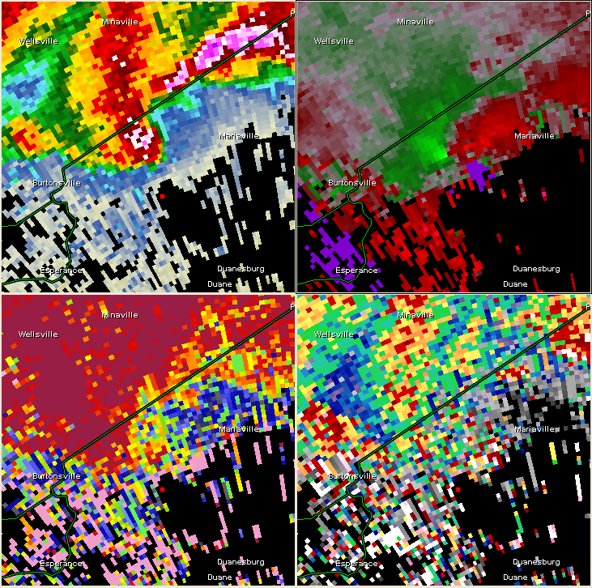
TDS Detection – Biggest Mistake
The inflow region!!!
CC is typically very low in a storm’s inflow region. Bugs, birds, dust and so on get sucked into a storm’s updraft.
Make sure low CC is associated with rotation AND sufficient reflectivity.

Slide 20
TDS Cheat Sheet
Reflectivity (>35 dBZ)
CC < 0.90
ZDR near 0 (not necessary but adds confidence)
ALL COINCIDENT WITH STRONG ROTATION/TVS

Slide 21
NE US Tornado Debris Signatures
Out of 54 tornadoes since 2012…
14 have produced debris signatures or 26%!!
Notes:
Update statistics

Slide 22
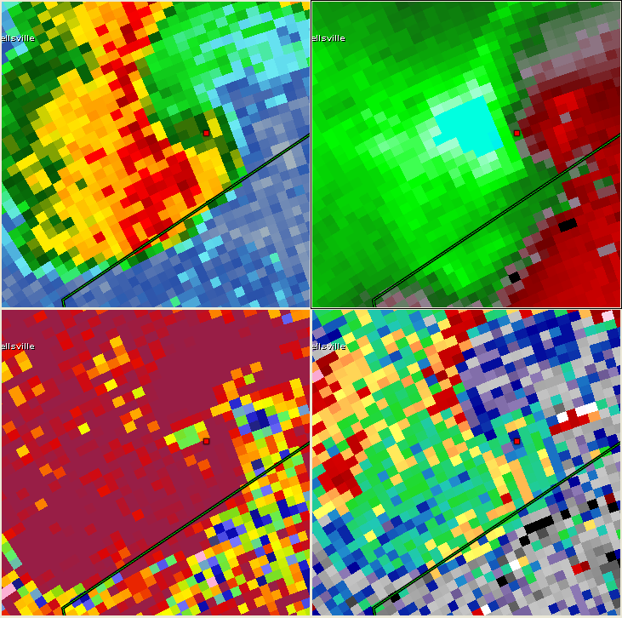
Schenectady County NY 5/29/13
48 knots Vrot around time of tgen
TDS? Probably (CC 0.80-0.85) with Z ~ 35 dbz
1000ft ARL
2242 UTC

Slide 23
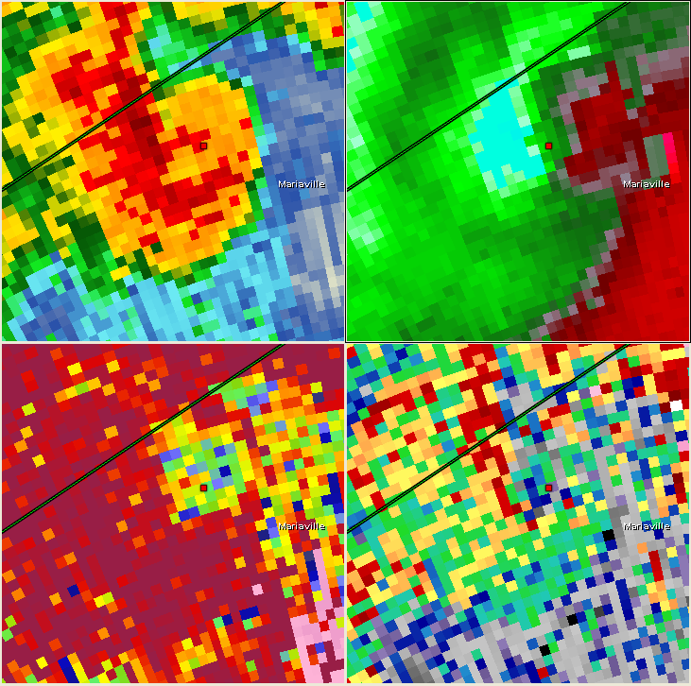
Schenectady County NY 5/29/13
Clearer TDS at this point.
Rotation remains broad but strong (NROT not shown up to 1.36)
2247 UTC

Slide 24
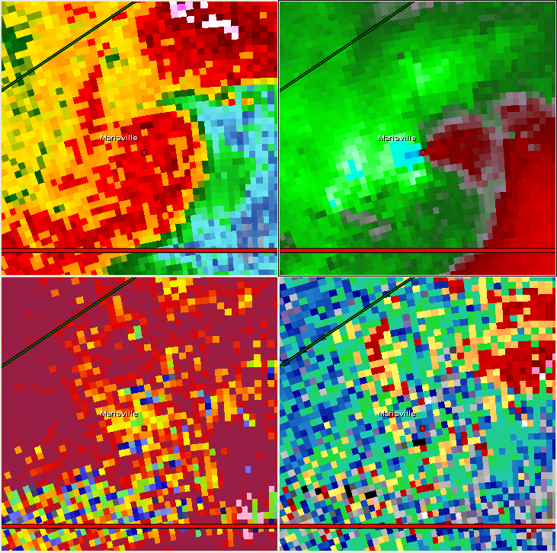
Schenectady County NY 5/29/13
Couplet tightens dramatically. Vrot 49 knots.
EF-2 damage in the town of Mariaville.
Weak TDS still visible.
2252 UTC

Slide 25
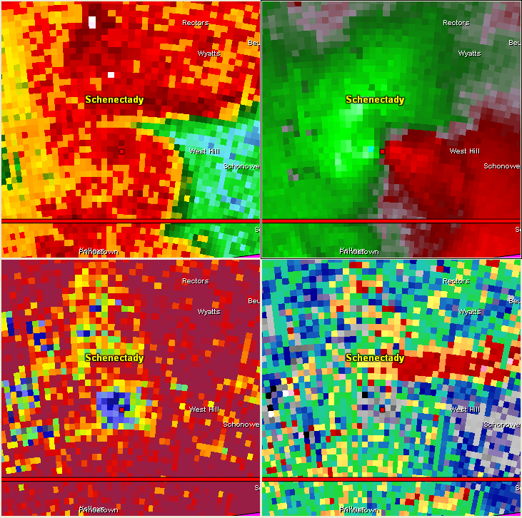
Schenectady County NY 5/29/13
Much more impressive TDS after tornado hits Mariaville.
TDS clear up through 6200 ft ARL.
2257 UTC

Slide 26
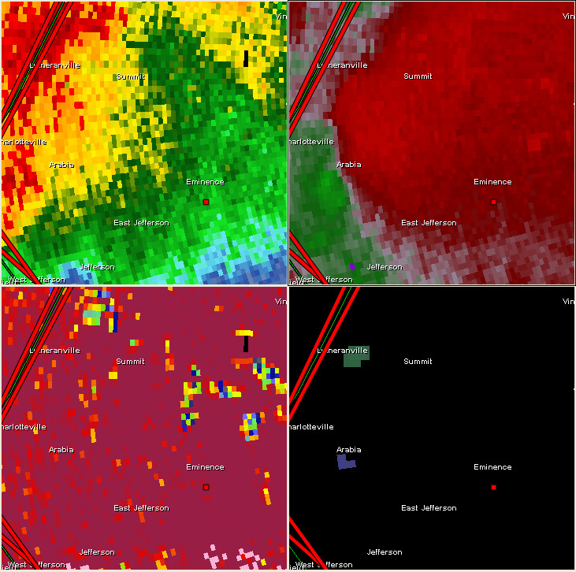
Schoharie County NY 5/29/13
No rotation detected on radar prior to tgen.
Pretty blah looking storm.
2252 UTC

Slide 27
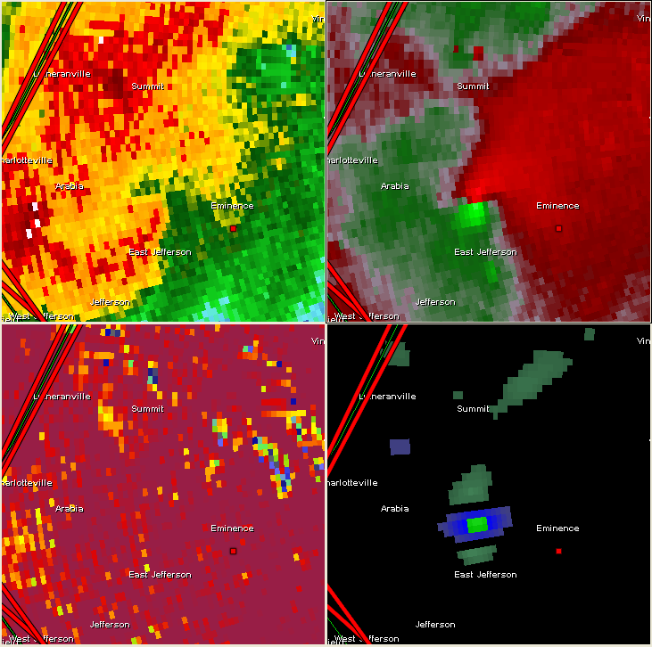
Schoharie County NY 5/29/13
5 minutes later… whoa!
40 knots of Vrot (40 inbound, 40 outbound)
No TDS
2257 UTC

Slide 28
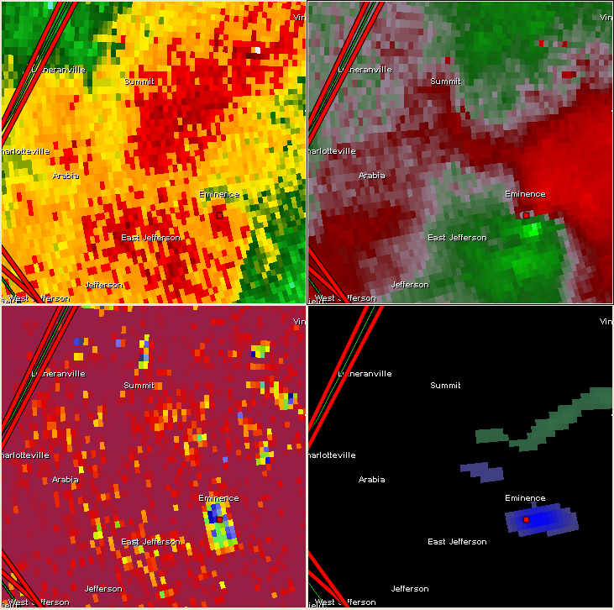
Schoharie County NY 5/29/13
Clear TDS
Tornado has lifted by this point.
2302 UTC

Slide 29
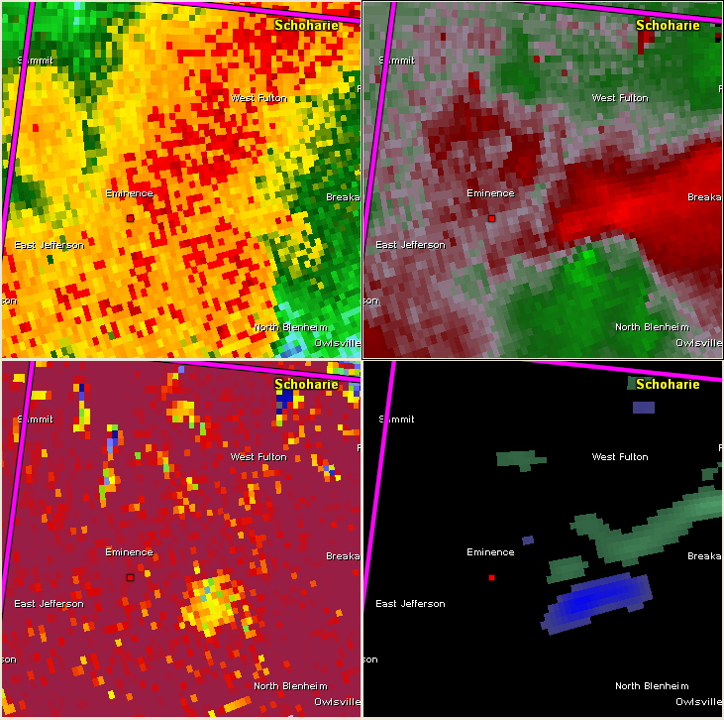
Schoharie County NY 5/29/13
TDS signature less impressive.
Max height of lofted debris around 3400 ft ARL.
2307 UTC

Slide 30
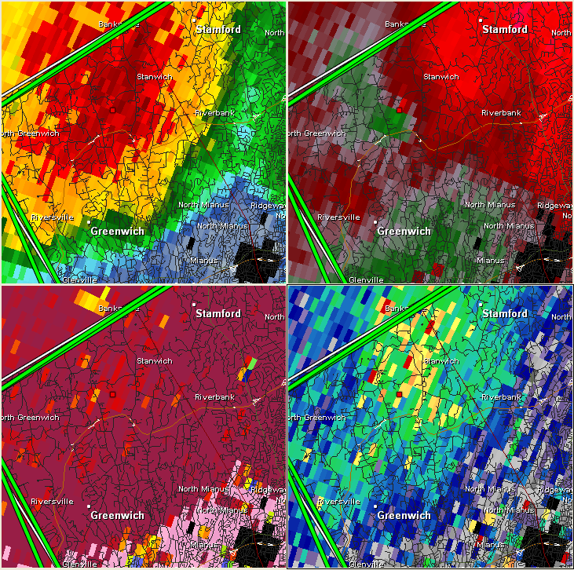
Fairfield County CT 7/1/13
Borderline case!
At time of touchdown Vrot of 26 knots (close to median value of all tornadoes).
1456 UTC

Slide 31
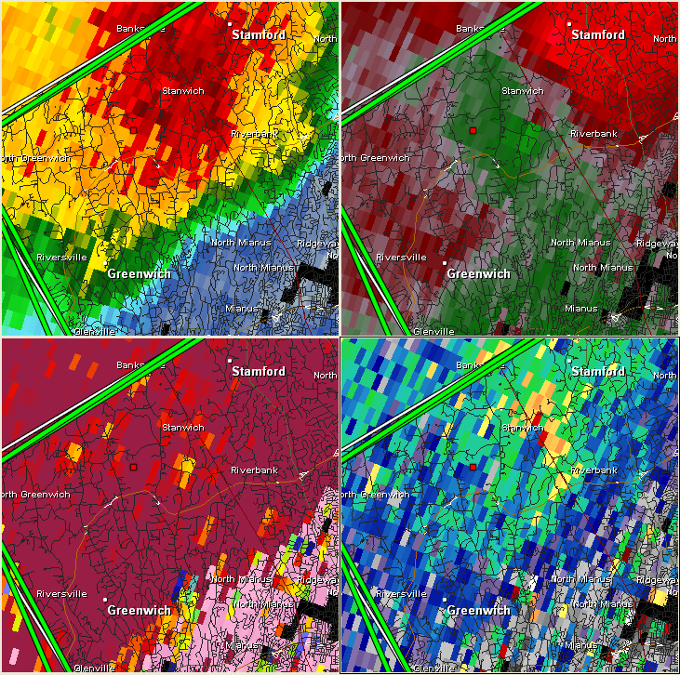
Fairfield County CT 7/1/13
Tornado still on the ground.
3.7 miles, 10 minutes.
EF-0 damage.
Slight CC depression (0.90 with couplet)
1500 UTC

Slide 32
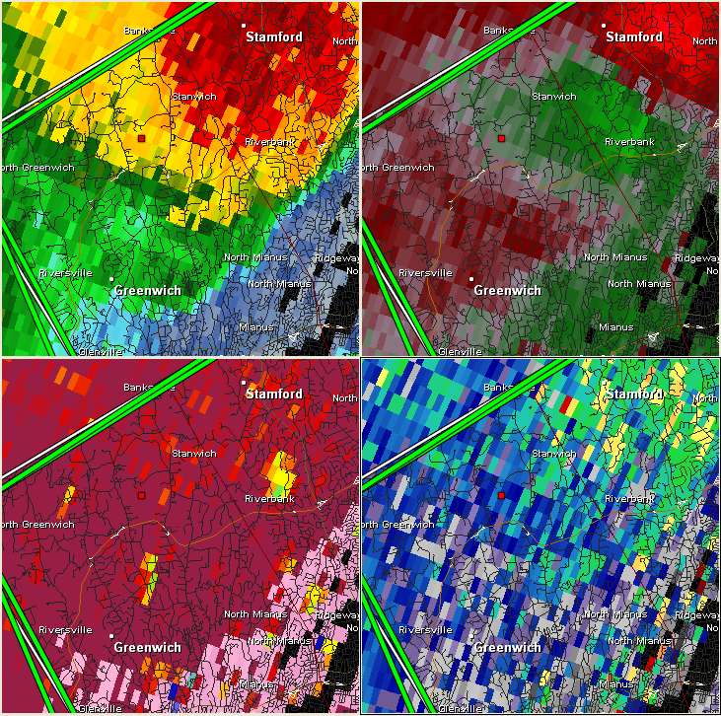
Fairfield County CT 7/1/13
TDS visible here – CC 0.85-0.90 along with ZDR near zero.
Only a few pixels – but coincident with damage path.
1504 UTC

Slide 33
Schenectady/Albany County NY 5/22/14
40 knots of Vrot at time of tgen – well above median of all cases.
1933 UTC

Slide 34
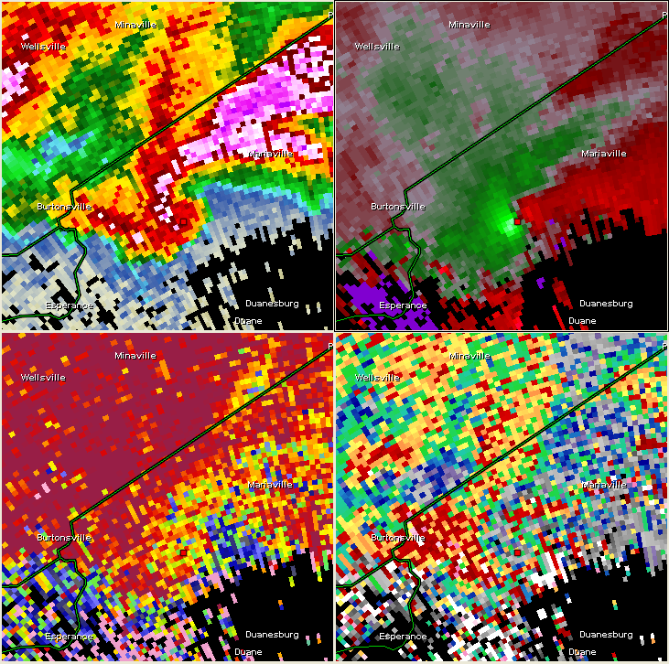
Schenectady/Albany County NY 5/22/14
Rotation tightens significantly.
Classic “hook echo” on reflectivity.
Only ~800ft ARL.
Low CC likely hail falling through updraft.
1938 UTC

Slide 35
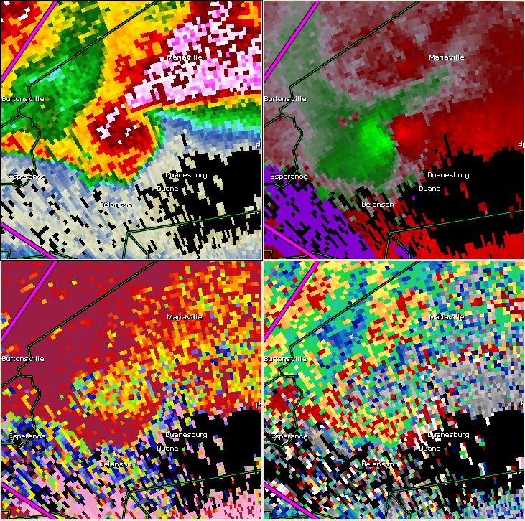
Schenectady/Albany County NY 5/22/14
Signal dominated still by hail.
Arc of noisy/low CC and ZDR into ”hook”
Still about 40 knots of Vrot.
1942 UTC

Slide 36
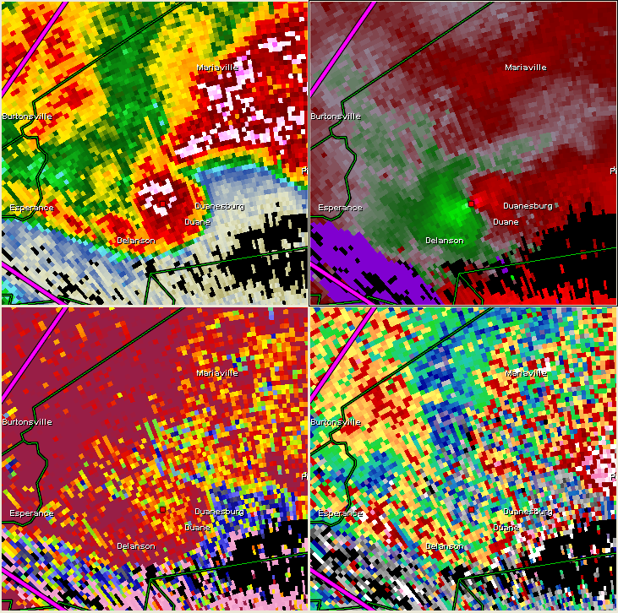
Schenectady/Albany County NY 5/22/14
Rotation strengthens near town of Delanson.
EF-3 damage.
Vrot ~46 knots.
Possibly a TDS here?
1947 UTC

Slide 37
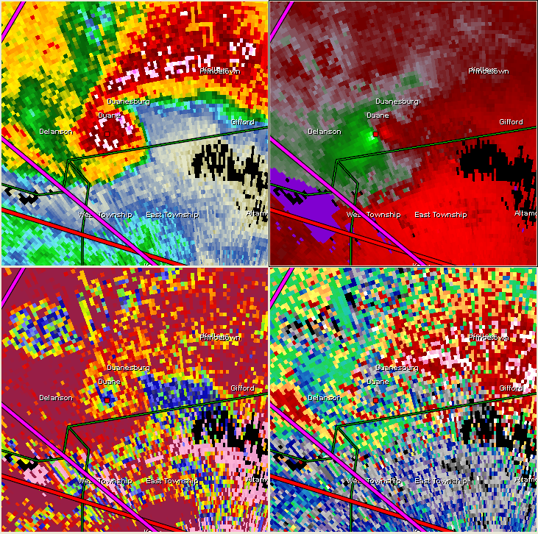
Schenectady/Albany County NY 5/22/14
Very clear TDS.
Maximum Vrot of nearly 50 knots.
Finally… a very clear TDS.
1952 UTC

Slide 38
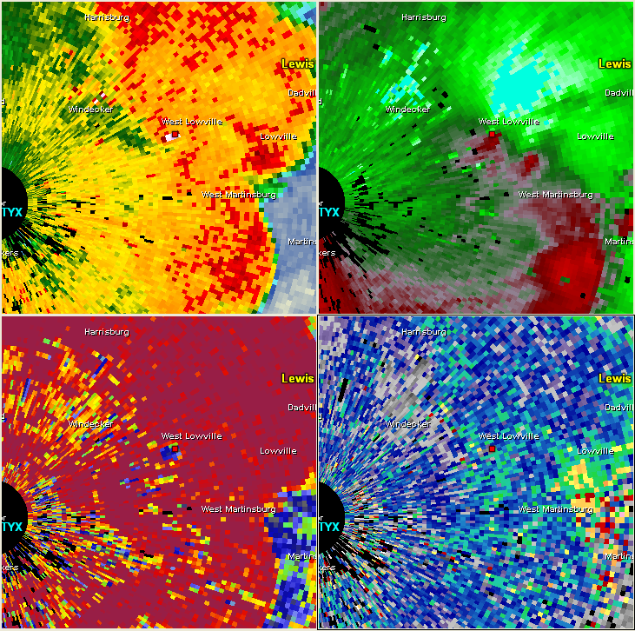
Lewis County NY 7/8/14
Strongest velocity signature of all cases.
35 knots Vrot prior to tornado.
2247 UTC

Slide 39
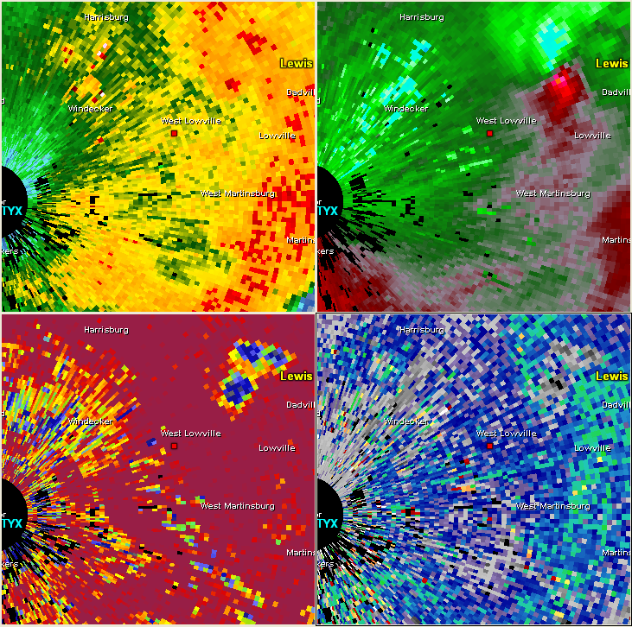
Lewis County NY 7/8/14
Large/classic TDS.
Vrot approaching 65 knots!
2250 UTC

Slide 40
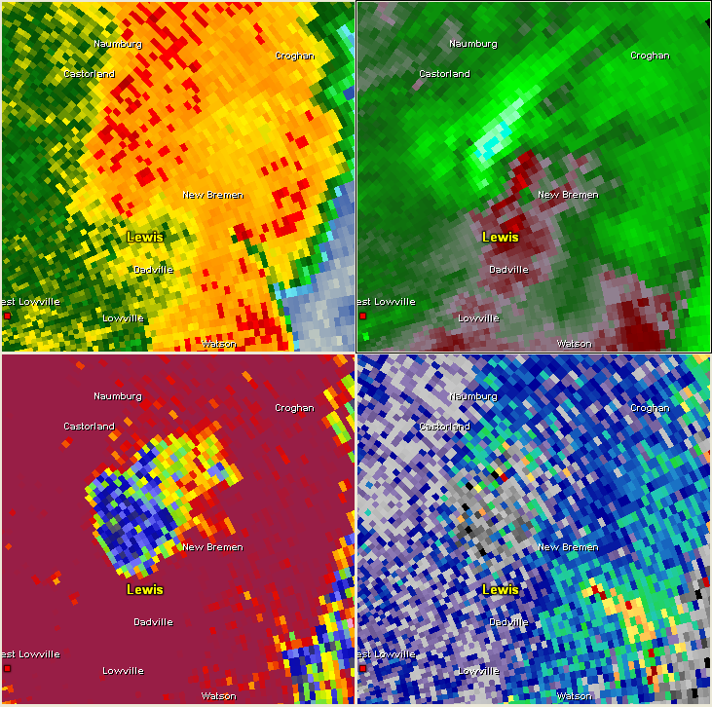
Lewis County NY 7/8/14
Couplet weakens but TDS grows.
2253 UTC

Slide 41
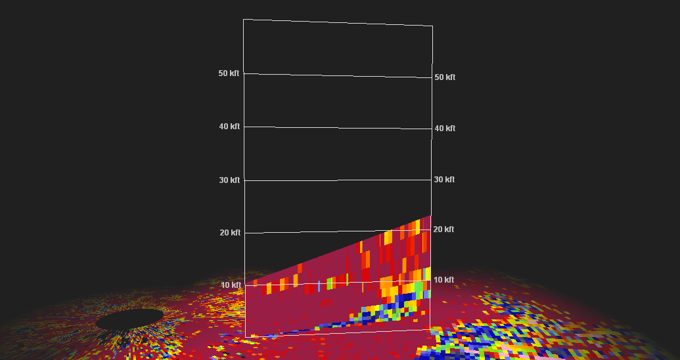
Lewis County NY 7/8/14
Tornado debris reaches nearly 9,000 feet ARL.
EF-1 strength, 12 mile path.
2247 UTC

Slide 42
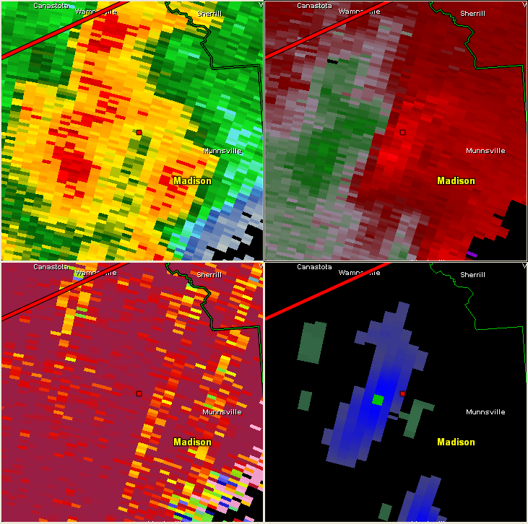
Madison County NY 7/8/14
4 fatalities / EF-2 tornado.
Broad meso prior to tgen.
NROT > 1.00
2258 UTC

Slide 43
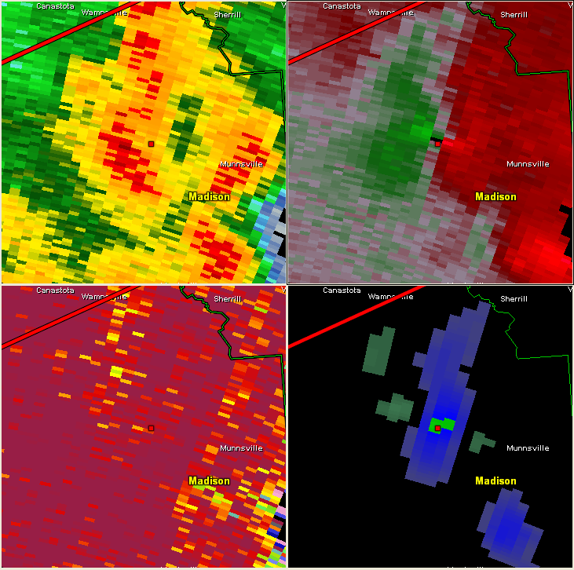
Madison County NY 7/8/14
Rapid tightening of low level rotation.
Vrot of 35 knots at time of touchdown.
2301 UTC

Slide 44
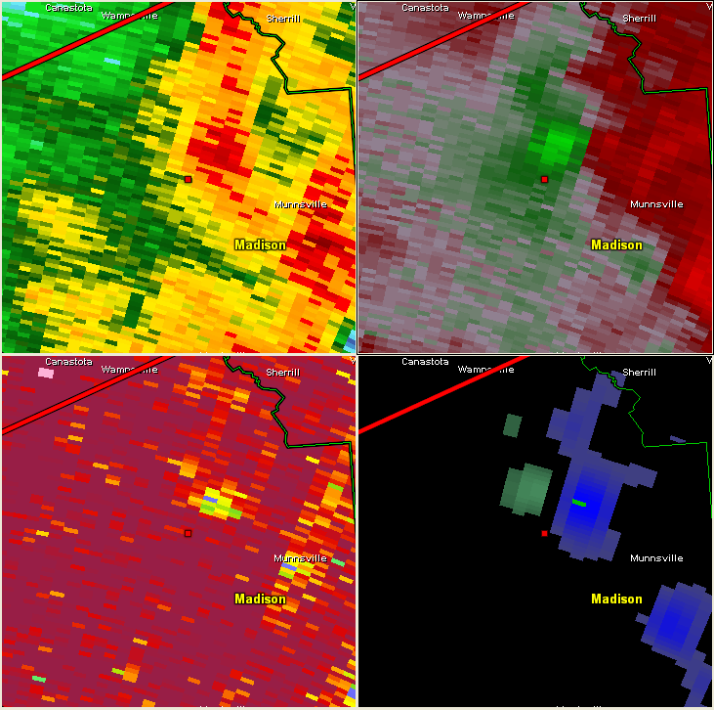
Madison County NY 7/8/14
TDS now apparent.
2303 UTC

Slide 45
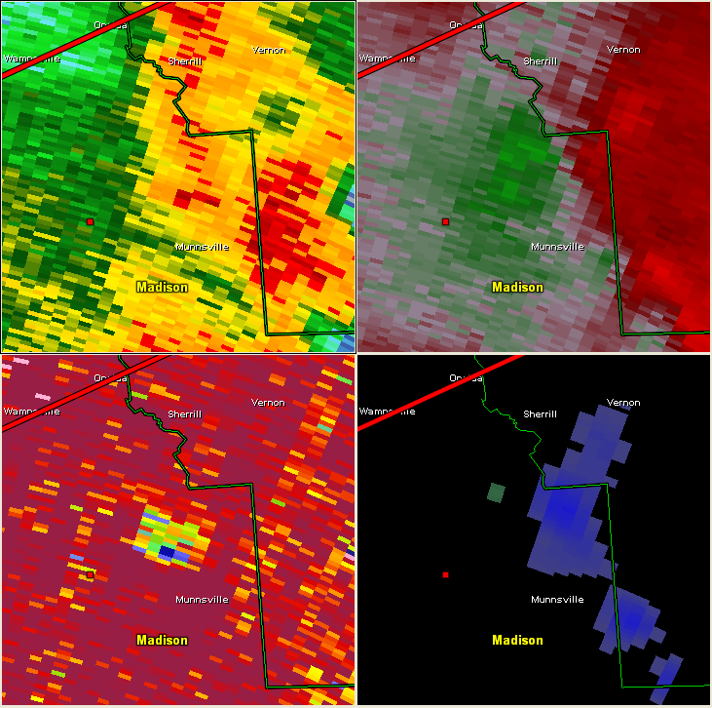
Madison County NY 7/8/14
Rotation has weakened, TDS remains.
2306 UTC

Slide 46
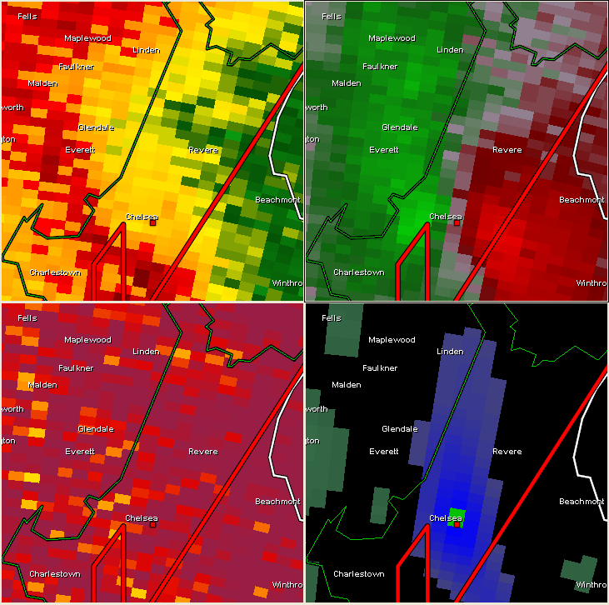
Suffolk County MA 7/13/14
Prior to touchdown 33 knots of Vrot (though not gate to gate)
NROT >1.0
1330 UTC

Slide 47
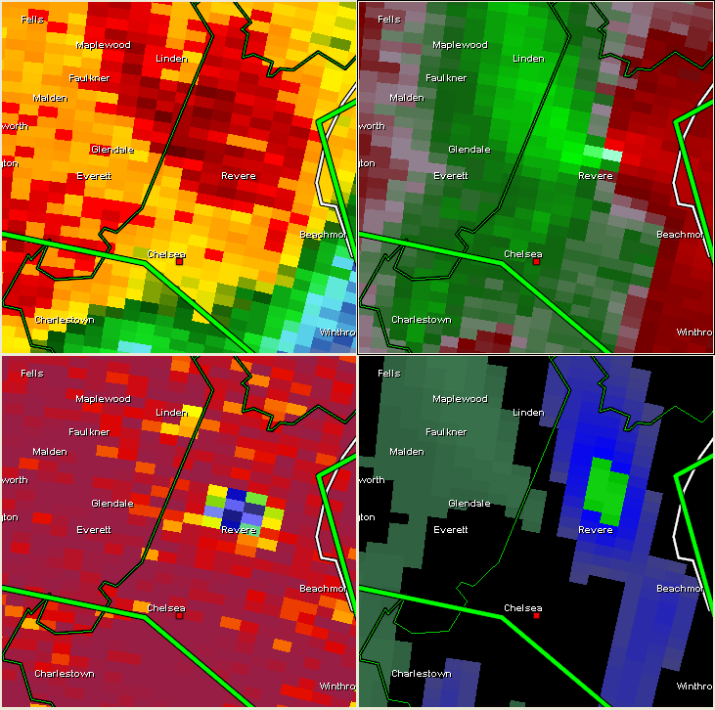
Suffolk County MA 7/13/14
VROT spikes to 42 knots after touchdown.
NROT >1.0
TDS extends up to 6100ft ARL.
1334 UTC

Slide 48
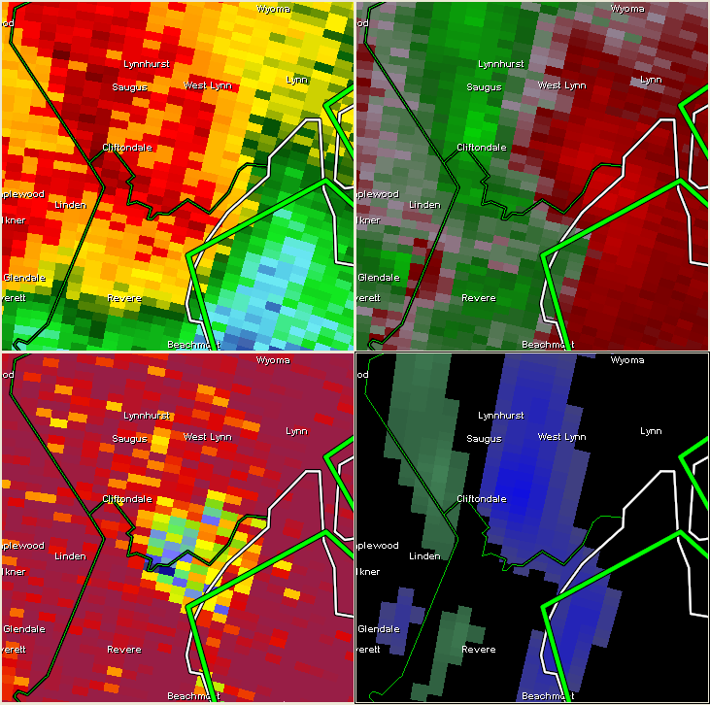
Suffolk County MA 7/13/14
Tornado lifts but debris remains lofted more than 5 minutes after tornado dissipates.
1339 UTC

Slide 49
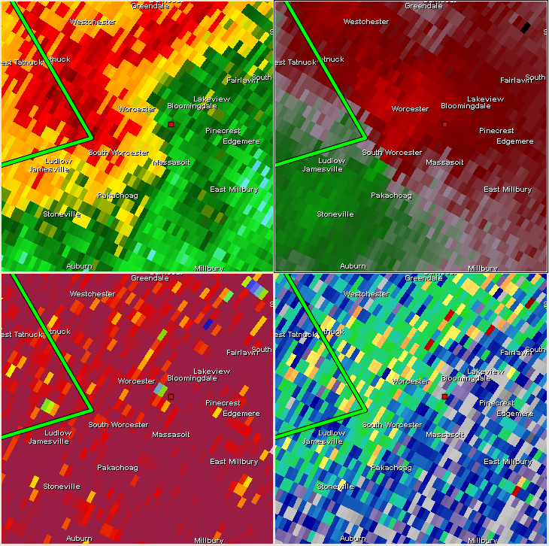
Worcester County MA 9/1/14
22 knots rotational velocity prior to touchdown.
NROT = 0.81
0004 UTC

Slide 50
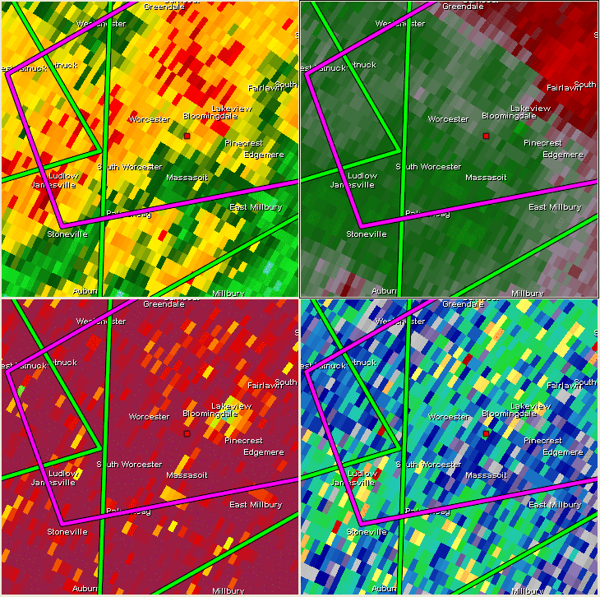
Worcester County MA 9/1/14
Peak VROT (not gate to gate) of 28 knots.
Small TDS does have vertical continuity 0.5 and 0.9 deg scans.
0004 UTC

Slide 51
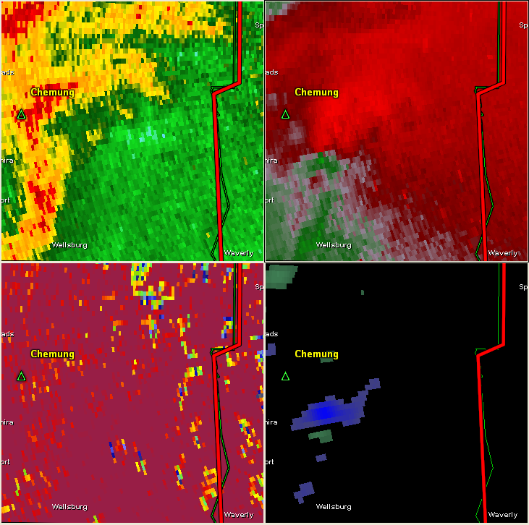
Chemung County NY 9/2/14
Vrot of 26 knots prior to tgen.
NROT = 0.93
2305 UTC

Slide 52
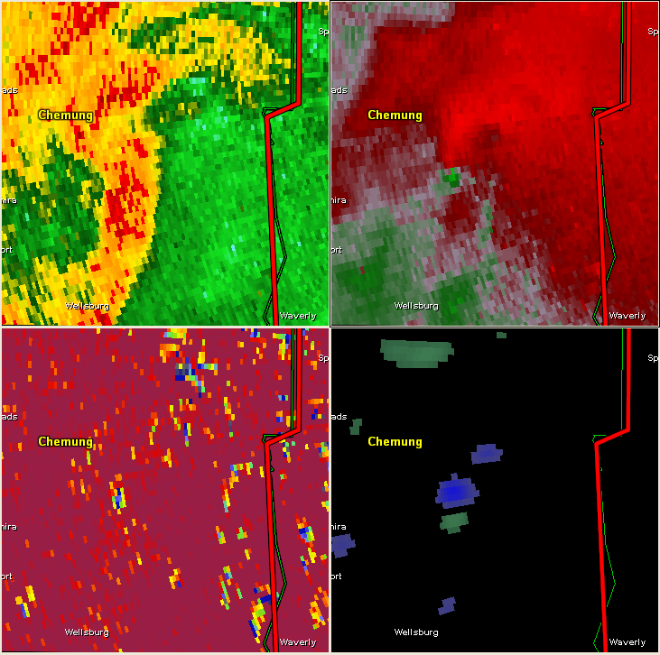
Chemung County NY 9/2/14
TDS reaches 9200ft ARL!
Maximum Vrot of 29 knots.
2310 UTC

Slide 53
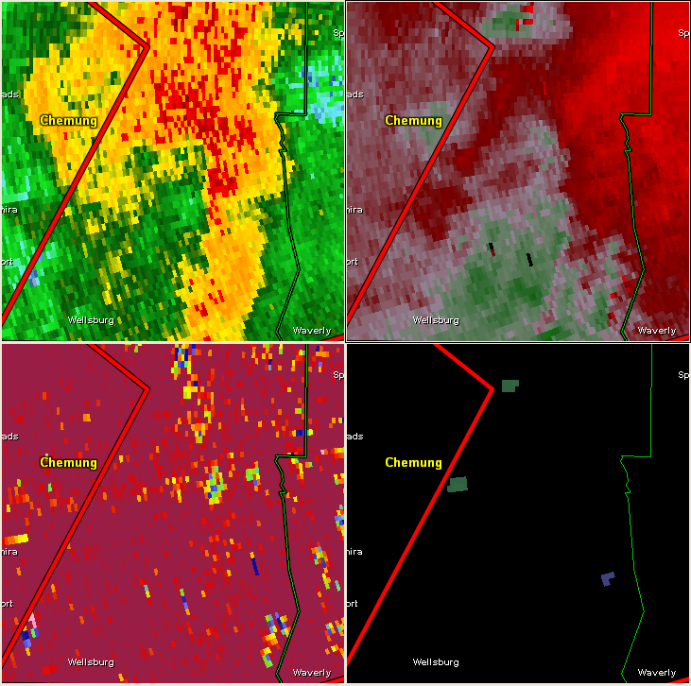
Chemung County NY 9/2/14
TDS lingers for nearly 10 minutes after tornado lifts.
2318 UTC

Slide 54
Summary
 | Vrot Prior (kts)
Mean | 25.5
Median | 26.6
 | Vrot Max (kts)
Mean | 29.5
Median | 30.7
Rotational velocity exceeding 25 knots is a good threshold for “concern”.
Previous CT-based study had 22.5 knots of Vrot… with many pre-super resolution cases.
3 out of the 4 EF-2 or greater tornadoes had Vrot >40 knots.

Slide 55
Summary
Tornado warnings preceded TDS only 2 of 14 times.
Can be useful to issue a warning in borderline case?
Still, 10 of 54 tornadoes had no velocity signature at all.

